Slide 1
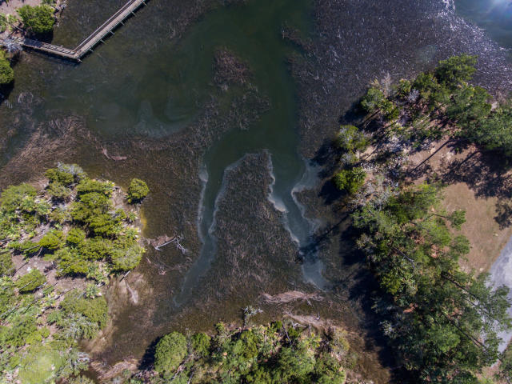
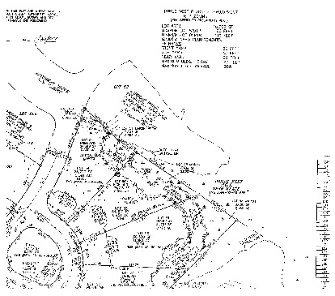
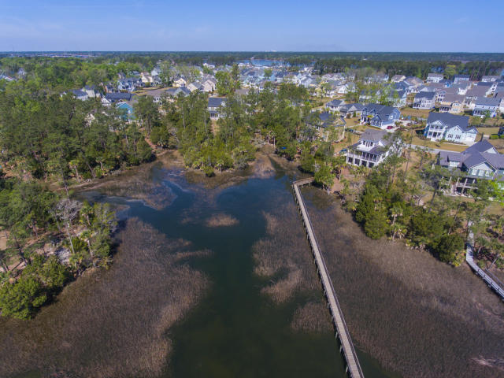
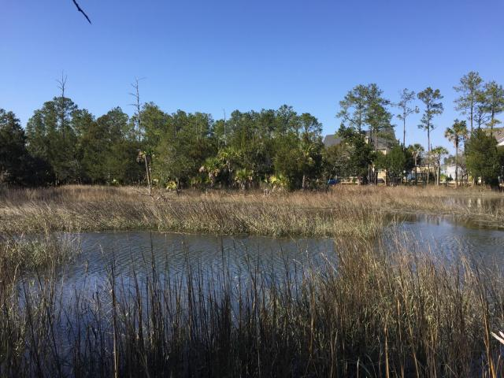
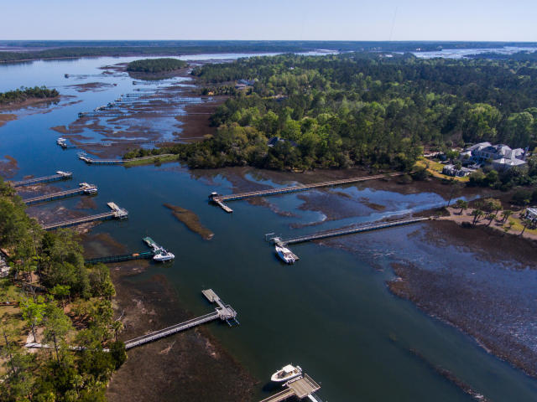

1604 Catamaran Court MLS# 17006217 | Price Reduced to $425,000
Price Reduction in Park West
$775,000
Price Reduced
One of Largest Waterfront Lots in Dunes West
Beautiful Gated Community of Dunes West
Just a few minutes from the award winning Country Club & Golf Course
Beautiful Walking Trails
Local Wildlife in Abundance
State of The Art Community Pool
Lot is next to Community Dock but tucked away from water traffic
.88 of an Acre
Stan Huff
843-670-2835 stan.huff@agentowned.com
www.agentownedrealty.com
Margaret Wannamaker
843-364-5851 wannamom66@gmail.com
AgentOwned Realty Co. Preferred Group, Inc. | 824 Johnnie Dodds Blvd | Mt Pleasant, SC 29464

