Slide 1
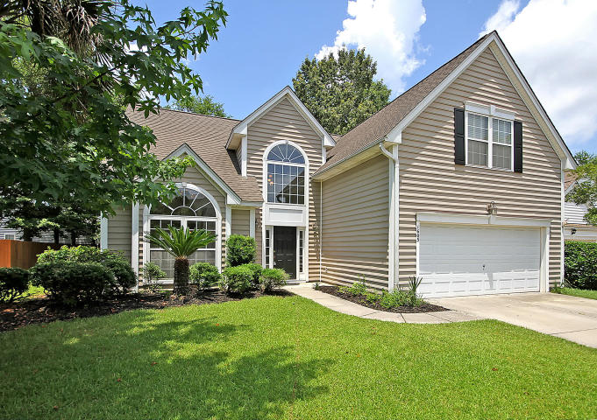
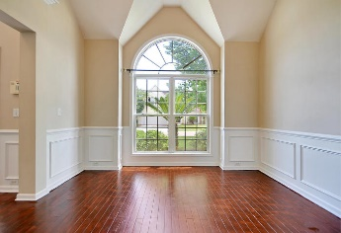
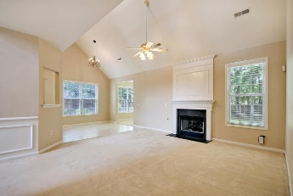
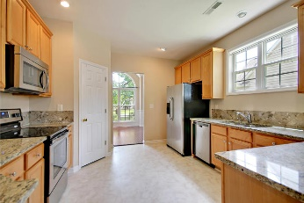
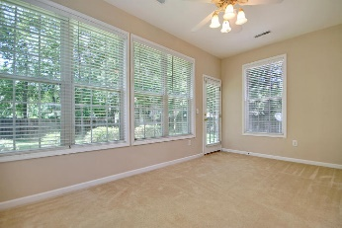
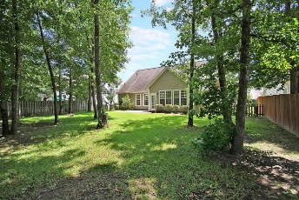


SELLER NEEDS THIS ONE GONE!
$15,000 Agent Bonus
with ratified contract by 4/15/18
1605 Jorrington St
Park West
Mt Pleasant, SC 29466
MLS# 18018189
$435,000
Welcome home! This beautiful well maintained home will WOW you!
Upon entering the home you will be greeted with wood flooring in the foyer and formal dining room. The home flows into the spacious living room and large open kitchen! The kitchen overlooks the living room with gas fireplace! Through the everyday dining area is the sunroom that takes you out into your large private fenced in yard.
The master bedroom is conveniently located downstairs and is equipped with an enormous walk in closet! Downstairs also offers a half bathroom and laundry room! Up the foyer stairs you will have three bedrooms and a full bath. One of the bedrooms is the FROG that is a true 4th bedroom. The home has recently had many updates/upgrades: HVAC, appliances, granite countertops, fenced yard, and garage door!
The home is also equipped with a home security system and sprinkler system. Age, sqft, taxes, acreage, HOA dues, and schools are approximate buyer to verify any and all information deemed necessary
Mason Thurber
(843) 709-5109 – C (843) 576-2699 – O
mason@theeverettgroup.net
RE/MAX Pro Realty, 9209 University Blvd, Charleston, SC 29406

