Slide 1
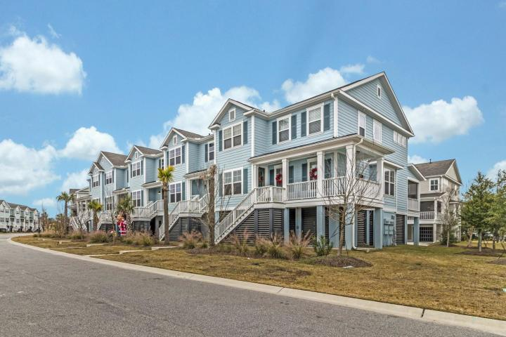
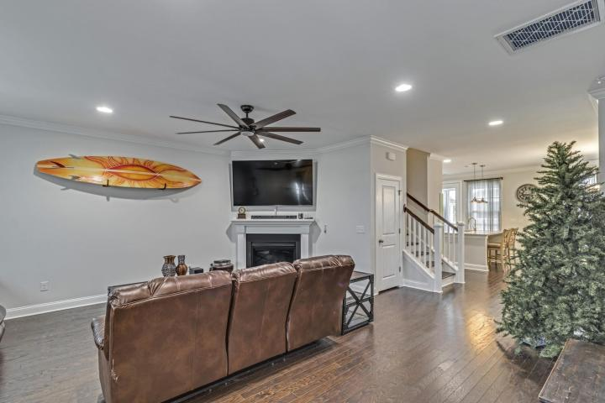
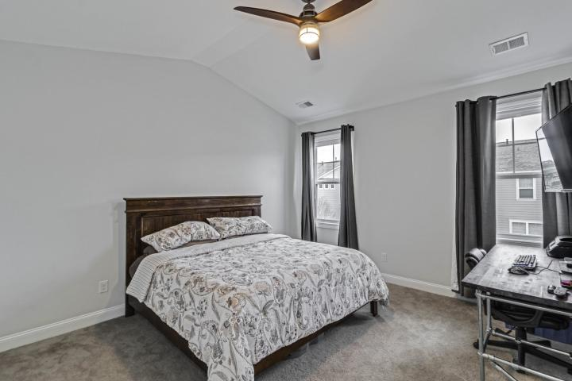
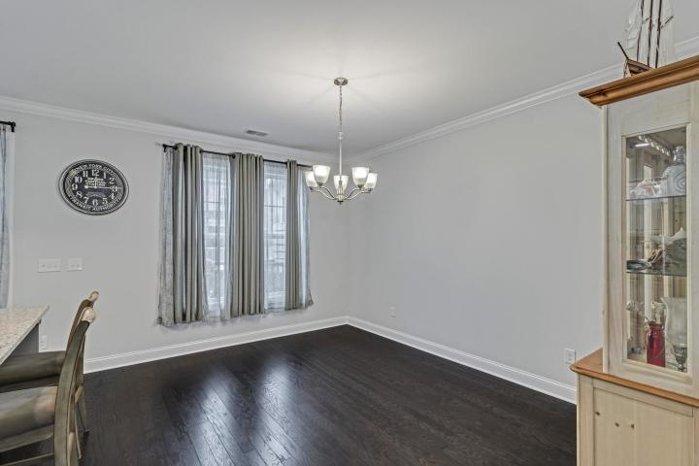
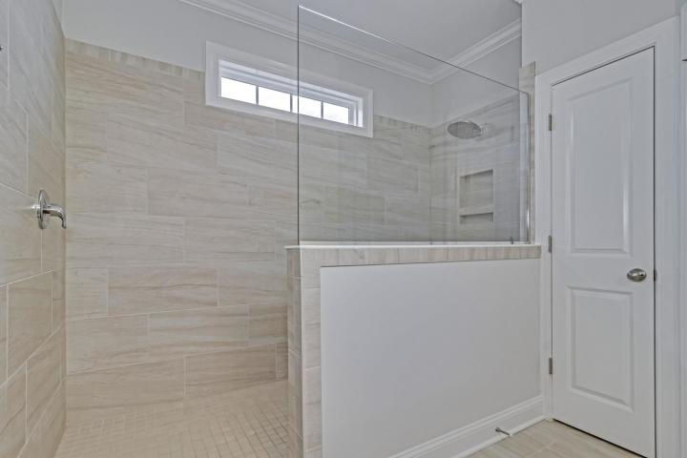
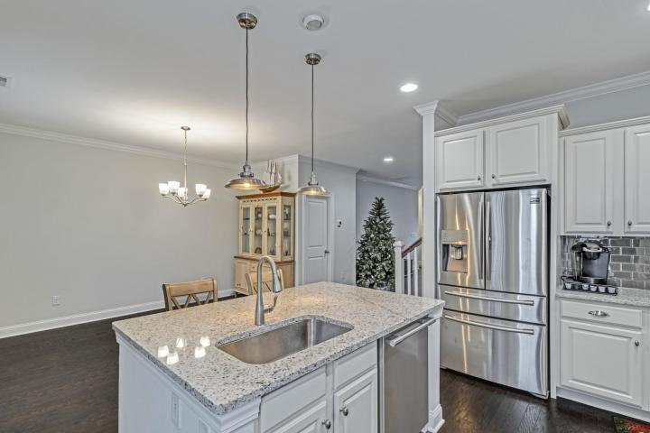
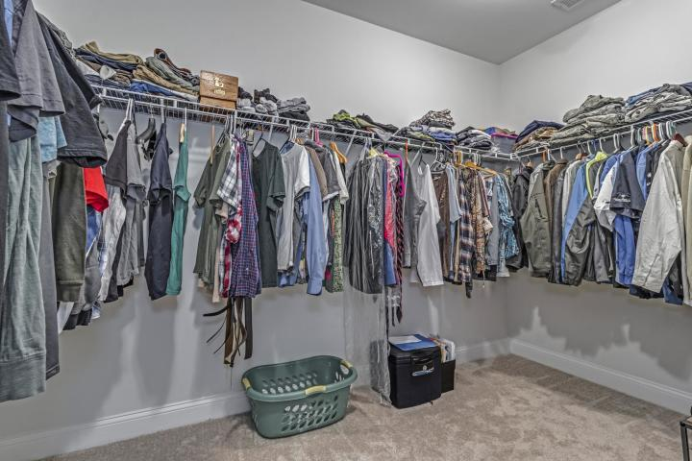
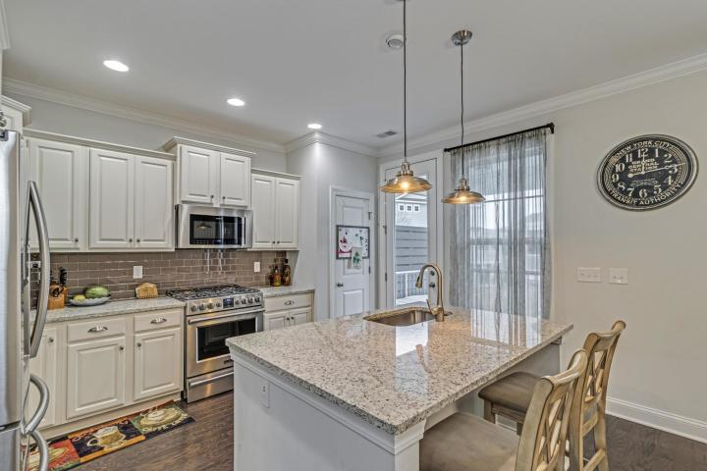
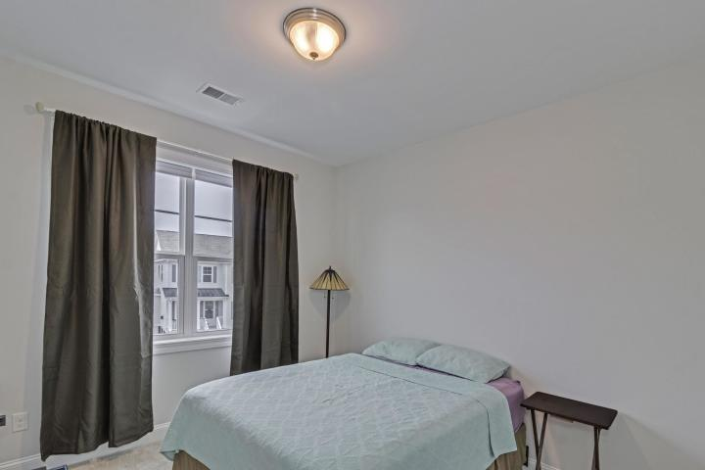
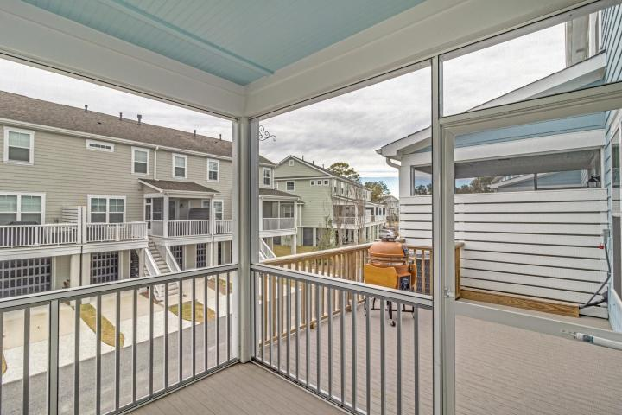
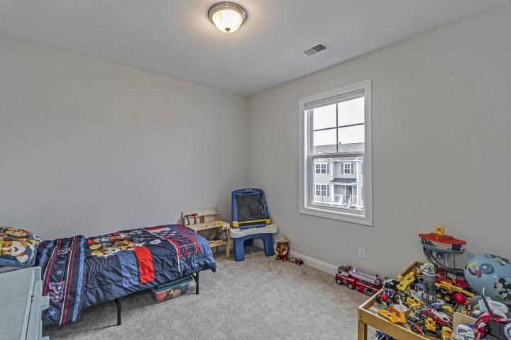


Short Sale
One of the Best Deals
in Mount Pleasant
1605 Prince Edward Street
Oyster Point ~ Mount Pleasant ~ MLS# 20000286 ~ $400,000
3BD/2.5BA Townhome in the exclusive Oyster Point Subdivision in the center of Mount Pleasant. Elevated 3 car garage with great storage. Beautiful wood floors throughout the downstairs. The gourmet kitchen flows to a large screened in deck perfect for entertaining or sipping a coffee in the morning sun.
The amenities of Oyster Point are second to none with an awarding winning neighborhood pool, crab dock, wonderful jog trails, exercise area, club house, and wonderful green spaces throughout the community.
Jason Newhauser
(843) 534-6564
jasonsellscharleston@gmail.com
www.jasonnewhauser.com
Coldwell Banker Residential Brokerage
1127 Queensborough Blvd. 103
Mt Pleasant, SC 29464

