Slide 1
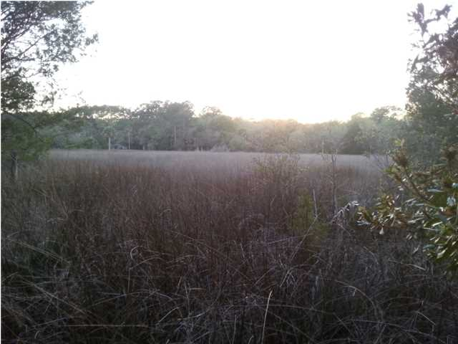
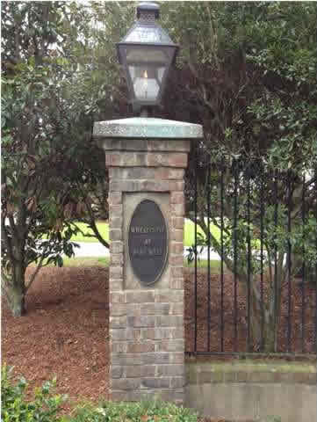
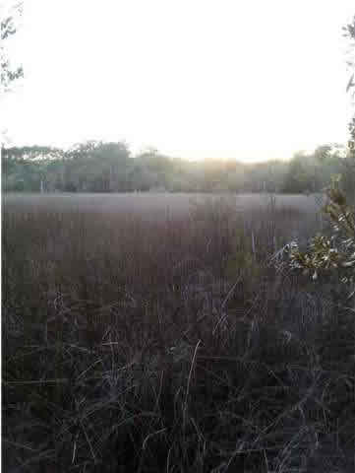
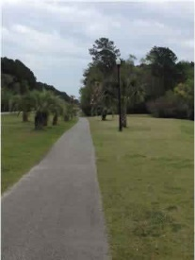
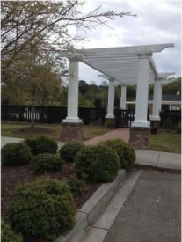
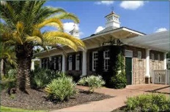
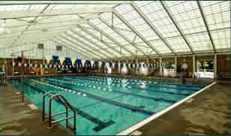
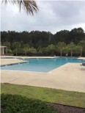
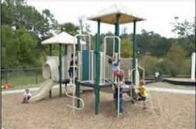
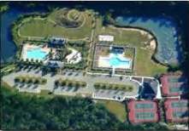
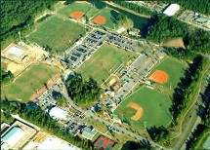


1605 Sewee Fort Rd
Marsh Front Lot
Wheatstone @ Park West
Mount Pleasant
MLS# 1409035
JUST REDUCED TO $179,000
Beautiful lot at the end of the cul-de-sac, with gorgeous 180° views of the marsh and all of the wildlife.
Park West is a fantastic Community in the heart of Mt Pleasant.
Homes in this area are typically selling for $400k - $600k range.
This is one of the last lots left in the Wheatstone section.
It's time to build your dream home today!
Stephanie Deaton
M – 843-743-4219
O – 843-769-5100
stephanie.deaton@agentowned.com

