Slide 1
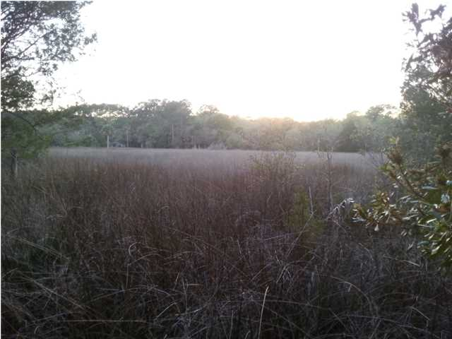
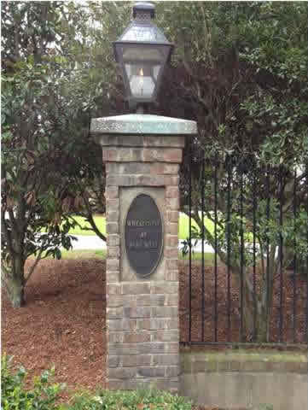
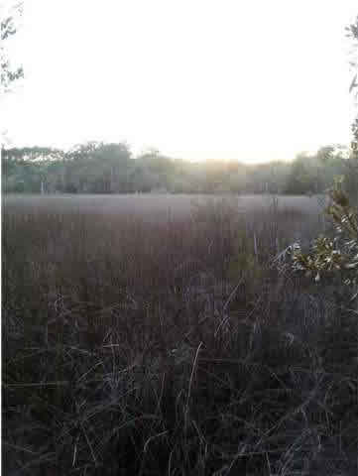
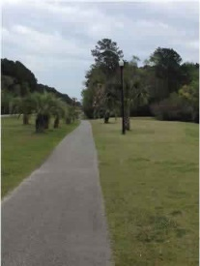
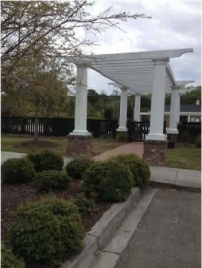
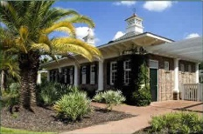
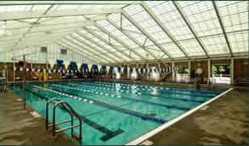
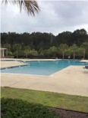
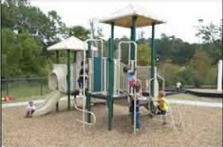
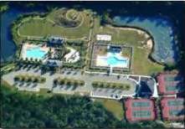
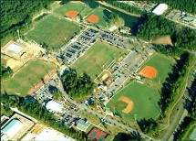


1605 Sewee Fort Rd
Marsh Front Lot - 3.5% Commission
Wheatstone @ Park West Mount Pleasant MLS# 1409035 Priced to Sell at $179,000
Beautiful lot at the end of the cul-de-sac, with gorgeous 180° views of the marsh and all of the wildlife.
Park West is a fantastic Community in the heart of Mt Pleasant.
Homes in this area are typically selling for $400k - $600k range.
This is one of the last lots left in the Wheatstone section.
It's time to build your dream home today!
Stephanie Deaton M – 843-743-4219
O – 843-769-5100
stephanie.deaton@agentowned.com

