Slide 1
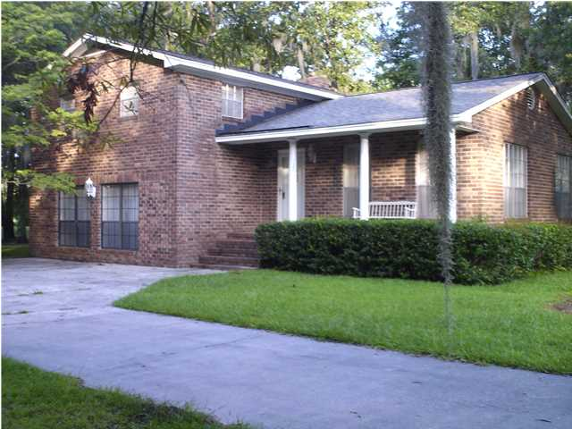
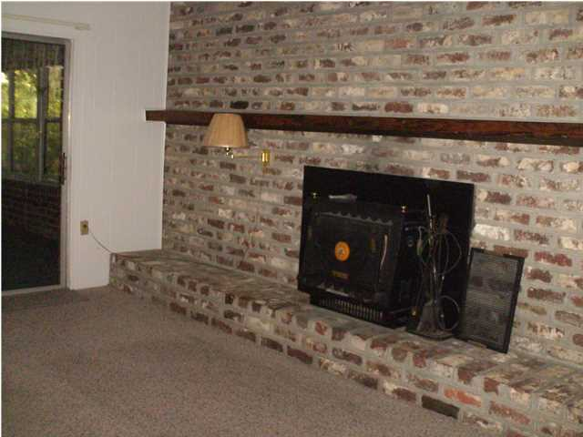
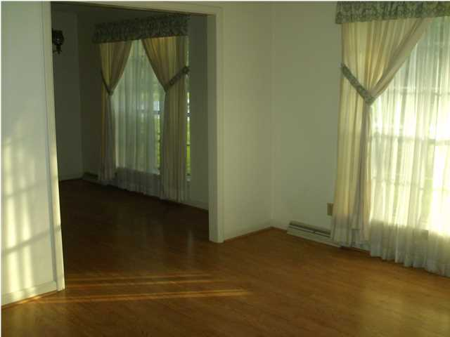
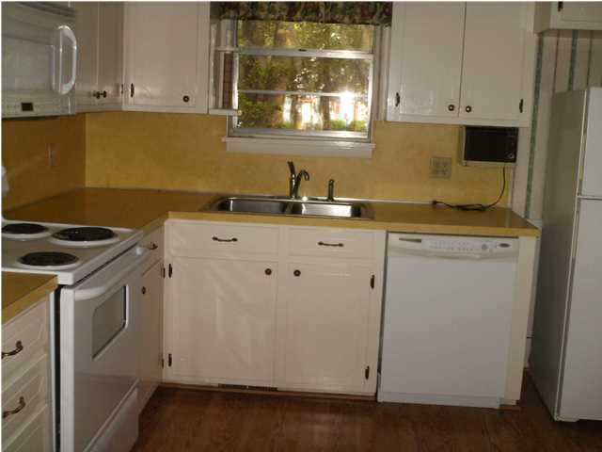
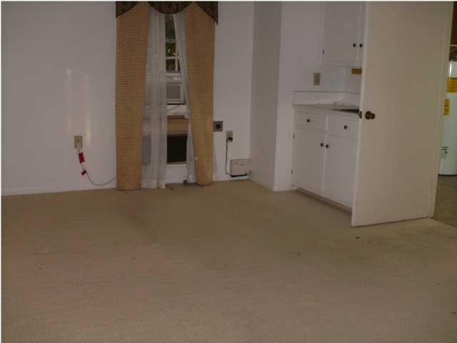
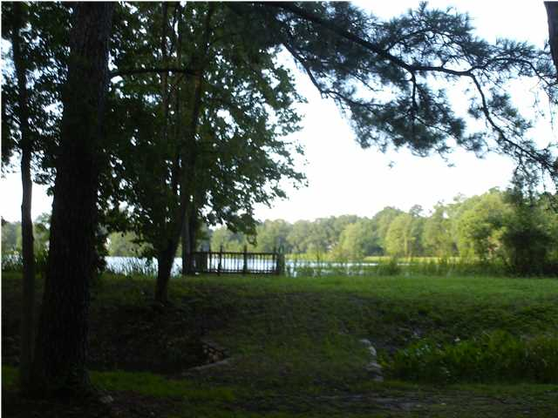
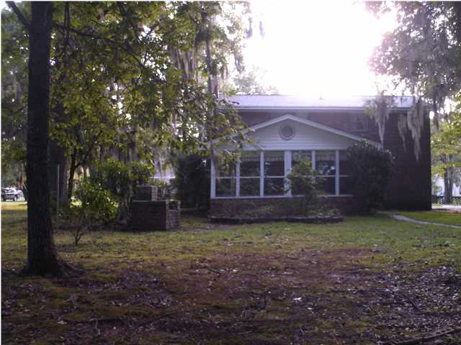
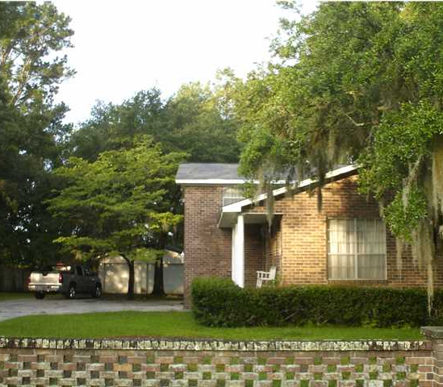
1605 Waterside Blvd
Pimlico
Moncks Corner
MLS# 1422367
$179,900
Price Reduced! Upgrade Potential!
Priced reduced from $219,000 ( $35,100.00 ) to allow Buyer to modernize as they feel is necessary. Backs up to Lake Hastie, a man made fishing lake …no power boats. At closing, owner will pay CNT Foundations LLC $9,350.00 to repair brick work & foundation issues with full price offer.
Michelle Riser & Bob Glover
843-860-1229 (Michelle) | 843-693-1837 (Bob)
mriser@ccim.net | bobglover08@gmail.com
Matthew Ryan Company, 104 Berkeley Square, PMB 59, Goose Creek, 29445

