Slide 1
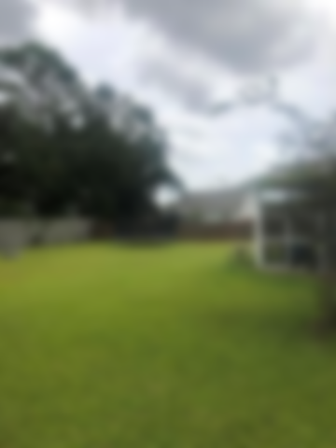
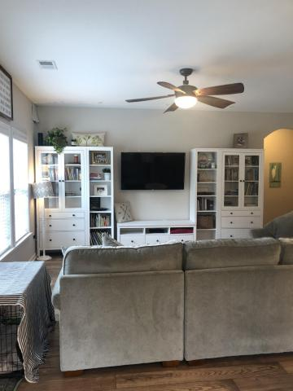
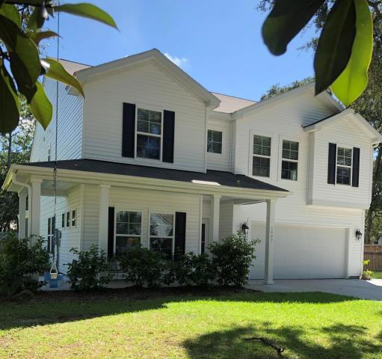
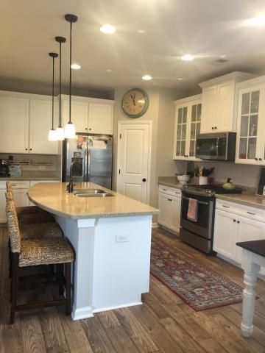
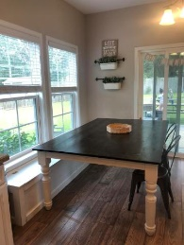
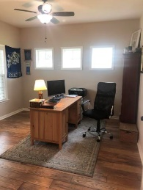
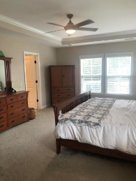
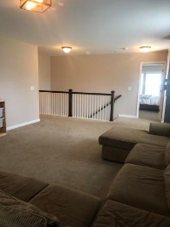
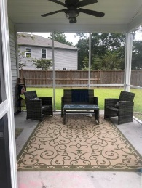
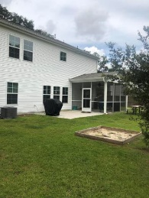
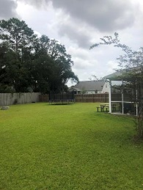


Spectacular 5 Bedroom 3 Full Bath Home Beautifully Upgraded On ½ Acre Cul De Sac Lot
1607 Stovall Court
Lakeside • Johns Island, SC 29455 • MLS# 18024625 • $420,000
If you need space this is the home for you! Like new home on approximately
1/2 acre cul-de-sac lot. 5 bedrooms and 3 full baths. Open floor plan with wood flooring throughout the 1st story. Large eat in kitchen with island and open to living area. Separate dining room currently being used for home school. Separate study/office area. Large master suite with huge walk in closet. Plus 3 more spacious bedrooms upstairs with another 1st floor Guest bedroom and full bath. Backyard is completely fenced in with lots of room for entertaining and playing.
Christina Garvin
(843) 270-7667 | cgarvin63@gmail.com
Elaine Brabham and Associates, LLC • 1890 Sam Rittenberg Boulevard, Suite 217 • Charleston, SC 29407

