Slide 1
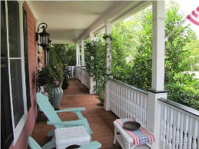
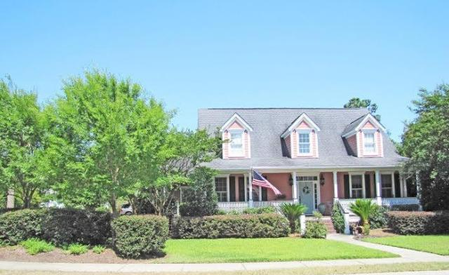
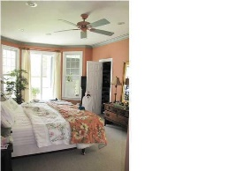
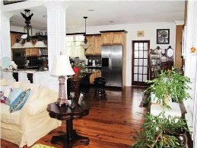
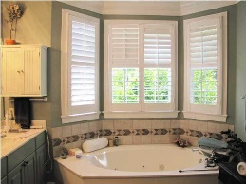
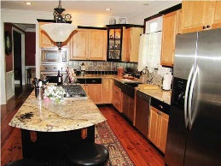
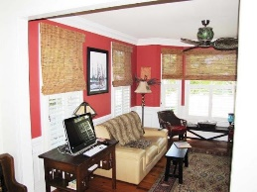
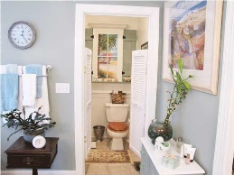
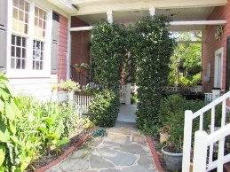
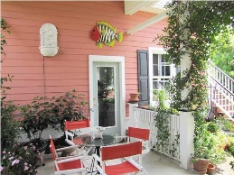
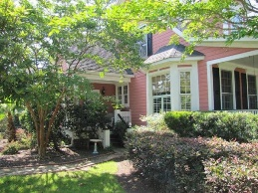
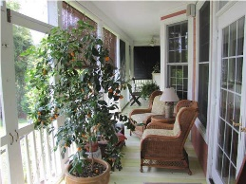
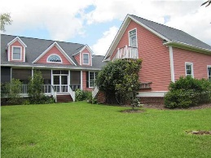

Motivated Sellers!!!
Reduced To $599,900
1608 Sewee Fort Rd ~ Park West ~ Mount Pleasant ~ MLS# 15015511
Dual Master Bedrooms Downstairs
.48 acre lot perfect for pool
4 BR / 3.5 baths
Viking, Asko appliances
Beautiful granite kitchen and bathrooms
Open concept
Gas fireplace
Full front and back porches AND side porch
Irrigation and lush landscaping
Corner lot cul-de-sac
Vaulted ceilings, lots of natural light
Detached 2 car garage with unfinished frog
Breezeway for relaxing
New A/C dual units
Excellent condition
Eat in kitchen and separate dining room
Two HUGE bedrooms upstairs
Therese M Jenkins
Mobile - (843) 568-9748
therese@beautifulhomesllc.com
Beautiful Homes Realty
130 River Landing Dr #7322
Charleston, SC 29492
www.beautifulhomesllc.com

