Slide 1

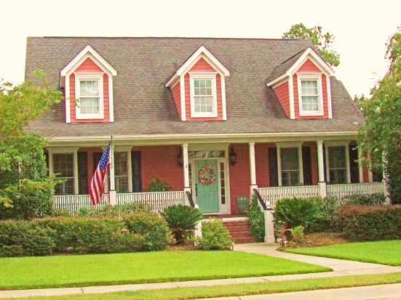
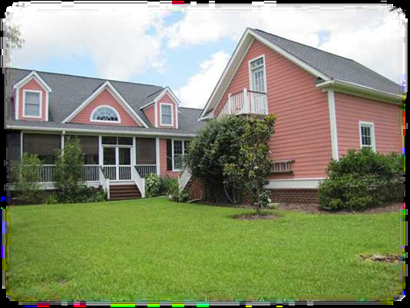
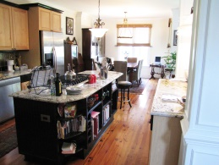
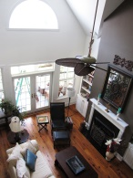
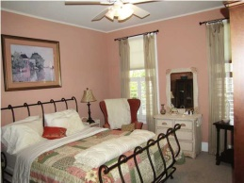
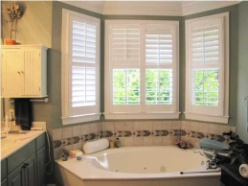
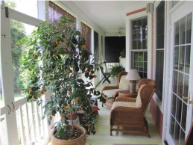
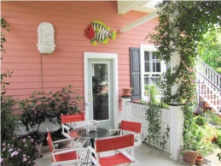
Price Reduced!
1608 Sewee Fort Rd ~ Park West ~ Mount Pleasant
MLS# 1406298 ~ $589,500
Beautiful custom built home on the largest and most private lot in Wheatstone! Open floor plan with antique heart of pine floors, vaulted great room, gas fireplace, Fantasia ceiling fans, built in bookcases and a gourmet kitchen. The floor plan connects the great room to the kitchen with custom columns and new designer lighting fixtures. Kitchen includes a large dining area, Italian granite ogee edged countertops, a large custom made center island that has a VIKING professional gas six-burner range with hidden downdraft, bookcases and wine storage. All appliances are stainless steel including VIKING wall oven and matching built in microwave and ASKO dishwasher. The sink is a black Kohler ceramic farmers sink with LadyLux Grohe faucet; back-splash of silver embossed tile; maple cabinets with under/over lighting plus additional recessed lighting.
UTILITY ROOM has antique hart of pine floor, a large pantry, cabinets, shoe rack, broom closet, its own half bath with blue eye granite counter top sink, wainscot and crown.
Two 1st floor master bedrooms including large master with his (double wide) and her (walk in) closets, crown molding, Berber carpet, and slider door. Master bath with granite double sinks, tile, jetted garden tub, custom 4 inch plantation shutters, separate wainscoted room with shower. Second master bedroom down has Berber carpet and access to full bath with granite counter top sink, tile floor, crown, chair rail and wainscot.
Large formal dining room with bay window, double crown with dental molding, custom 4 inch plantation shutters, Fantasia ceiling fan and wainscot. currently used as media room/study.
Second floor has two huge bedrooms sharing a large full bath, both rooms have 3 closets (plus large unfinished storage area), crown and Berber carpet.
Detached two car garage contains a workshop area and is connected to the house by a breezeway which provides entry to the utility room. A flagstone patio and garden area provides access to an approx. 400 sq. ft. unfinished space over the garage.
A veranda style screened-in back porch accessible via patio doors from both master and family room, two new ceiling fans w/lights and provides access to a large private backyard that is capable of holding a large pool. It has custom Bahama shutters to provide additional privacy. A 300 s/f columned front porch with upgraded lighting runs the length of the house. A 3rd small porch provides side entry to the utility room, or for sitting out.
Additional features include a four zone irrigation system, security system, two new fully warranted HVA/C units, double hot water heaters, one year home warranty, transferrable termite bond. Annual dues for Park West and Wheatstone are $850. Taxes are $1,473 per year. Home owner ins is $2270 and flood ins is $400.

