Slide 1
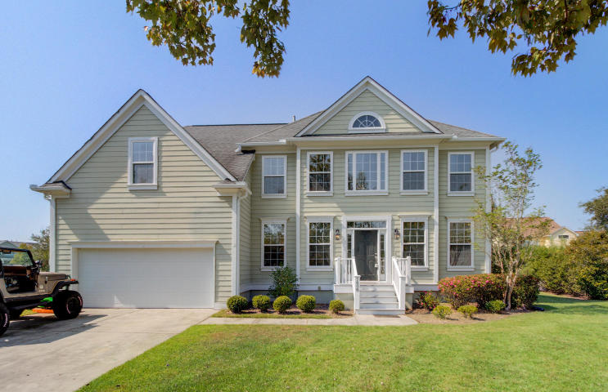
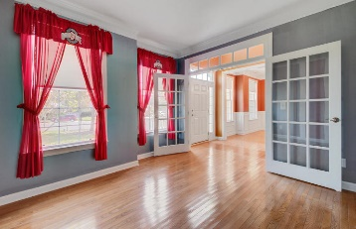
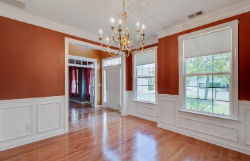
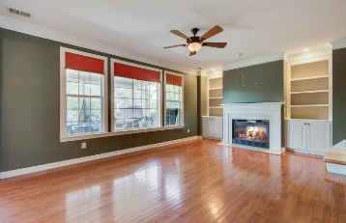
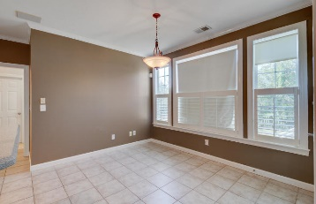
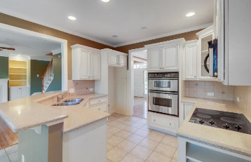
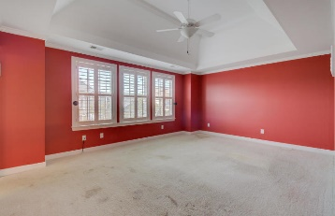
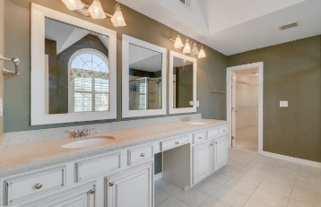
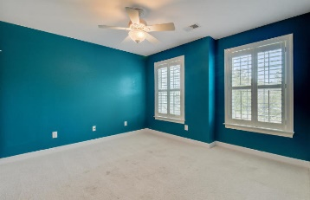
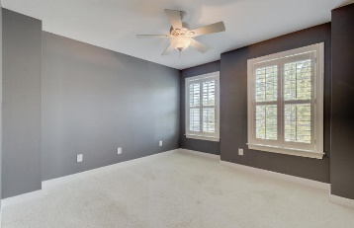
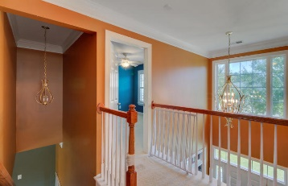


1608 Willowick Court Dunes West ~ Mt Pleasant MLS# 19027706 ~ $475,000
Open House Lunch ~ Friday, Oct 3 from 11 - 1
Handyman Special… Bring your hard hats!
Improved Price!
New Price!
Priced to sell! This 5 bedroom 3 bath home in highly desirable Dunes West is ready for new owners. Located on a quiet cul-de-sac pond site it offers everything the community has to offer at an affordable price. As you enter there is plenty of opportunity for a flex space room or an office across from the formal dining room. The antique white glazed cabinets and quartz countertops in the kitchen are stunning. Downstairs features hardwood floors which flow from the entry way into the living room with fireplace. Enjoy outdoor living on the screened in porch. The master suite features a spa bath and the tray ceiling. The large 5th bedroom could serve as an entertainment room, gym or whatever your heart desires. Home is being sold "as-is" and seller says "sell" so make an offer.
Hillary Jones
(843) 709-4666 hillaryjones@sc.rr.com | www.ahomeinsummerville.com
Realty ONE Group Coastal | 1510 Trolley Rd | Summerville, SC 29485

