Slide 1

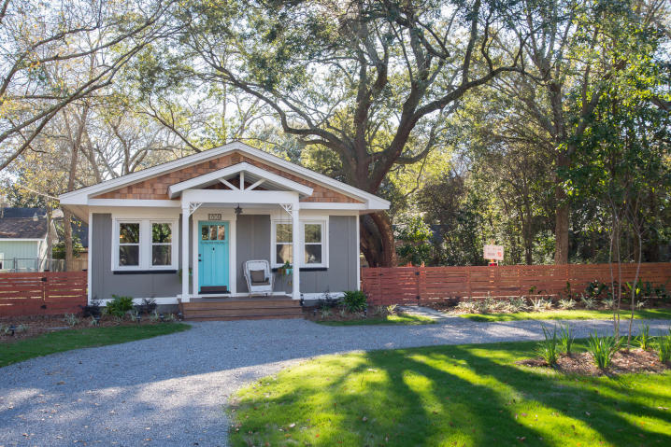
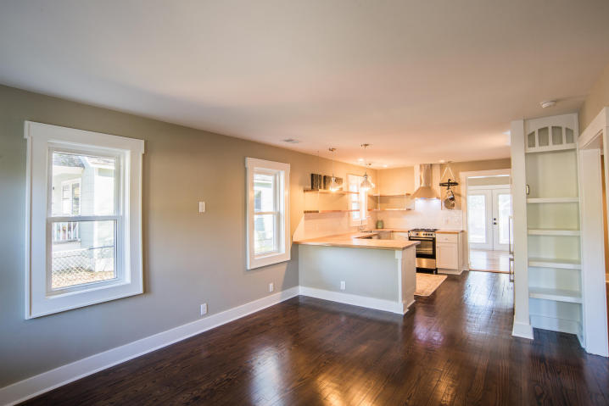
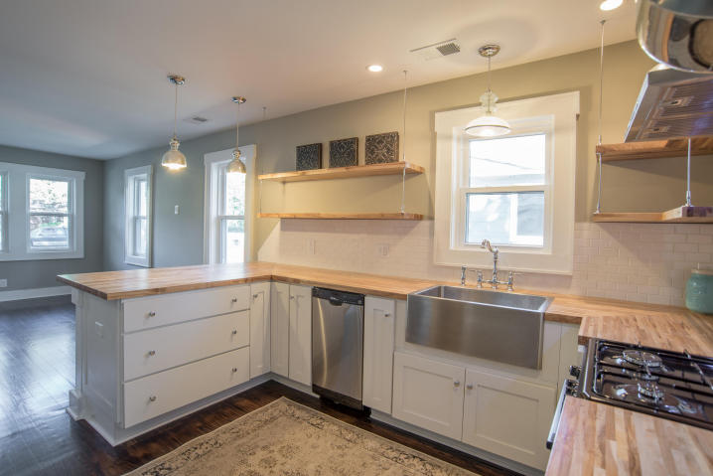
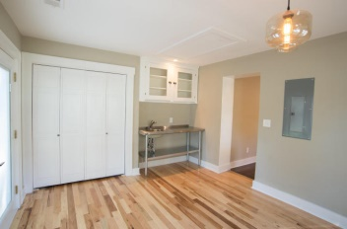
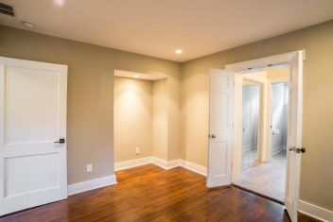
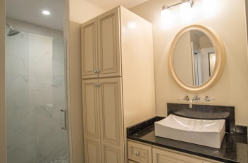
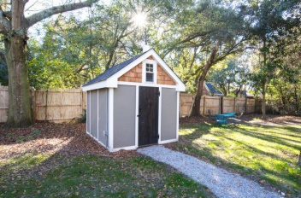
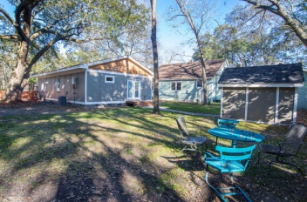


Just Listed!
1609 Poinsetta Road - Pinecrest Gardens
Charleston - MLS# 15000532 - $239,950
Coastal Cottage Meets Urban Loft... Simple, elegant living in West Ashley. No detail has been left out of this efficient and thoughtful design. This a beautiful restoration of an Arts and Crafts style cottage that has every convenience including complete plumbing, electrical and HVAC replacement. New architectural shingled roof. Original restored hardwood floors and new high-end appliance package including gas range & 8.3 gpm on-demand hot water heater. The exterior has Hardie siding. Huge lot with Grand Oak, Pecan, circular driveway, and restored outbuilding, frame this beautiful and private setting providing nearly unlimited expansion possibilities on a lot that requires no flood insurance. Centrally located in Prime West Ashley. Minutes to downtown, beaches, I-26 and I-526
Visit www.1609poinsettaroad.com for more info and photos
Edmund Major
843-343-6666 C edmund@flywaysc.com
www.flywaysc.com
Flyway Real Estate, LLC
1630 Meeting St. Bldg 1
Ste 302
Charleston, SC 29405

