Slide 1
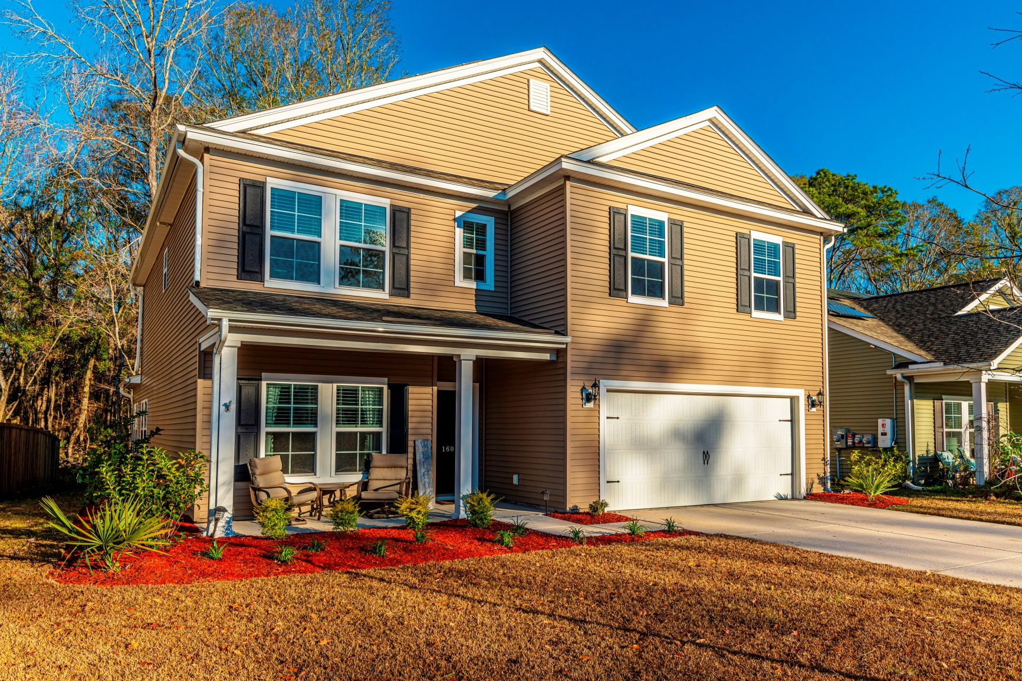
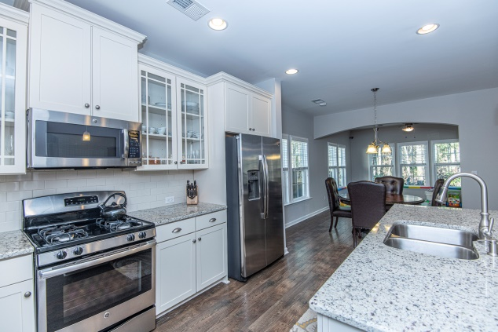
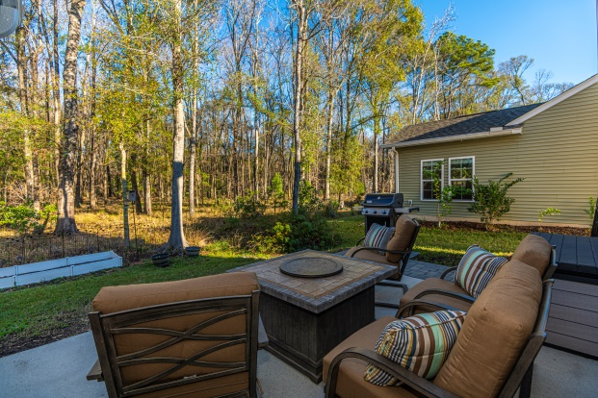
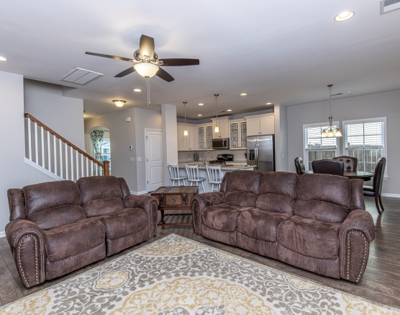
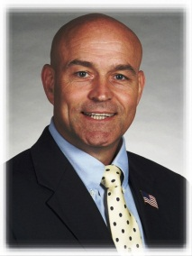

“ Great location, convenient to everything, energy $$ saver…”
160 Gazania Way
Charleston, SC 29414
Open House &
“Wine-down” Friday
10 January
5:30PM-7:30PM
Hosted by Amy, 843-729-5571
$407,500!
5 BR, 3BA
2835 SF
Nice family home, move-in ready, priced well…
1BR down, 4 up, flex spaces
Love the Kitchen - stainless appliances, gorgeous granite, upgraded cabinets
MBR w/separate tub & shower
Serene woods/wetland backing
Easy walk to Bees Landing Recreation Ctr
Walk to new grocery and shops - open soon
Environmentally friendly living!
STEVE ROWE
,Realtor®
Retired Military. Active Agent.
(843) 303-7438
srowe@carolinaone.com
www.SteveRoweHomes.com

