Slide 1
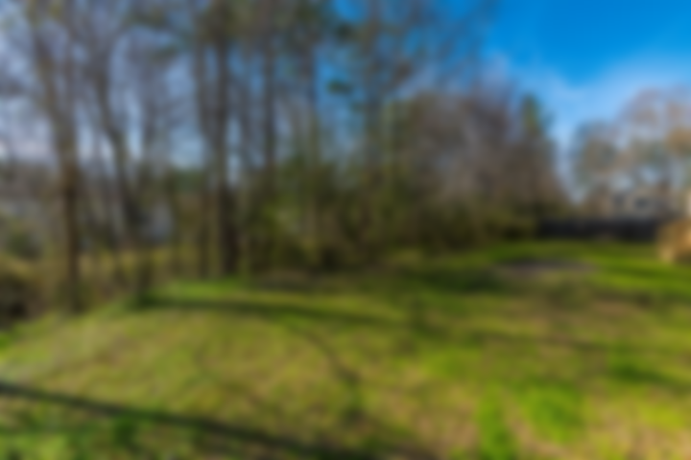
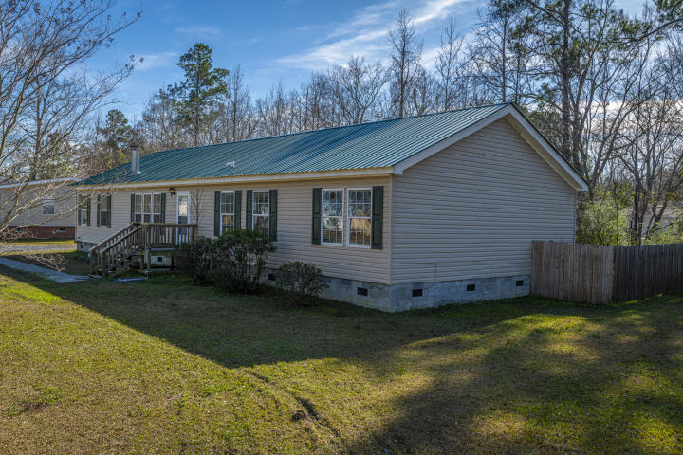
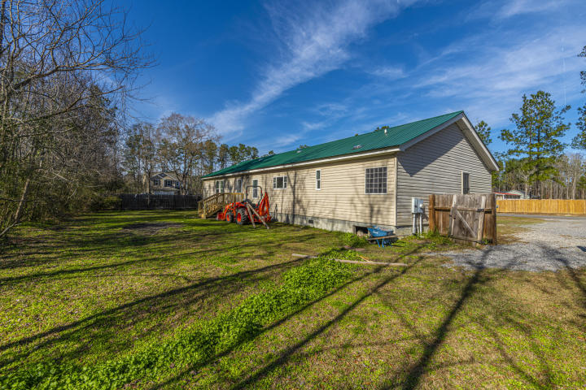
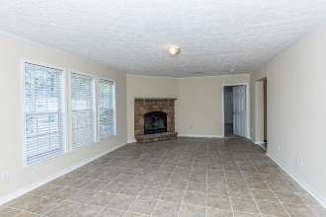
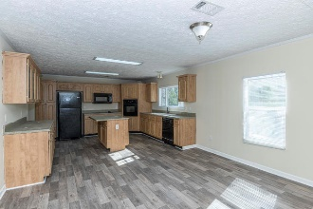
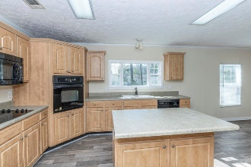
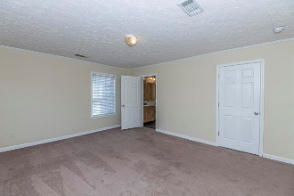
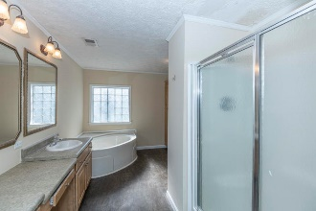
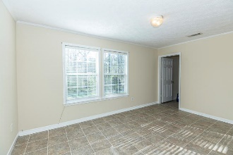
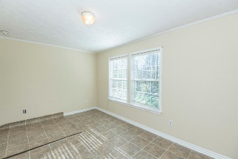
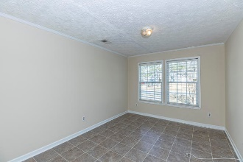
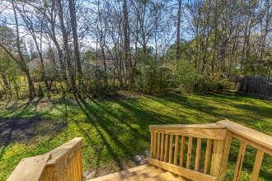
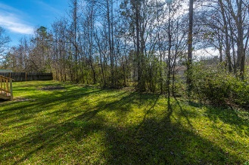


160 Mcmakin Street Pinehill Acres ~ Summerville ~ MLS# 20002133 ~ $225,000
Looking for a Move in Ready Home?
No HOA & Large Spacious 1/2 Acre Yard
Look no further, this well maintained,4 bedroom 2 full bath home is the one you have been waiting for! . As you enter, you'll be greeted by new vinyl floors, fresh paint, a spacious floor plan, a great flow for entertaining and everyday living. The eat in kitchen boasts a dishwasher, built-in microwave and wall oven, abundance of cabinets lots of counterpace and an island. Master Bedroom is large enough for a king bed and lots of other furniture. It is separated from secondary bedrooms for added privacy. The walk in closet offers lots of storage space and the Master Bathroom boasts a luxurious garden tub, separate shower and double sinks! Each bedroom is spacious with it's own large walk in closet. Yard is large enough to create your dream garden, oasis. Mostly fenced with an easy access gate, back property not fenced, but tree/bush lined for added privacy. No HOA restrictions, park your boat, RV, etc... Home is zoned DORCHESTER DISTRICT 2 SCHOOLS! Conveniently located near shopping, dining, and Historic Downtown Summerville. A $1150 Lender Credit is available and will be applied towards the buyers closing costs and pre-paids if the buyer chooses to use the seller's preferred lender. The credit is an addition to any negotiated seller concessions. Schedule your appointment to see your new home today!
Jacqui Swain (843) 295-9484 jacqui.swain@carolinaone.com www.jacquisellscharleston.com
Carolina One Real Estate
1530 Old Trolley Road
Summerville, SC 29485

