Slide 1
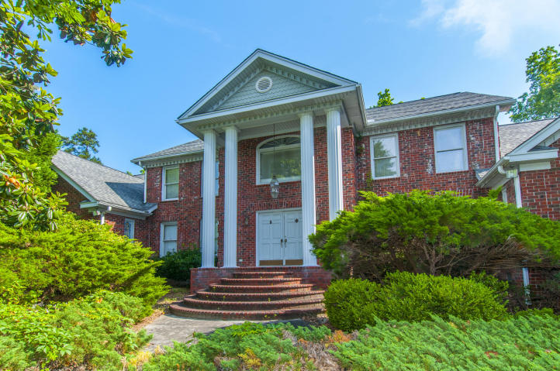
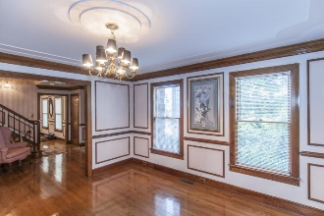
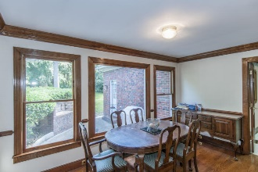
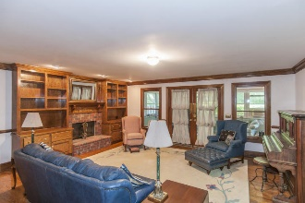
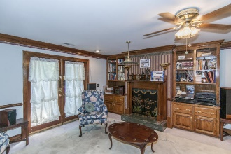
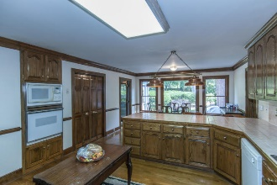
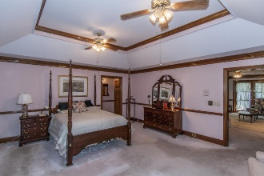
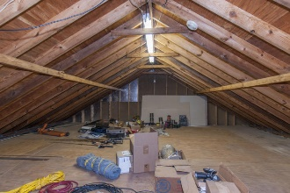
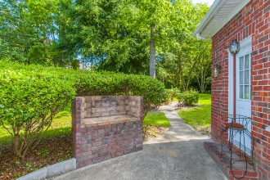
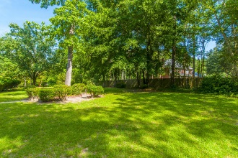
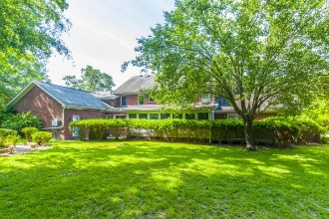


Five Car Garage in Summerville!!!
160 Rolling Meadows Dr
Walnut Farms
Summerville, SC 29485
MLS# 16025051
$695,000
6 Bedrooms | 5½ Baths | 4,961 sf
This 4,961 Sq. Ft. custom built, brick home features a large .89 acre lot and a massive 5 car garage (1,275 Sq. Ft. Garage)! Hardwood flooring 3/4'' tongue and groove throughout most of the first floor. Large eat in kitchen overlooking the back yard. Solid oak cabinets, extra large pantry, large enough to add an island. Tons of counter & cabinet space for the chef and entertaining, as well as, a wet bar. Family room is open and has a fireplace. Formal dining room is large and will easily hold your largest dining rm furniture. Formal living would make a great office. Both offer chair rail & crown molding. 400 square foot sun room is great additional space. 1,000+ sq ft Downstairs Master Suite featuring it's own enclosed all-in-one washer/dryer, sitting room with fireplace and built ins, Sunroom is not included in square footage but has window heat and air unit. Massive storage above 2 car garage with stairs leading up to it from back of garage (not inside the home). Extensive, top of the line solid wood trim throughout the home.
Larry & Kathy Mazalatis
Larry Cell 843-693-0529
Kathy Cell 843-693-0159
Office 843-871-9133
AGENTOWNED PREMIERE GROUP | 1800 TROLLEY RD | SUMMERVILLE, SC 29485

