Slide 1
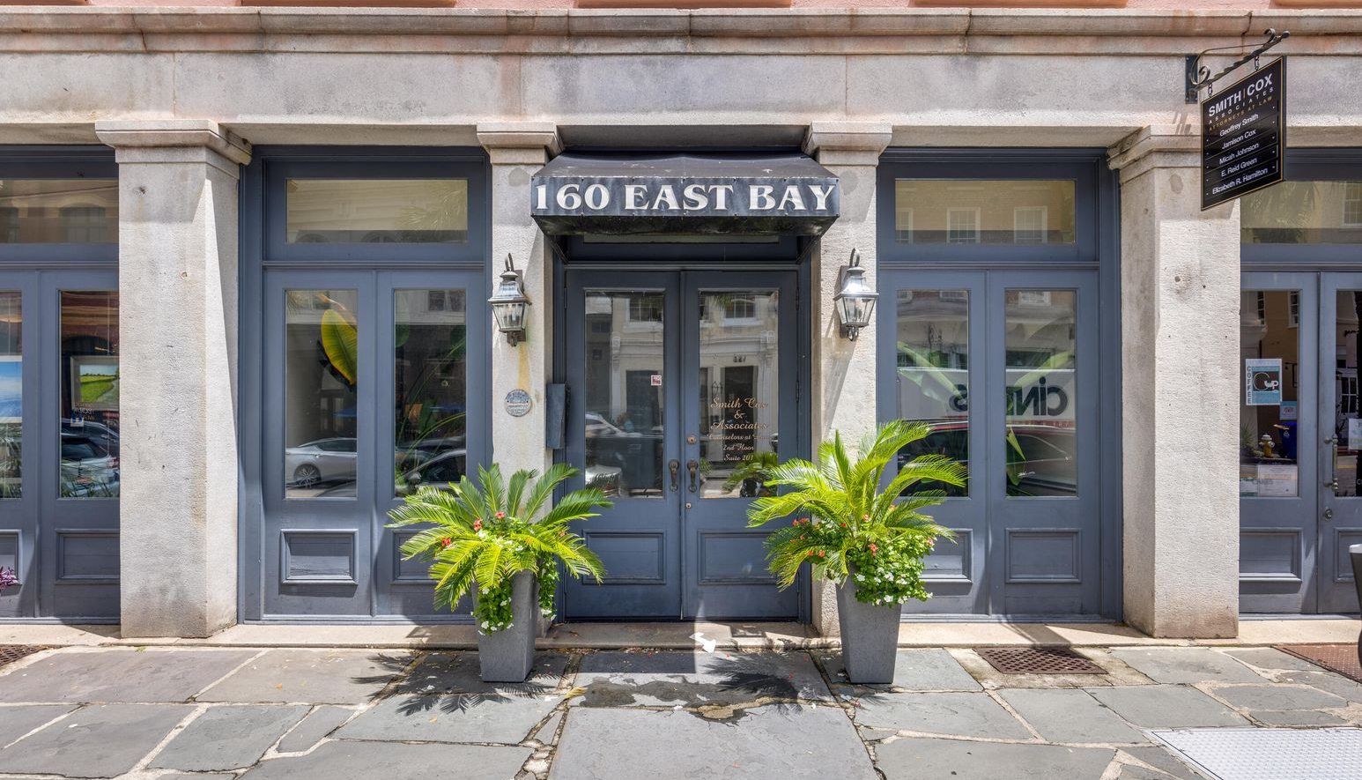
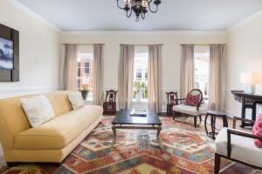
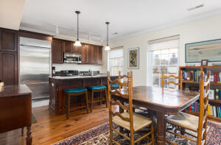
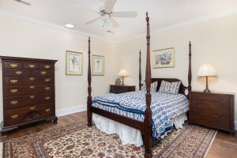
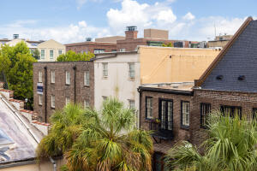

Open House Nov 5th 10-1 ~ Door Prizes!
Hosted by Liz Butler | 843-367-6604 | lizbutlerhomes@gmail.com
160 E Bay Street #303
French Quarter | Charleston, SC 29401 | MLS# 22021323 | $1,100,000
Beautiful condo on East Bay between two cobblestone streets in the Historic French Quarters. Steps away from the Battery, Waterfront Park, Rainbow Row, museums, restaurants, art galleries, boutiques and much more. Completely renovated 3rd floor condominium has tall ceilings, skylights, large windows and open floor plan. Tons of natural light and custom molding. Large bedrooms are equipped with spacious closets and private baths. One deeded dedicated off-street parking space is included, located in the rear of the building. Beautifully furnished common space on the 3rd floor for entertainment/recreational use. Built circa 1813 and converted into condos in 2006. Historic building is part of Prioleau's Range purchased in 1770. Building awarded the Carolopolis Plaque. Enjoy downtown living.
Lisa Deaton
843-224-7878
lisamdeaton@comcast.net
AgentOwned Charleston Group
902 Savannah Hwy
Charleston, SC 29407-7802

