Slide 1
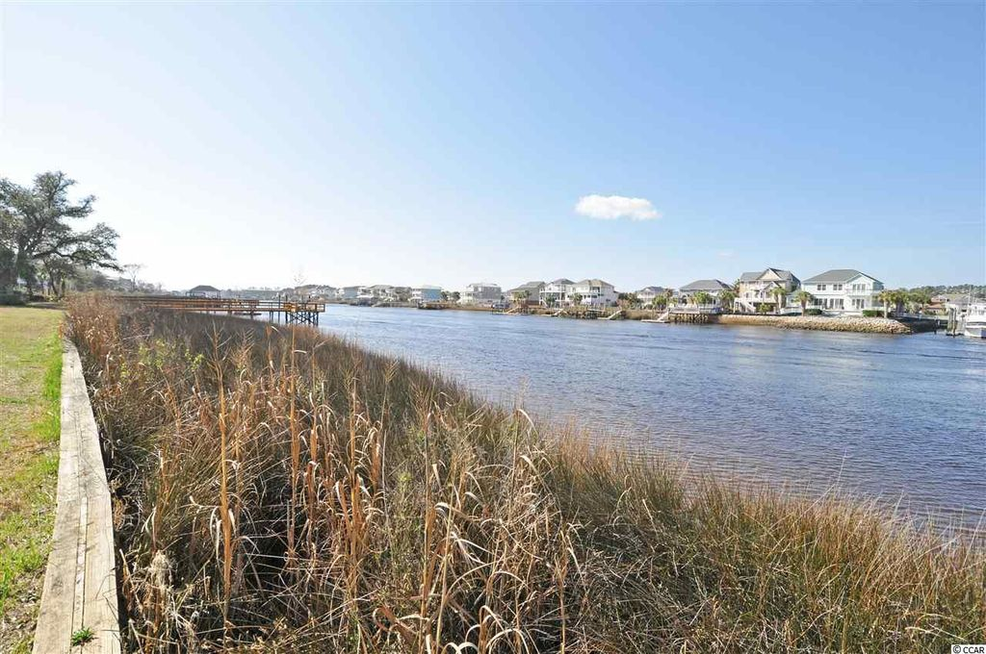
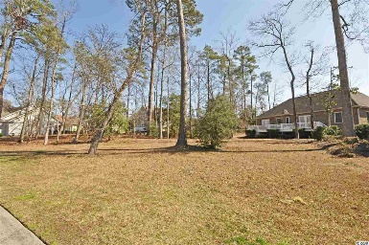
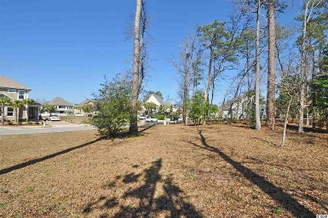
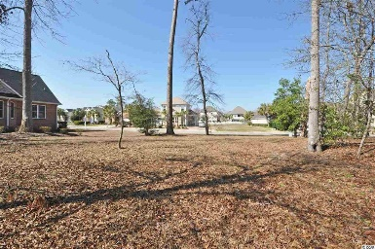
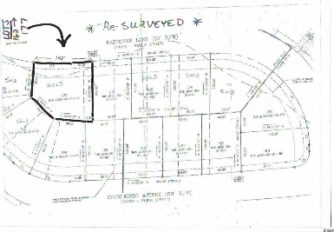
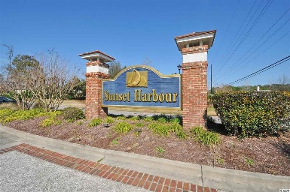
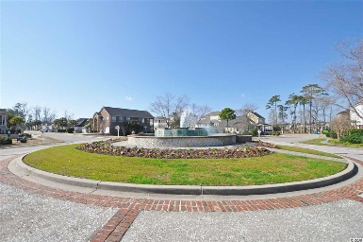
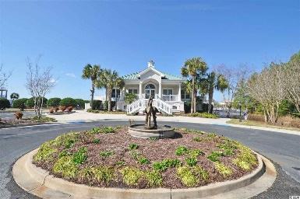
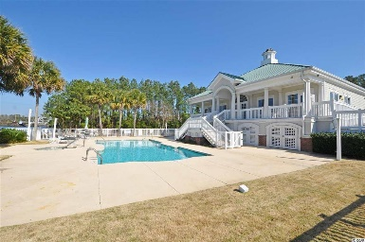


Boaters' Paradise In Upscale ICW Community
1610 Eastover Ln (Lot 177)
Sunset Harbour
North Myrtle Beach, SC 29582
MLS# 1802841
$79,500
This lovely, OVERSIZED, lightly wooded lot is located in an upscale community of luxury homes -- private yet in close proximity to restaurants, shopping including the new Coastal North Town Center, and a 5-minute drive to the ocean! The lot parcel boasts road frontage of 102' as compared to the standard lot frontage in Sunset Harbour of approximately 55 - 65 feet. Overall lot size is greater as well. Amenities include a beautiful clubhouse and pool complex directly on the Intracoastal Waterway, boat launch, boat dock and onsite boat storage! The complex features beautiful landscaping with various small lakes throughout. Attractive for investors, builders and home-buyers to build your dream house now at an amazingly low initial investment. There is no stipulated time frame during which one must build on this lot following purchase. In addition, the owner will furnish a complete set of plans for a luxury home which can be built on the site. Sunset Harbour is a premier boating/ICW subdivision, located between "Old Highway 17" and the "Intracoastal Waterway" in popular North Myrtle Beach. Sunset Harbour has 175 lots with currently about an 80% build-out. This lot is a rare buyer opportunity!
Deborah Collins
843-424-9013
dctidewater@yahoo.com
Connie Ross-Karl
702-306-2643
conniesross@aol.com
NEW WAY PROPERTIES MYRTLE BEACH

