Slide 1

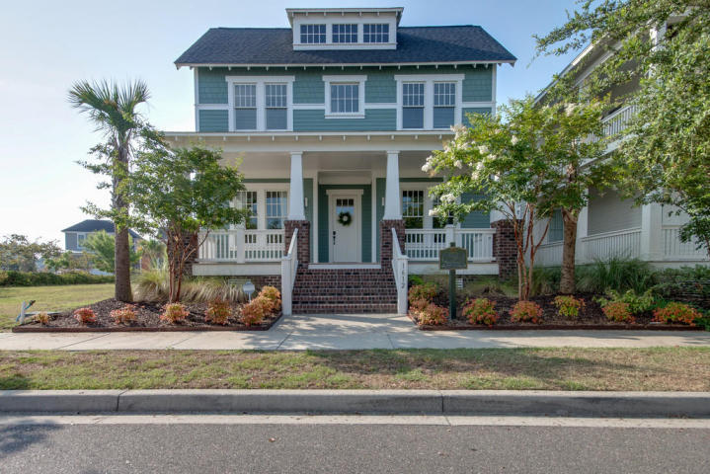
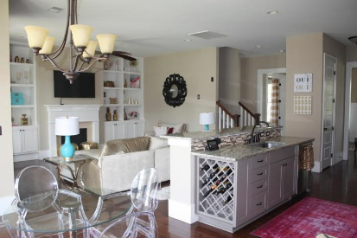
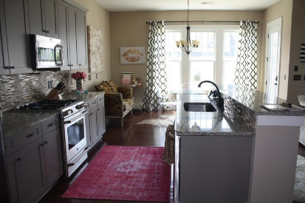
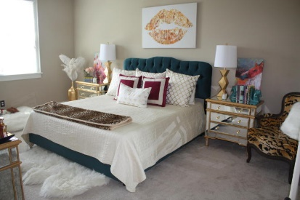
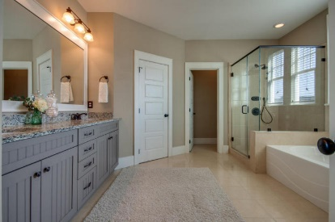
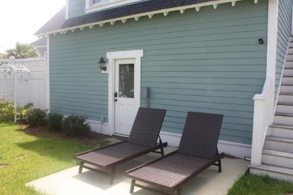
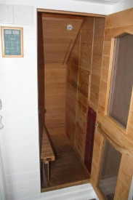
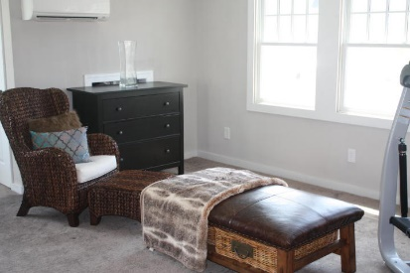
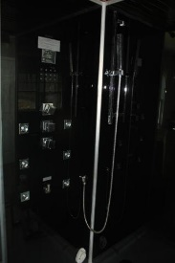
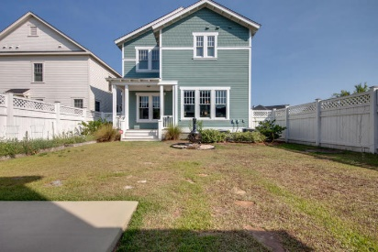


Back On The Market!
Available
Nov 1st!
1612 Paradise Lake Drive
Watermark · Mount Pleasant
MLS# 16018356 · $678,400
Beautiful home, with office, formal dining room, both with wanes coating, laundry room with built in shelving. Open floor plan, gas fire place, mid wall outlets for lighting over art, one half bath on main floor, upstairs has four bedrooms, and two bathrooms. Out back you will find a two car garage, with mother in law suite, private gym or studio apartment, this space even has a separate electrical meter easy to produce rental income to cover a good portion of your mortgage. This space boasts a sauna, steam shower and mini kitchen. Tax Records show 3165 square feet in main house and 552 square feet in detached garage.
Carly Jent
(843) 642-6057
carly@scpmx.info
www.scpmx.info
SC Property Services | 1514 Mathis Ferry, Suite 202 | Mt. Pleasant, SC 29464

