Slide 1
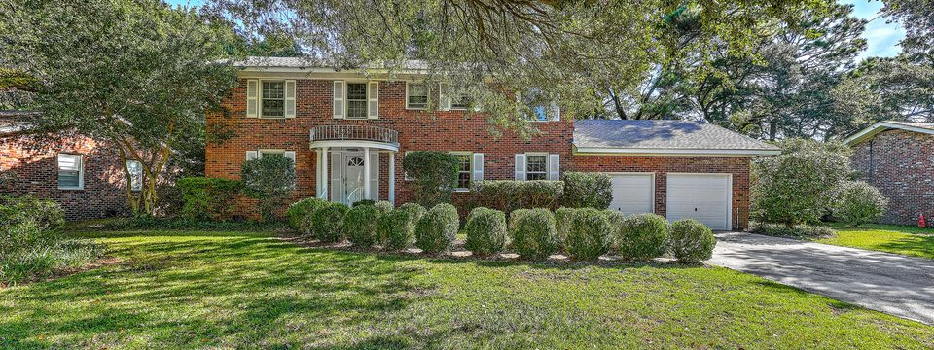
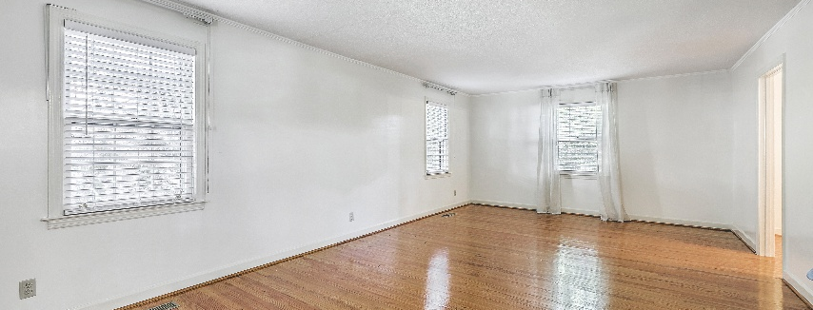
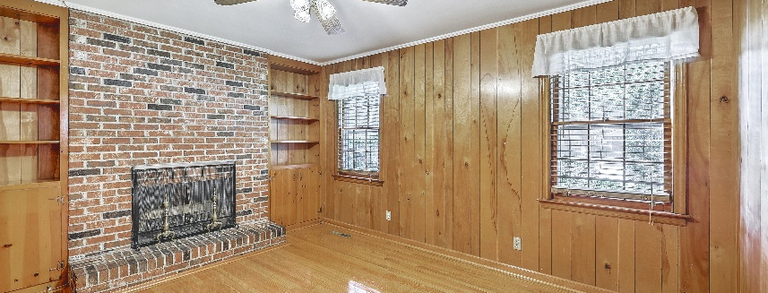

JUS
9714 ROSEBERRY STREE
MOTIVATED SELLER!
/
7
1/
ii
In The Heart Of West Ashley
1612 Amberly Road | Charlestowne Estates III | MLS# 25025278
TAKE A VIDEO TOUR!
�
$685,000
4 BED
3 BATH
2,340 SQ_FT
0.28 ACRES
Stately Brick Home in the Heart of West Ashley - No HOA! Welcome to 1612 Amberly Road, a beautifully maintained two-story brick home offering timeless curb appeal and modern updates in one of Charleston's most desirable neighborhoods. Located just steps from the exciting new Ashley Landing development, and in the preferred zone for Orange Grove Elementary Charter School, you'll enjoy the charm of an established community with excellent schools, shopping, dining, and parks close by. Inside, refinished solid wood floors flow through much of the home. The traditional floorplan features a formal living room, dining room, spacious kitchen with newer stainless-steel appliances and solid wood cabinetry, plus a relaxing den or office with a wood-burning fireplace. Upstairs offers 4 bedrooms and 2 full bathrooms, while the main floor includes a third full bathroom, giving flexibility for guests or a future downstairs bedroom conversion.
Additional highlights include a newer architectural shingled roof, freshly painted two-car garage, a large fenced-in backyard with newer shed, and fresh interior paint throughout. With approximately 2,340 square feet, this stately brick home blends Charleston character with thoughtful updates - all in a well-kept neighborhood with no HOA restrictions.
Scott Baskin
THE SCOTT BASKIN TEAM
843-324-4139
scott@explorecharlestonrealestate.com
SCOTT BASKIN TEAM

