Slide 1
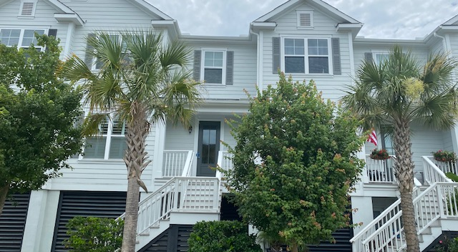
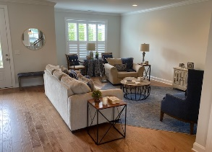
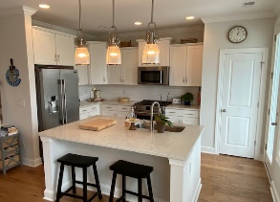
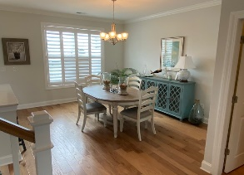
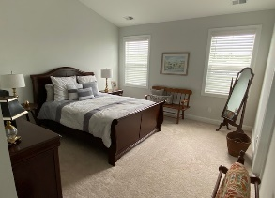
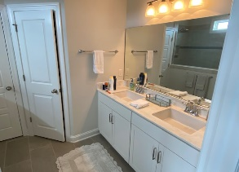
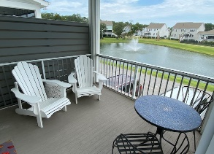
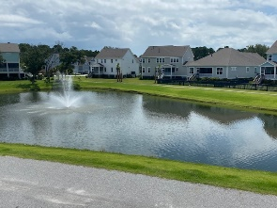
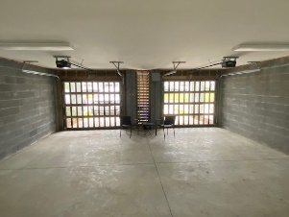

Oyster Point Townhome
New Price!
1612 Prince Edward Street
Mount Pleasant, SC 29466 | MLS# 22019031 | $719,000
Welcome to Oyster Point with it's exquisite amenities located in the much desired community of Mt. Pleasant. Built in 2018, this townhouse has had one owner who used it as a second home and kept it in impeccable condition. The owners paid a lot premium for the location as one has an unobstructed view of a pond and fountain from the screened porch. Entering the unit the abundance of natural light, wood flooring and open floor plan is apparent from the family room with gas fireplace to the dining room which is situated next to the Chef's kitchen. The kitchen features stainless steel appliances,, white cabinets, tile backsplash and flooring, quartz countertops. a pantry and center island. The first level has beautiful crown molding and powder room. Upstairs one finds the master bedroom and bath with two additional bedrooms that share a bath. The sizable master bedroom has a large walk in closet and a bath featuring dual vanities, walk in shower and an additional closet added during construction.
Oyster Point is conveniently located near shopping at Towne Center, 4 miles from the beach and 9 miles to Charleston. Oyster Point has become one of Mt. Pleasant's premier communities with dock facilities for kayaking, tennis courts, clubhouse and pool.
Click for a Video Tour
Carey Budds
843-475-1505
cdft73@aol.com
Carey Budds
843-475-1505
careybudds@gmail.com
ERA Wilder Realty | 125 Wappoo Creek Ste F | Charleston, SC 29412

