Slide 1
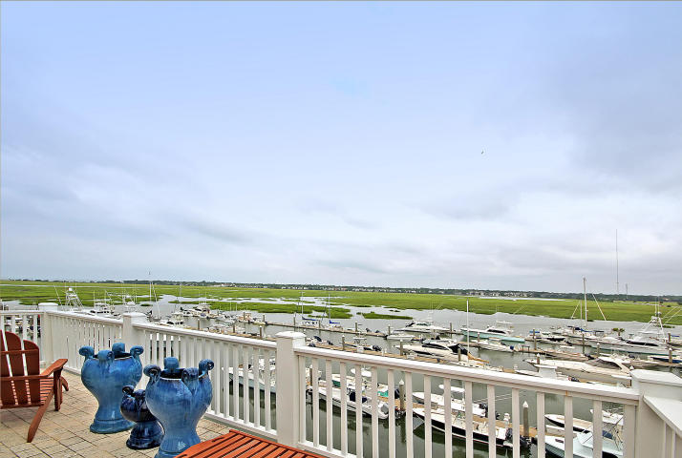
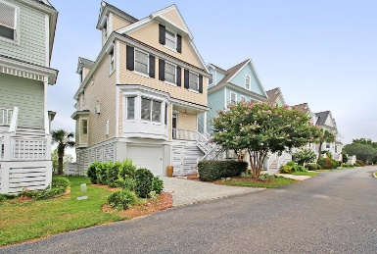
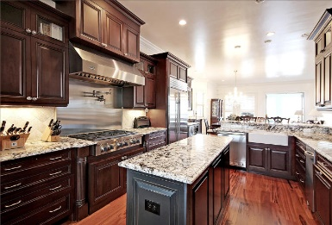
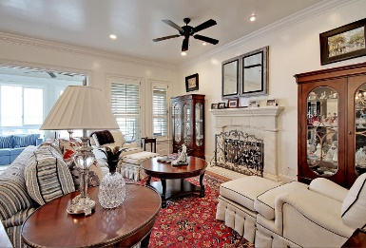
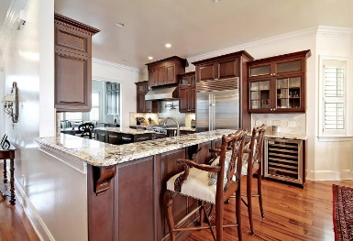
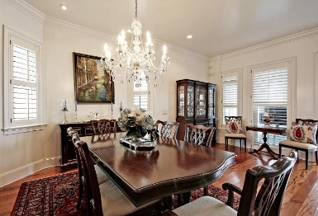
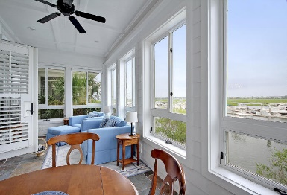
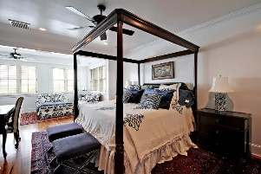
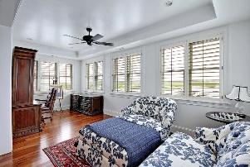
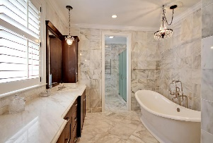
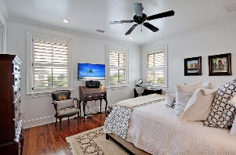
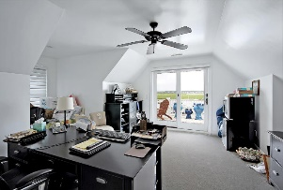


1613 Marsh Harbor Lane Marsh Harbor | Mt Pleasant | MLS# 15021171 | $1,450,000
New on the Market
Spectacular Waterfront Listing!
*Selling Furnished* *House Generator* *Hurricane Shutters* This home is truly amazing with breathtaking views from almost every window and a lifestyle that can be found nowhere else. Enjoy the best of the Lowcountry with Sullivan's Island Beaches and downtown Charleston being minutes away. Elevator from garage to top floor, the owner spared no expense. From the front door you can see all the way through to the marina and marsh. You will notice immediately the warm tone of the Caribbean Heart Pine floors as you walk toward the family room. On the right after you enter is the powder bath with slate floors and vessel sink. The newly renovated magnificent kitchen offers Sub Zero and Wolf appliances, wine cooler, ice maker, new granite counter tops just to name a few. Attached to the kitchen, a sitting room gives the perfect space to have an intimate or casual meal. Don't forget the sunroom off the spacious living area, this is the perfect place to enjoy your morning cup of joe while soaking in the sunshine and panoramic views....especially useful in the chilly winter months! Onto the second floor, the graciously appointed master bedroom includes a sitting area boasting million dollar views. The master bathroom has marble floors and countertops, custom cabinetry, a Victoria-Albert slipper style tub, separate shower and toilet. The master closet is just off of the master bath and connects directly to the laundry room. You will also find another bedroom suite on the second floor; the bathroom has beautiful granite counters and shower. On the third floor are two more bedrooms and a full bath. The room being used as an office leads you to the balcony where you will find arguably the best view in the house. Other features not to miss...2 tankless water heaters, water purifying system throughout entire home, heavy trim package, water spigots on all decks and porches, ample parking and storage underneath, plantation shutters and window treatments throughout. In addition to the marina and dock facilities, there is a pool and activity center. Move in immediately and enjoy the unparalleled lifestyle Marsh Harbor delivers.
JERICHA A. MCGEE
Mobile - (843) 568-1767
jdelia@mycharlestonproperty.com
www.mycharlestonproperty.com

