Slide 1
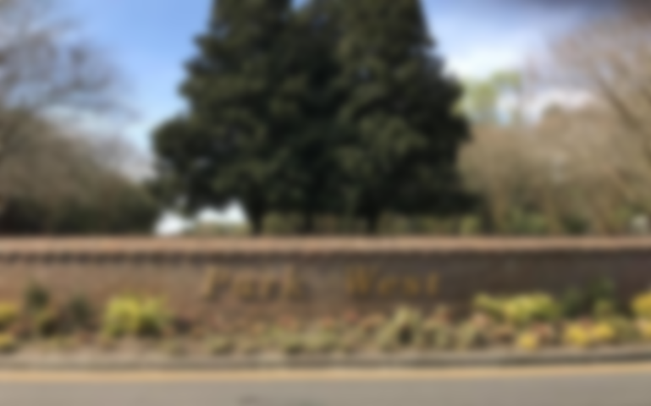
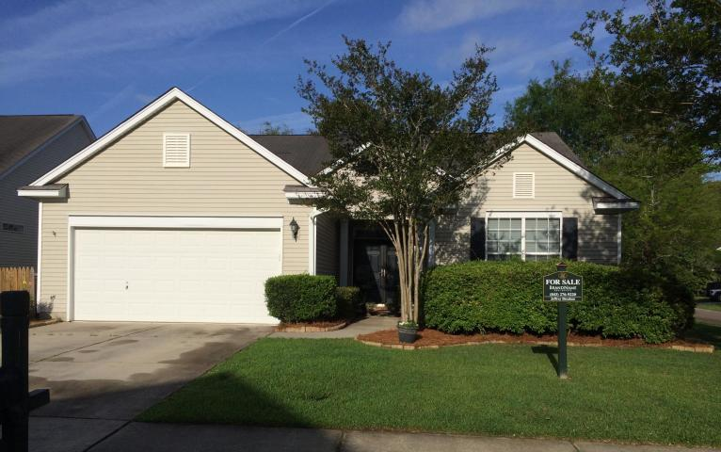
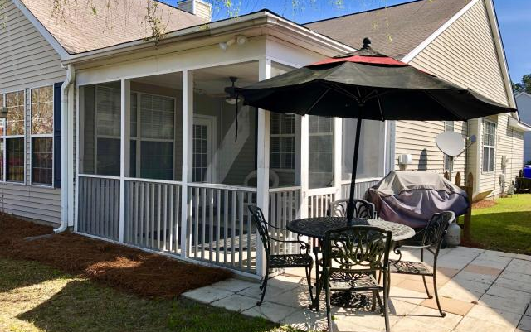
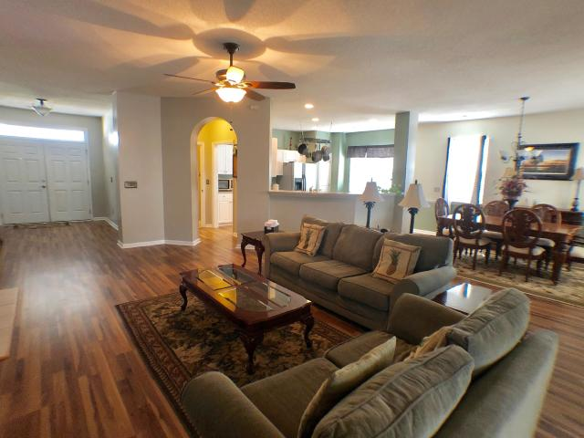
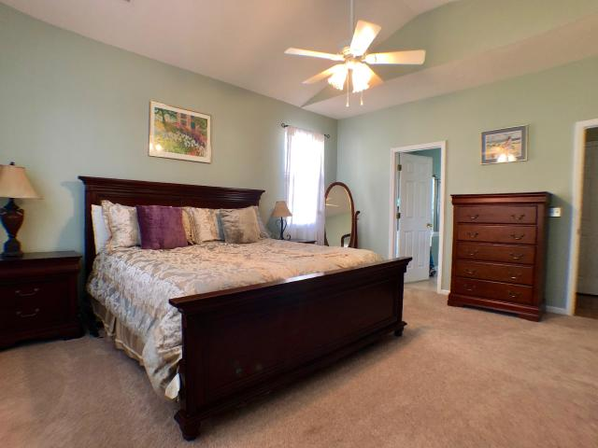
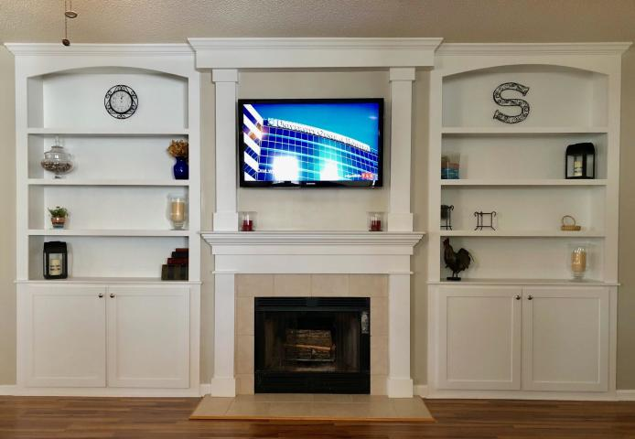
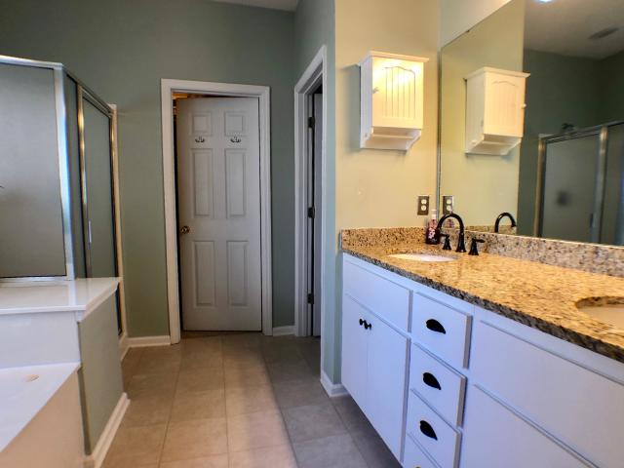
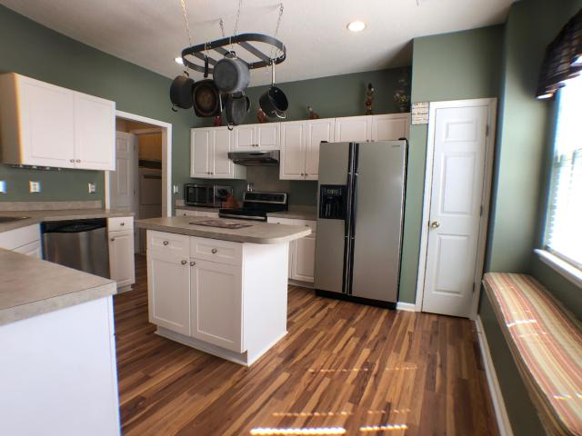
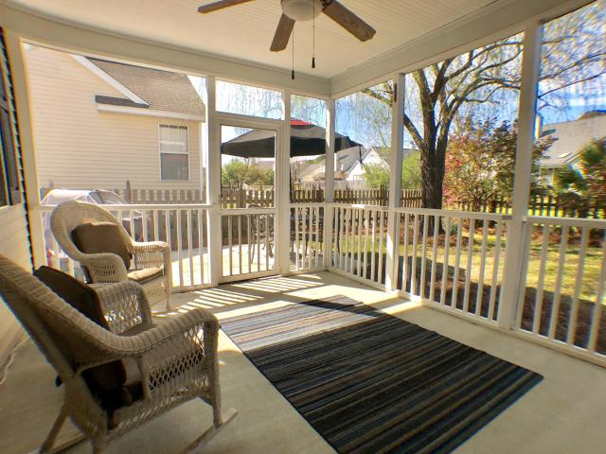
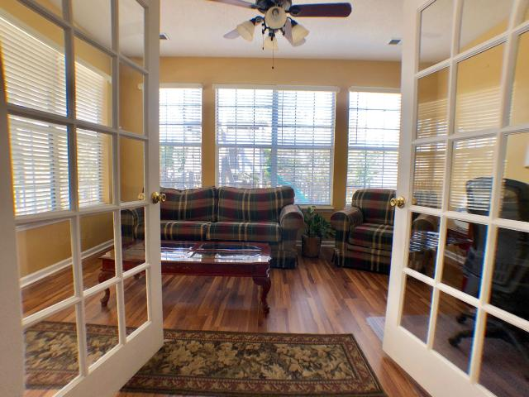
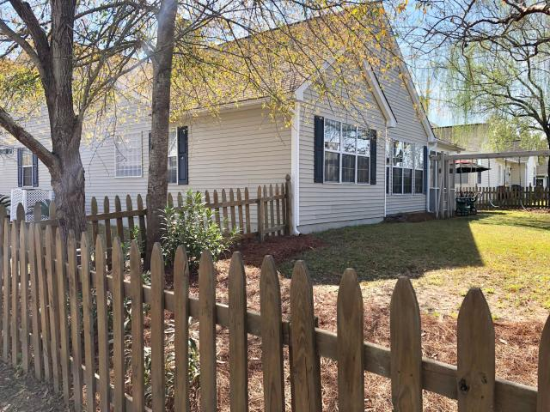
Welcome Home to Park West
1613 Thomas Barksdale Way
Mount Pleasant, SC 29466 ~ MLS# 19008439 ~ $378,000
Beautiful, turnkey one story ranch, open floor plan integrates living, dining, & kitchen, perfect for entertaining! Stunning custom built-ins, tiled fireplace, & handcrafted framed mantel is functional for both decor and storage. Upgrades include new laminate wood flooring, plush carpet in bedrooms, tile in bathrooms/laundry (2018) new garage opener (2017) new gas HWH ( (2016) new HVAC (2015). Kitchen features Stainless appliances, chef's island, tons of storage. Private master en suite features vaulted ceilings, relaxing Jacuzzi tub, double vanity sinks w/ granite. Double French doors lead you to the bright sunroom/office & backyard oasis with screened in porch, patio for grilling & shady landscaped back yard overlooking neighborhood easement. Close to schools shops trails & beaches.
Established Foxmoor Park West offers numerous amenities, is close to schools, shopping, recreation center, walking trails, and the new library and Costco. Owners have added tons of custom features throughout home...in addition to built-ins, they have added storage cabinets in the laundry room, above the toilet in master watercloset, and floor to ceiling shelving in garage. Items that do not convey are closed cabinets in garage, playset in backyard (will consider offer).
Jeffrey Sheahan
(843) 276-9220
jeffrey.sheahan1@gmail.com
JeffreySellsCharleston.com
Brand Name Real Estate
4 Carriage Lane Suite 106
Charleston, SC 29407
Michael Albenesius
(843) 343-5870
m.albenesius@gmail.com

