Slide 1
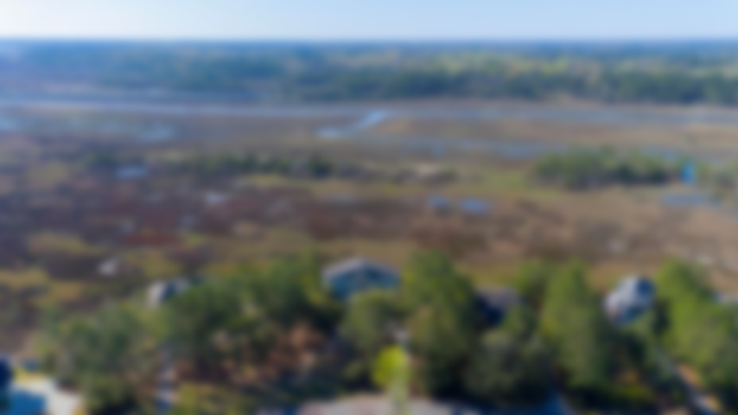
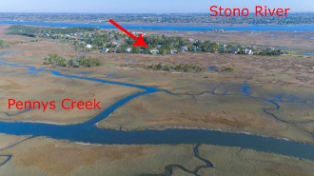
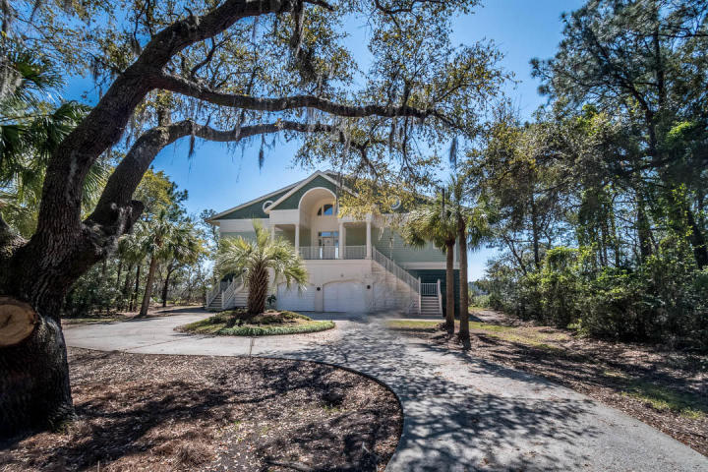
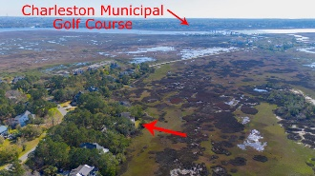
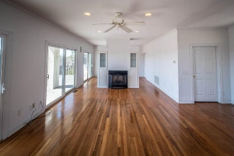
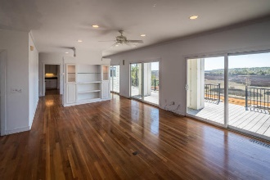
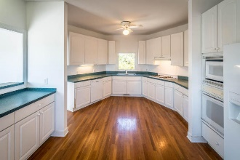
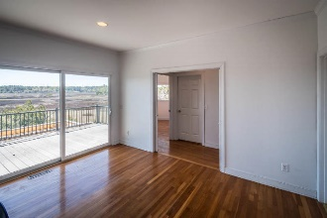
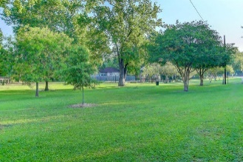
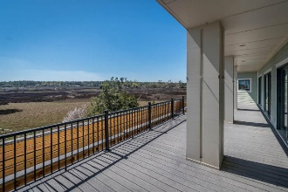
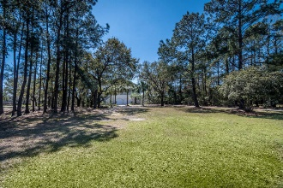


HOME ON 3/4 AC MARSH LOT
NEW PRICE $627,500
1614 Regimental Lane
Headquarters Plantation ~ Johns Island, SC 29455
MLS# 18008954 ~ $627,500
Architect designed custom-built elevated home behind the gates in Headquarters Plantation! Situated on an OVERSIZED .74 acre marsh front lot w/gorgeous expansive marsh vistas. Compared to current lot availability, values, & proximity to downtown combined w/new construction prices today- duplicating this property would be almost impossible! Only a golf cart ride away from St John's Yacht Harbor with boat slips for sale or lease and only minutes away from Municipal Golf Course, Folly Beach, great local restaurants & bars & downtown Charleston! The open first floor plan includes a spacious kitchen with breakfast nook, dining room, living room, family room and two guest bedrooms (OR his and hers OFFICE suite) and full bath. This home is perfect for entertaining w/first floor living spaces all opening to partially covered exterior TREX decks. Master Suite w/gas fireplace is on 2nd level & features large walk-in closet, en suite bath, tub & separate shower & dual vanities. Two additional good sized BRs are upstairs each w/dual closets & tons of adjacent floored attic storage. The kitchen is spacious & has pass through opening to the dining room, gas cooktop & , original custom cabinetry offering plenty of space for storage. Wood floors are on main level as well. THIS home, THIS lot, THIS location--a must see today!
Sheila Romanosky
(843) 224-0242
sromanosky@carolinaone.com

