Slide 1
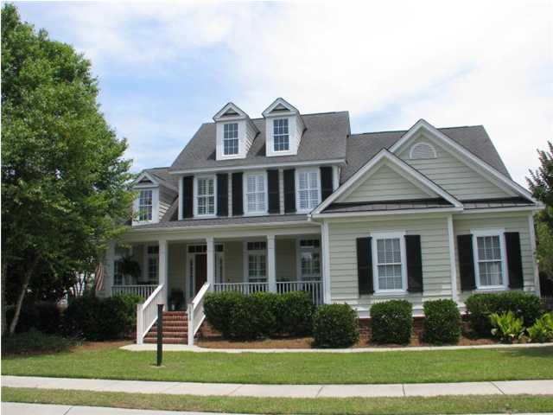
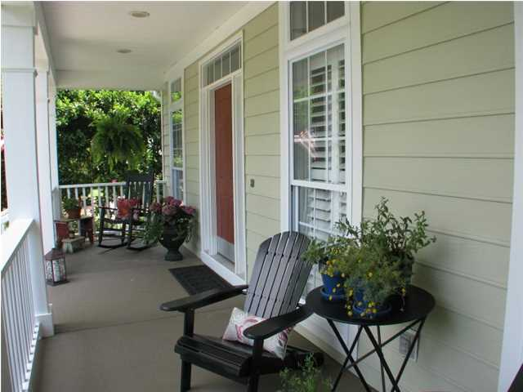
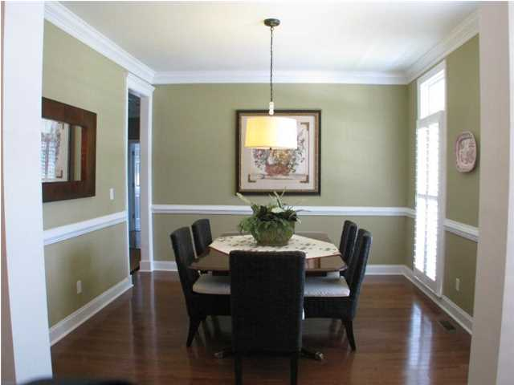
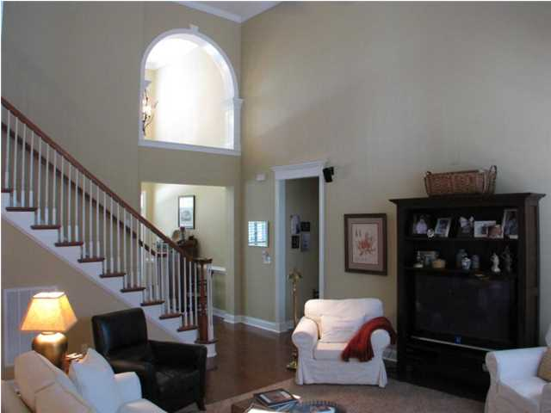
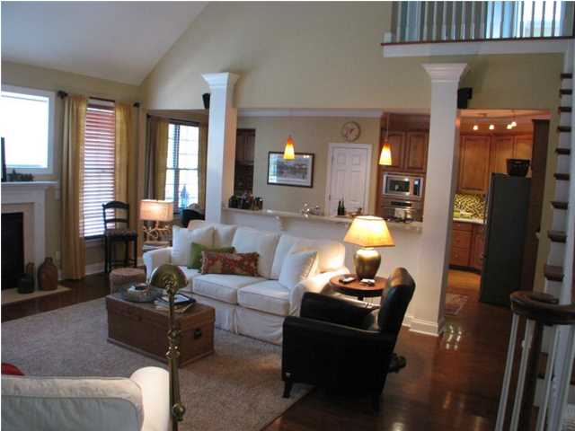
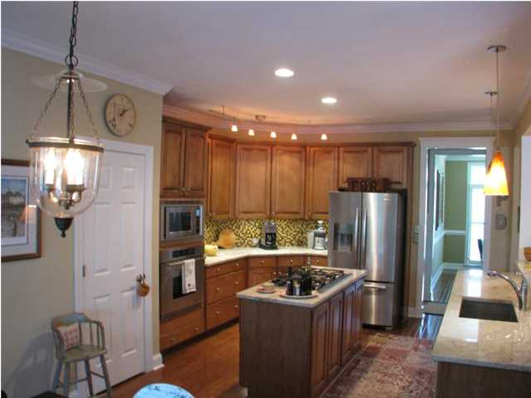
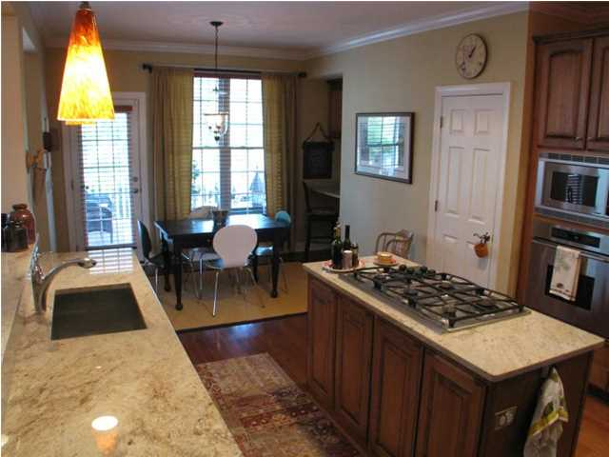
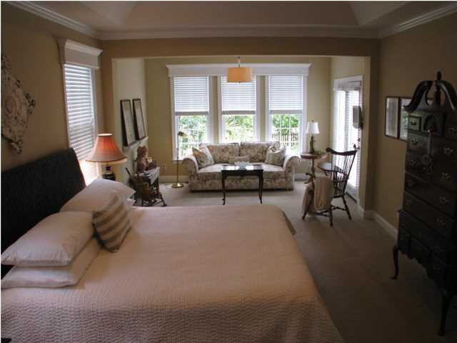
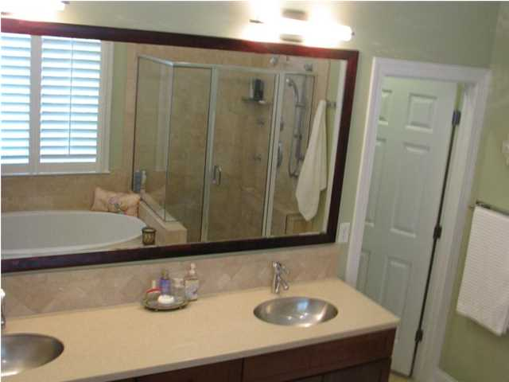
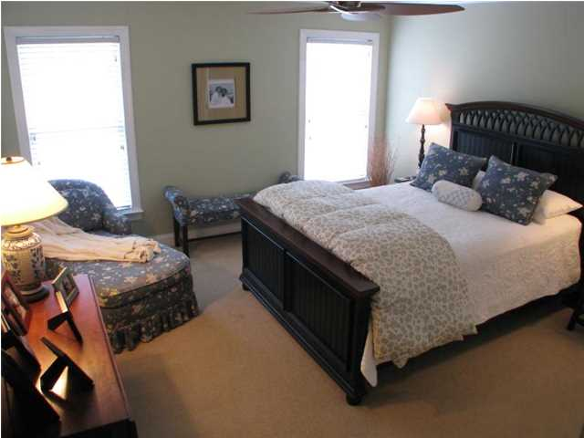
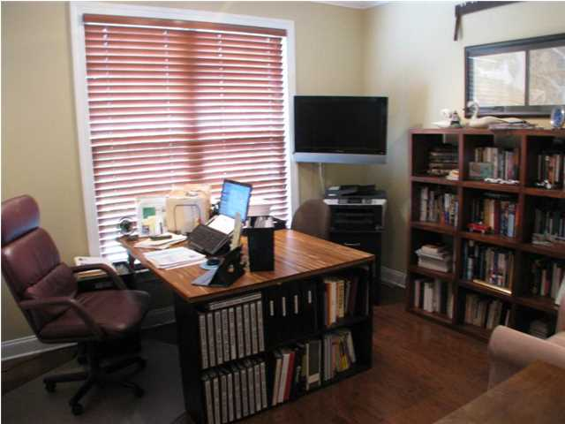
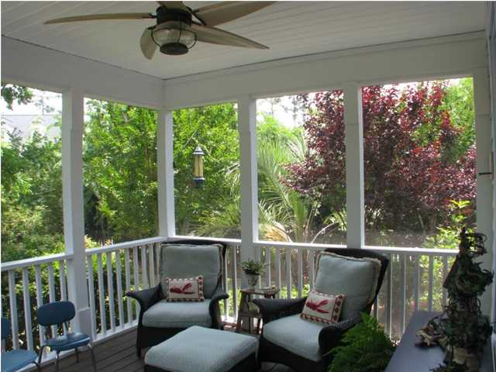
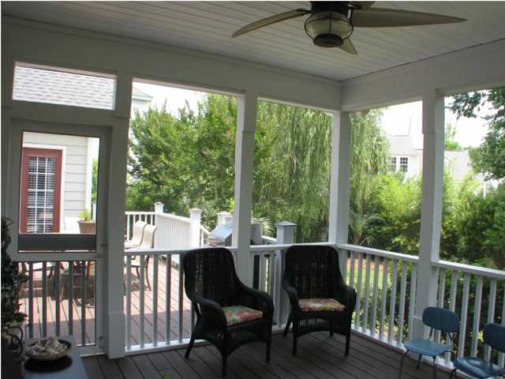
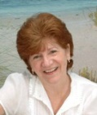

1616 Sewee Fort Rd Park West Mt Pleasant MLS# 1414032 $487,500 5 Bedrooms | 3 Baths
Beautiful custom Built "Southern Living" 5 bedroom, 3 full bath home located in desirable Wheatstone section of Park West. The spacious first floor Master Suite boasts a tray ceiling and separate sitting area. This home is a must see, with incredible upgrades such as imported bath fixtures, solid surface / granite countertops, tiled bathrooms, custom window treatments, smart-house wiring, surround sound and upgraded lighting and ceiling fans. Hardwoods throughout first floor and carpet in bedrooms. Gourmet kitchen has custom cabinets, stainless steel appliances, Dacor 5 burner gas cooktop, Dacor wall oven and built-in microwave, GRANITE countertops and striking glass mosaic tile backsplash. This is a great home to entertain your friends and family, and has a wonderful open floor plan with 20 ft ceilings in the living room and foyer. The master bath with vaulted ceiling, garden tub, dual stainless steel sinks, Grohe faucets, travertine floors & backsplash and spa shower (with 6 shower heads) will not disappoint. Upstairs you will find 3 generously sized bedrooms with lots of closet space and storage. The 5th bedroom is downstairs with an adjacent full bath which makes for great home office, guest suite, Mother-in-Law suite, nanny’s quarters or play room. Please don't overlook the lovely fenced backyard with lush landscaping and gardens that compliment this corner lot. Perfect for family gatherings and entertaining Al fresco. With lawn irrigation, security system and finished garage, this home will not disappoint. There is a transferable Termite Bond available. Park West is a master planned community with some of the finest recreation fields in the area; other amenities include swim, tennis, shopping, child-care, medical facilities and gym. Laurel Hill Primary, Pinckney Elementary and Cario Middle are located within the development.
Beautiful Custom-Built Home
Maggie Curtis
ABR, EPRO, LMC
(843) 693-8207 M
maggiecurtis@comcast.net

