Slide 1
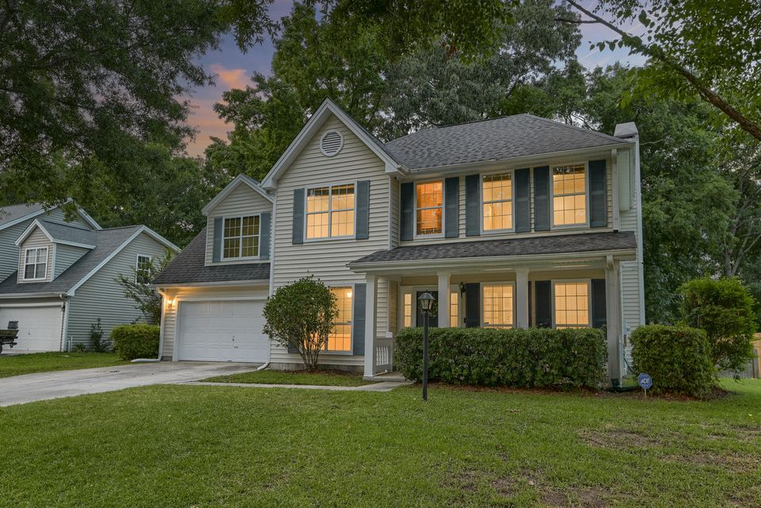

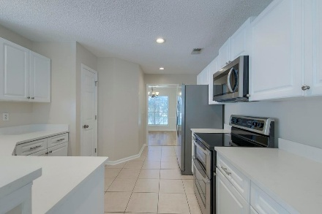
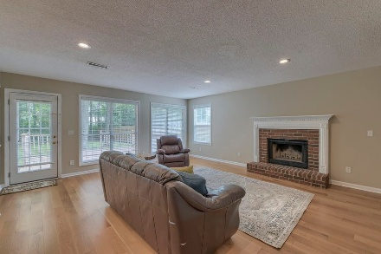
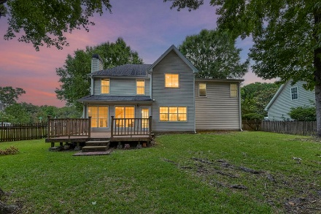
Price Improvement & Open House Sunday 12-2
OPEN HOUSE
SATURDAY 12-3
Open House Saturday 12-3
1616 Dotterers Run
Forest Lakes Extension | Charleston, SC 29414 | MLS# 25016514 | $550,000
OWNER HAS MOVED AND IS READY TO SELL!!
Move-in ready and NO HOA! On a shady corner lot in a cul-de-sac, three generously sized bedrooms plus athe 4th bedroom is a massive FROG that can easily serve as a bedroom, office, home gym or whatever you dream up. The main floor features a formal dining room, a dedicated home office, and an open-concept eat-in kitchen with quartz countertops. The kitchen flows seamlessly into a comfortable den, complete with a cozy fireplace and gleaming hardwood floors. Step out back to a large deck overlooking a private, wooded backdrop on a .28-acre lot—perfect for outdoor entertaining or quiet relaxation.
A stream backs up to the large backyard. Nearby is a walking path that leads directly to West Ashley Park. West Ashley Park boasts soccer, baseball, two playgrounds, wooded walking trails, and fishing, perfect for the whole family.
And talk about location! You're only 7.3 miles to the airport, 8 miles to historic downtown Charleston, 16 miles to Folly Beach, and just one mile from I-526. Additionally, you're conveniently located near area schools, hospitals, shopping, and dining.
This home combines comfort, convenience, and natural beauty come see it for yourself!
Book your showing today!
Amanda Kennedy-Colie akcolie@mattoneillteam.com 843-224-5865

