Slide 1
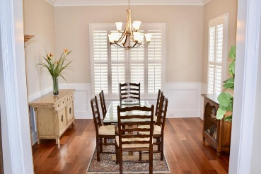
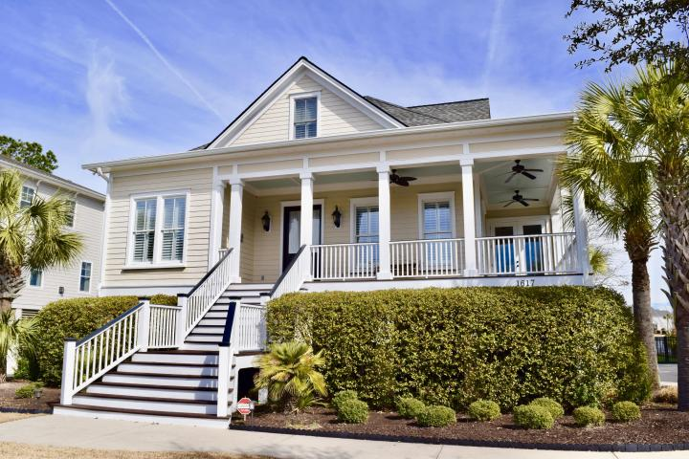
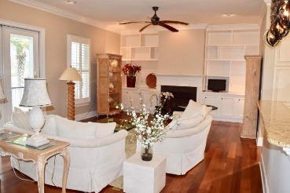
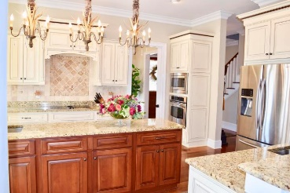
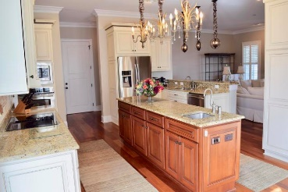
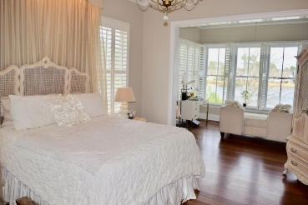
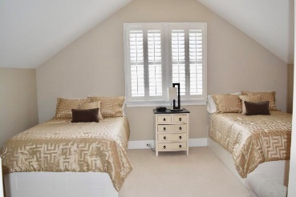
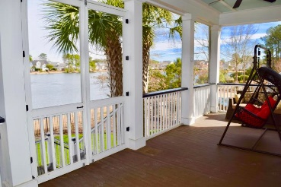
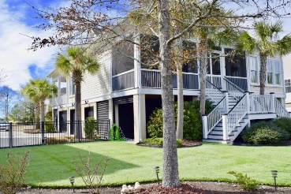
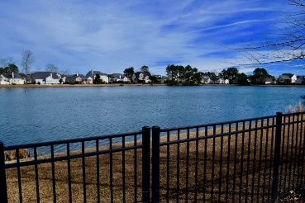


1617 Rivertowne Country Club Drive
Rivertowne Country Club | Mount Pleasant
MLS# 18003079 | $695,000
Just Listed in Park West
Bring Backup Offers!!!!
Amazing home located in one of Mt Pleasant's most popular golf club communities. Home is set on a breathtaking water front lot that has one of the best views in the neighborhood. This meticulous four bedroom house greets you with a wraparound porch that would be prefect for enjoying the southern life while in the evening shad. Upon entering the the foyer you will notice beautiful hardwood floors and a wonderful open floor plan. Large master bedroom is located on the first floor with a sitting room that has an amazing water view. Master bath has dual granite vanities, elegant tub and shower and a large walk in closet. The gourmet kitchen features a huge center island with prep sink, stainless appliances and custom cabinets, pantry plus eat-in dining. The formal dining room is perfect for those special occasions with family and friends. Second downstairs bedroom could also serve as a office/study. Sit and relax on the oversized screen porch that over looks an astroturf lawn that stays green year around. The 2 car drive under garage has over 2000 sf of space including a workshop. There is a covered oyster shell patio at the rear of the property (the full width of the house). The home has a irrigation system, landscape lighting, and a black aluminum fenced back yard. The overall lot size is 0.33 acres including the easements to the lake and road. Rivertowne Country Club amenities include a pool area, playground, lighted tennis courts and covered picnic area.
Jessica Williams
(843) 847-8081
jessicaw.realtor@gmail.com
RE/MAX Alliance
1200 Two Island Ct., Ste. A
Mt. Pleasant, SC 29466

