Slide 1
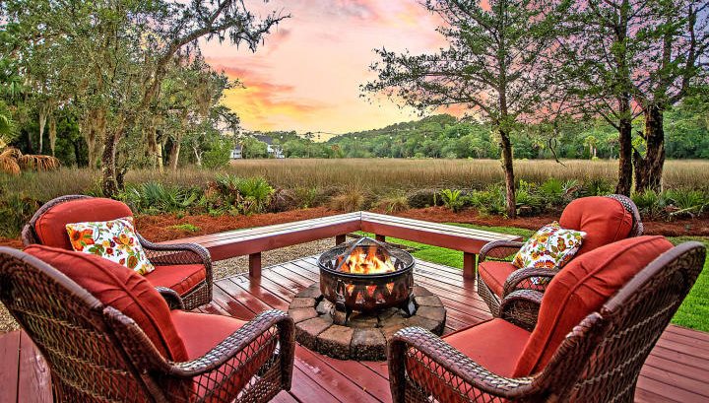

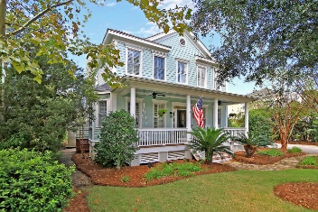
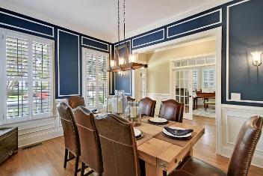
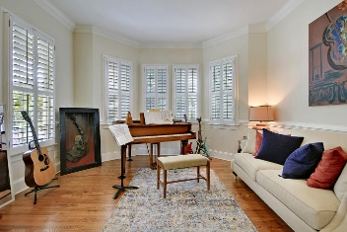
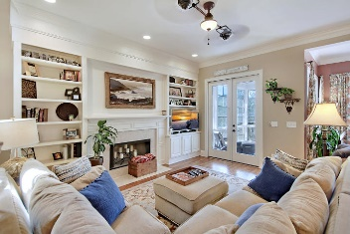
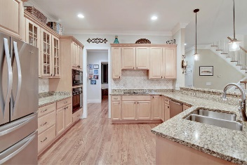
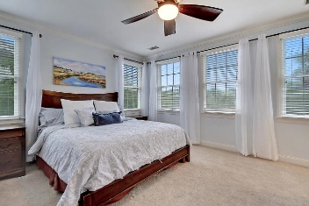
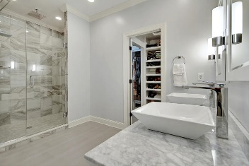
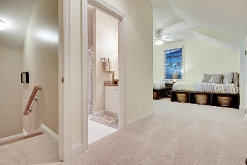
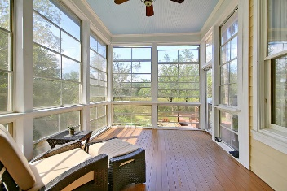
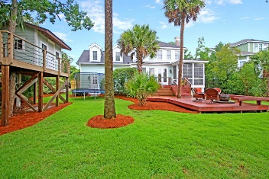
Price Reduced in Dunes West!
New A/C Units With Nest Controllers PLUS a 10 Year Warranty
$2,500 Agent Bonus
Dreaming of Marsh Front Living in Mt Pleasant?
1617 Sewee Fort Road
Park West ~ Mount Pleasant, SC 29466 ~ MLS# 19020080 ~ $645,000
This stunning home in Park West is a lowcounty gem you don't want to miss! Features in this open house include wainscoting in the formal dining room, bay window and trim work in the living room, & open concept between the eat-in kitchen & family room with its fireplace & built-ins. The remodeled master suite boasts a huge custom closet with a luxurious en-suite bath and a large walk-in shower with two rainfall shower heads. The FROG is spacious and offers a private in-law suite with a full bath. French doors open into the music room which is suitable to be used as a home office or playroom. The four seasons room allows access to the two-tiered deck and serene views of the marsh, wildlife, and amazing sunsets. The mature landscaped yard also includes irrigation fed from a separate water line. Enjoy the community amenities which include miles of walking trails, two swimming pools, a tennis center, playgrounds & beach volleyball court.
Book your viewing today!
Nate Gainey nate@mattoneillteam.com 843-513-2038

