Slide 1
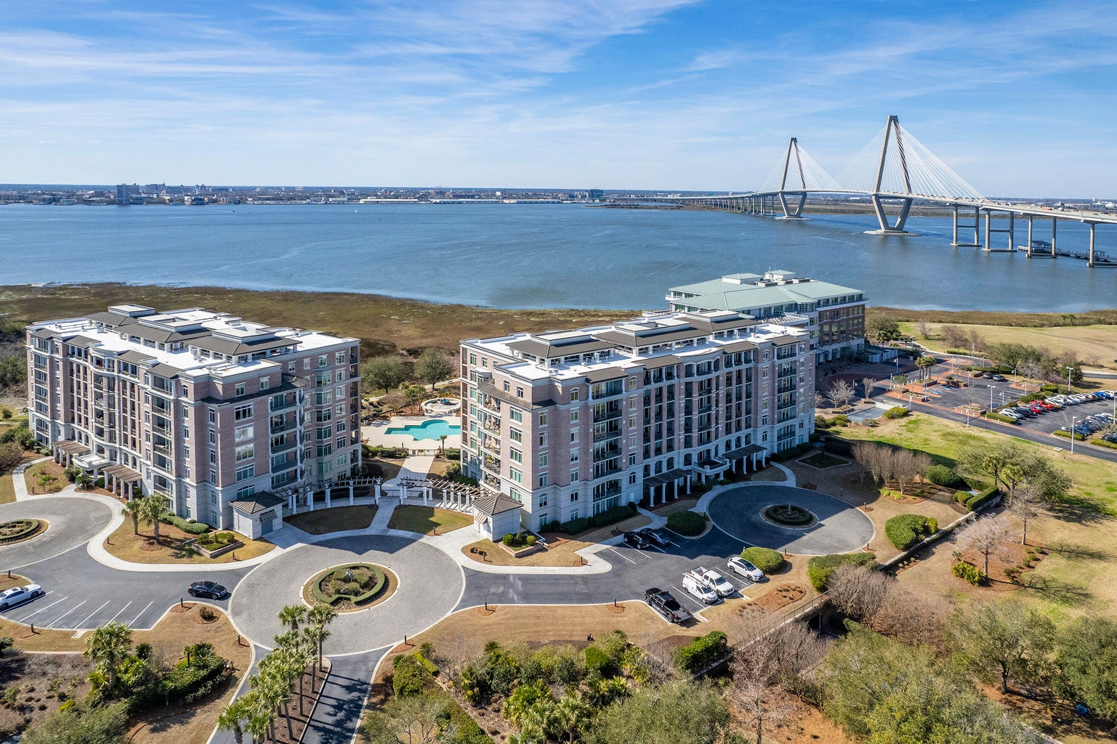

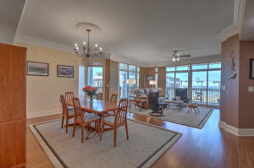
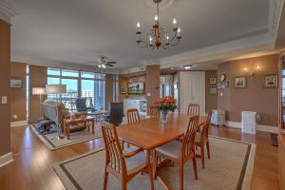
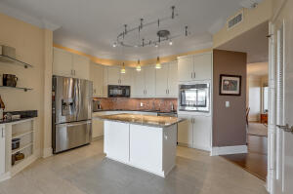
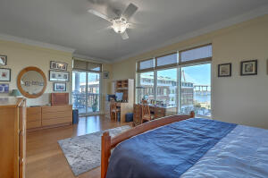
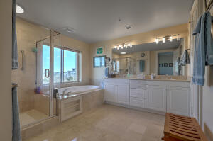

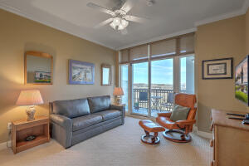
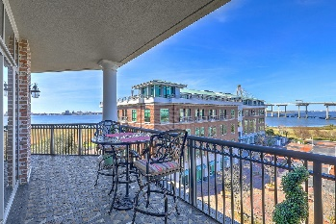
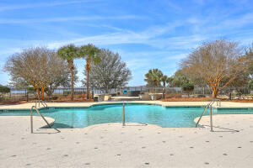
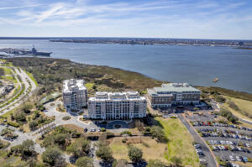
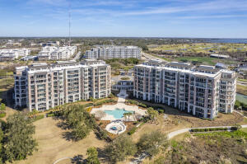
Ann Whalen
843-224-8696
awhalen@century21properties.com
Open House Sunday 12-2
161 N Plaza Court 501
Renaissance On Chas Harbor | Mount Pleasant, SC 29464 | MLS# 23003547 | $1,495,000
Gorgeous condo! Gorgeous views!
Highly sought after 6th floor end unit with stunning views of Charleston, the Cooper River and the Ravenel Bridge. The welcoming entrance has marble floors and beautiful artwork. Numerous amenities include a well equipped exercise room, The Renaissance room that can hold over 100 guests with a catering kitchen, 3 guest rooms and 1 guest suite to accommodate your guests, two libraries a beautiful pool with a view and well maintained grounds. The Renaissance is central to everything. Just a hop, skip and a jump to downtown Charleston, Patriots Point and Waterfront Park. Each unit has two underground garage spaces, additional storage and a semi-private elevator. This condo has to be seen to be believed.
Century 21 Properties Plus | 1090 Park West Blvd | Ste 103 | Mount Pleasant, SC 29466

