Slide 1
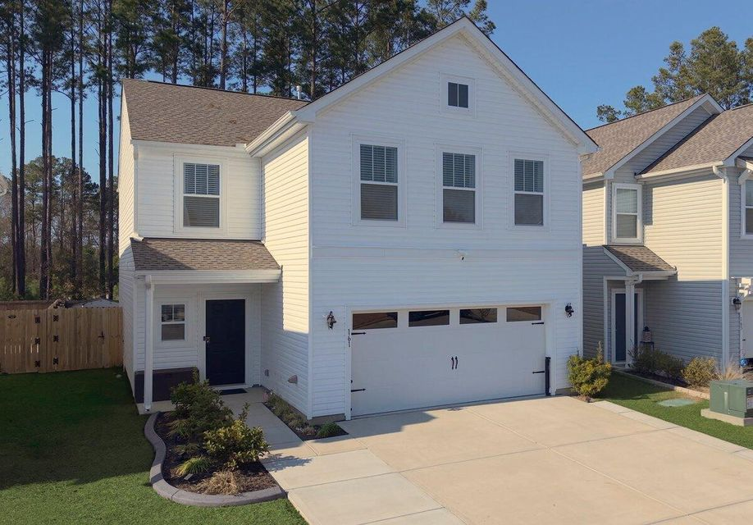
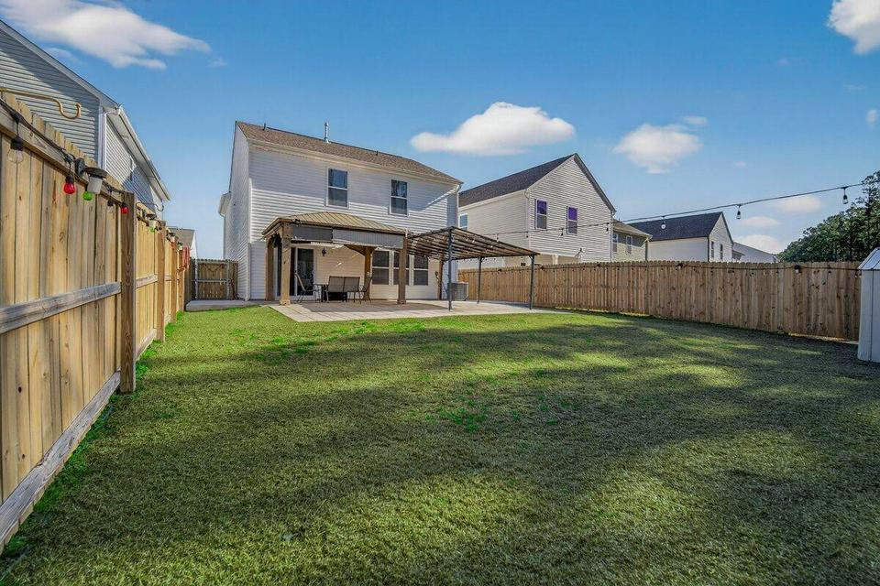



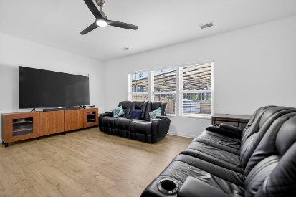
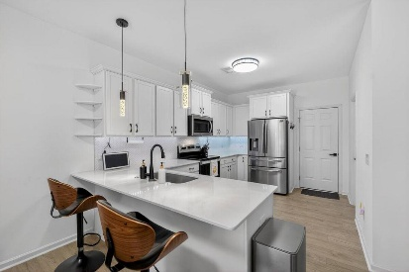
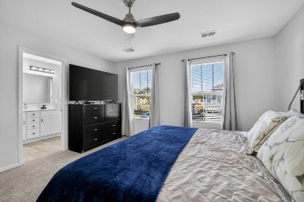
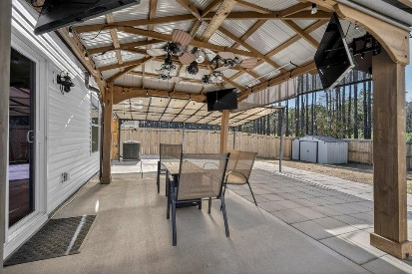
161 Surfbird Road Nexton | Summerville, SC 29486 | MLS# 26005520 | $399,900
Your Lucky Day Has Arrived in Nexton!
Under $400,000 and Charmed Upgrades
Open House Saturday, March 14th from 11AM-PM
JUST LISTED!
Welcome to 161 Surfbird Road in North Creek Village of Nexton, where thoughtful design and upgrades beyond imagination come together in a home that is just over two years old and lives far beyond its size. As you pull into the expanded driveway, the first thing you notice is space. Not just curb appeal, but true functionality. The widened concrete drive comfortably allows three cars side-by-side and up to six vehicles total, a rare and valuable upgrade in North Creek. Creative lawn edging frames the home beautifully, while full gutters with gutter guards offer long-term peace of mind. Even before stepping inside, you can feel that this home has been intentionally elevated. Step through the front door, and you are immediately welcomed by rich wood laminate floors that create a seamless, modern flow throughout the main level. The lighting and ceiling fans have been completely upgraded, eliminating every builder-basic fixture and replacing them with clean, stylish selections that feel curated and cohesive.
Living at 161 Surfbird Road means enjoying more than just a beautifully upgraded home; it means embracing the lifestyle that makes Nexton one of the most sought-after communities in the Lowcountry. North Creek Village offers its own amenity hub, complete with a resort-style pool, shaded seating areas, open gathering lawns, and a clubhouse that serves as the hub for neighborhood events and connection.
Just beyond your front door, North Creek Center offers everyday convenience within walking distance or a quick golf cart ride. Grab your morning coffee at Dunkin, meet friends for dinner at Buffalo Wild Wings, or take care of errands close to home. From there, explore Nexton Square, Downtown Nexton, The Marketplace, or The Hub...all easily accessible and filled with shopping, dining, and entertainment. Enjoy local favorites like Taco Boy, Somme Wine Bar, Halls Chophouse, or spend an afternoon at Pickle Bar. This is the lifestyle buyers are searching for connection, convenience, and community all in one place.
In a community as desirable as North Creek Village, finding a four-bedroom home of this caliber, with this level of upgrades and functionality, is exceptionally rare. Call today to schedule your private showing and experience 161 Surfbird Road for yourself!
4.25% Assumable Rate for those who qualify!
VIDEO TOUR
Elissa Campbell
843-853-1433 | elissa.campbell@agentownedrealty.com
AgentOwned Realty Preferred Group | 824 Johnnie Dodds Blvd | Mt Pleasant, SC 29464

