Slide 1
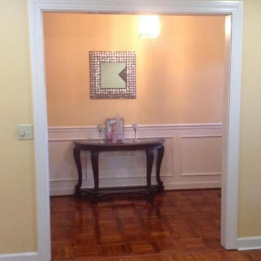
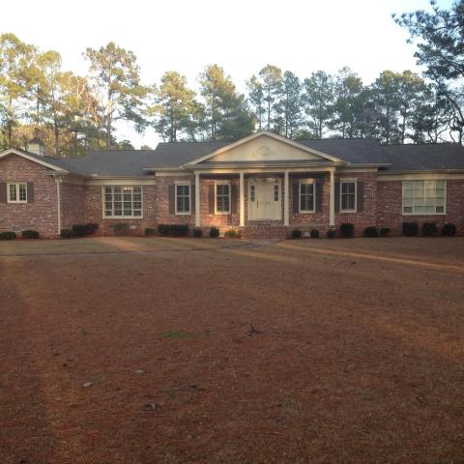
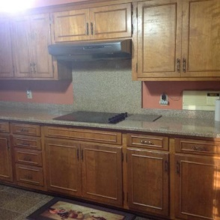
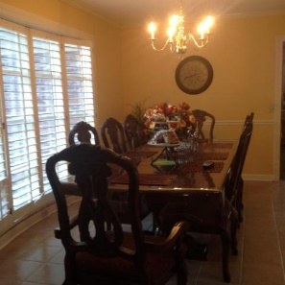
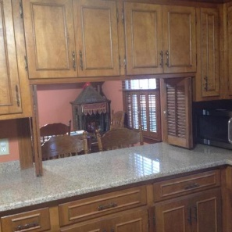
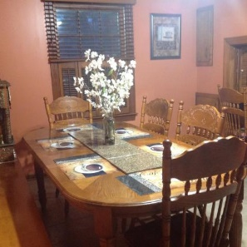
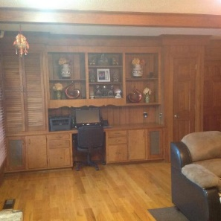
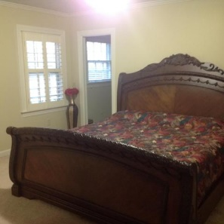
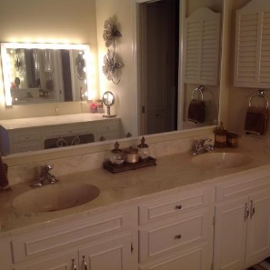
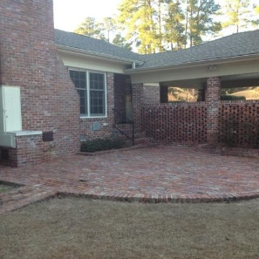
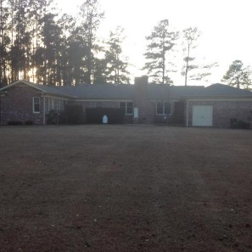
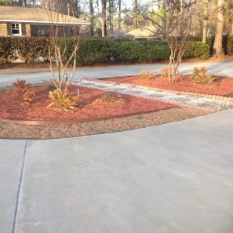
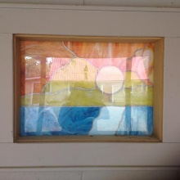

Beautiful 3200+ Sq Feet Home In Holly Hill On Over An Acre!
Must See!
1620 Jill Street
Holly Hill, SC 29059 | MLS# 18004591 | $350,000
This 4 bedrooms and 3 full baths as well as 2 half baths is located at the end of a quiet street. New roof in 2016 with 50 year warranty of shingles and 25 year warranty of labor. New granite and tiles as well as appliances since 2011. New carpet and all new toilets as well. New vapor barrier and insulation within the last year. Home has two HVAC units.
Carla C Davis
Mobile - (843) 437-4873
gaweber@tds.net
AgentOwned Premiere Group
141 A N. Main Street
Summerville, SC 29483

