Slide 1
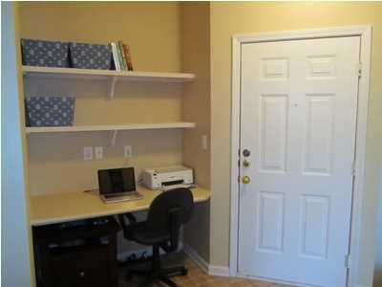
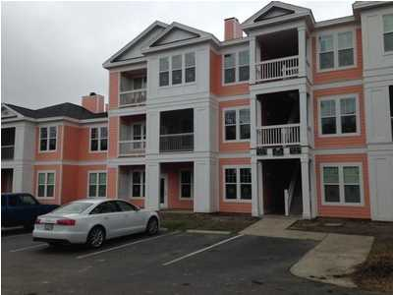
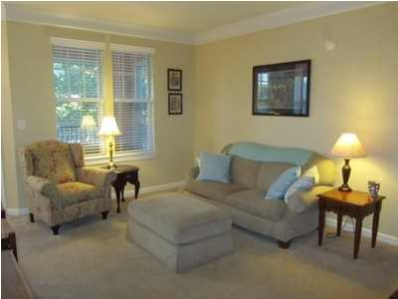
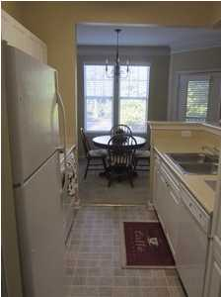
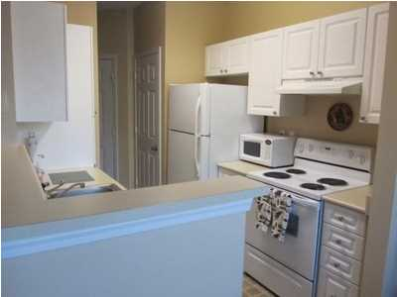
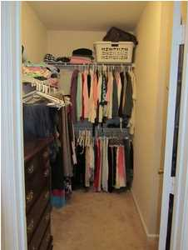
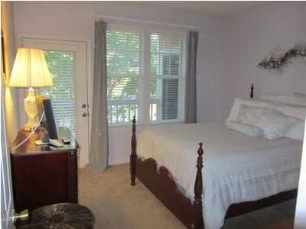
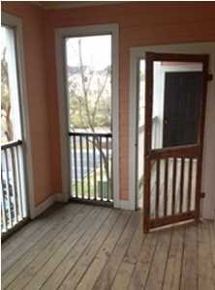


1621 Chatelain Way Southampton Pointe Mt Pleasant, SC MLS# 1414460 $148,900
Best Bargain - Great Location
Southampton Pointe is convenient to I-526, Towne Center, beaches and Downtown. This unit is in a great location within the complex-directly across from the Amenities Center! Southampton is in the last stages of a major renovation such as new siding, new high impact windows and new balcony railings and doors. Updated bath and built in computer/desk area.
Dick Comerford
843-209-5893
rcomerford28@att.net

