Slide 1
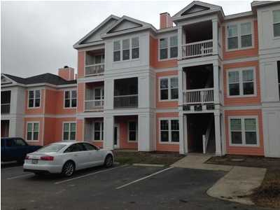
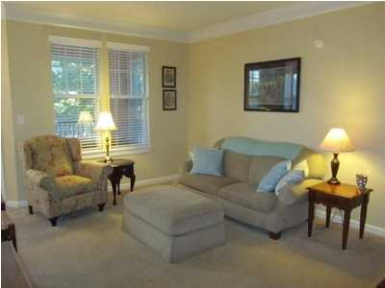
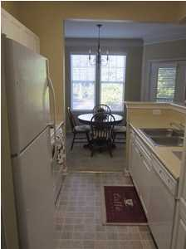
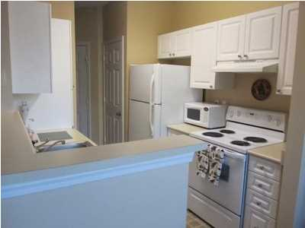
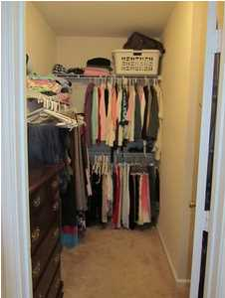
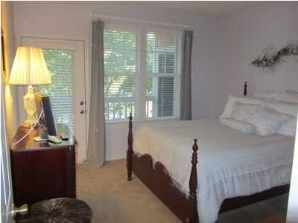
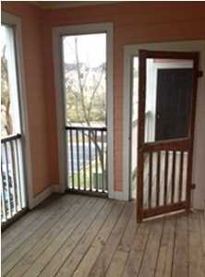


1621 Chatelain Way Southampton Pointe Mt Pleasant, SC MLS# 14028270 Reduced to $125,000
Reduced & Ready to Sell!
New lower price! Make offer! Southampton Pointe is convenient to 526, Towne Center, beaches and Downtown. This unit is in a great location within the complex-directly across from the Amenities Center. Southampton is in the last stages of a major renovation such as new siding, new high impact windows and new balcony railings and doors. Updated bath and built in computer/desk area.
Dick Comerford
843-209-5893
rcomerford28@att.net

