Slide 1
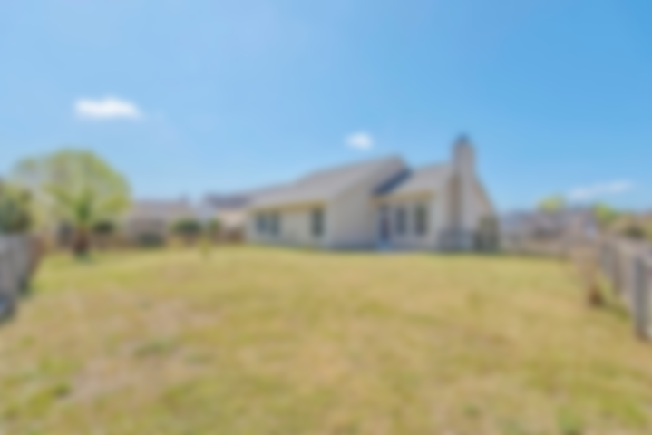
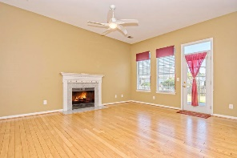
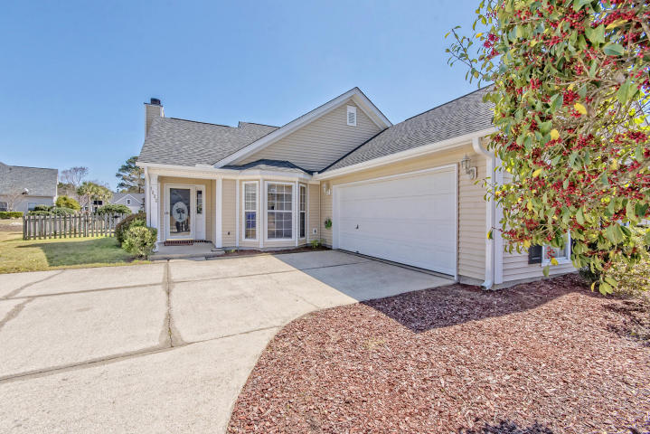
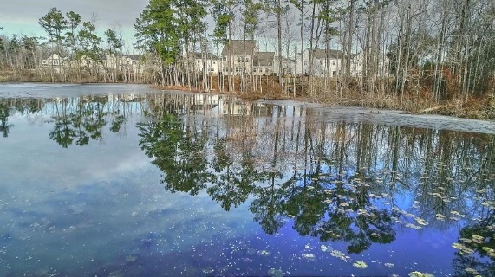
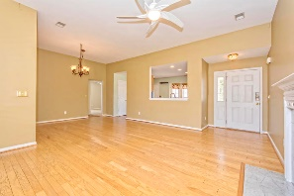
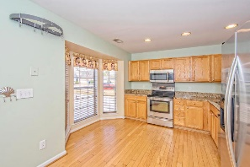
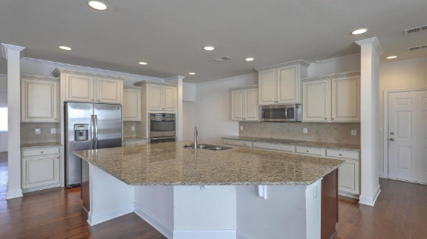
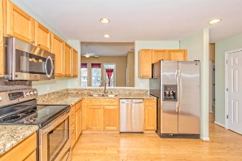
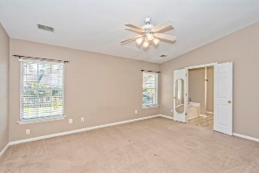
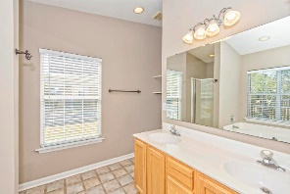
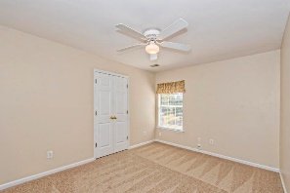
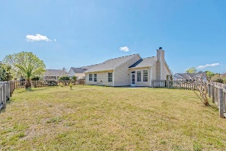


Open House Sat 11-4pm
One Of The Best Deals In Mt Pleasant!
1622 Pin Oak Cut
Dunes West
MLS# 18004029
$333,900
Abundant natural light, a nice, open floor plan and gleaming, hardwood floors are the first things you notice in this meticulously maintained one story home in Palmetto Hall just outside of the Dunes West gate**Features include: YEAR OLD SC CERTIFIED HURRICANE RESISTANT ROOF with new gutters**Eat-in kitchen with granite counters, s/s appliances and plenty of counter and cabinet space, looking out into living area**Privately situated Master en suite w/walk-in closet, spacious bath with dual vanities, separate garden tub and shower**Living/dining area with wood burning fireplace offering plenty of space for entertaining**Generous storage throughout**Fenced backyard w/stamped concrete patio**Two additional bedrooms tucked away & guest bath complete this wonderful home - ready for YOU! Located in a desirable community, Dunes West offers membership to an award winning golf course and club house, tennis, pools, boat ramp and boat storage plus plenty of walking paths. This lovely home is conveniently located to shopping, dining and minutes from the new Roper St. Francis hospital. And, an easy drive to area beaches and historic downtown Charleston.
Desiree Maurer
Office - (843) 416-2000
Mobile - (843) 327-9010
desiree.maurer1@gmail.com
www.yourcharlestonhousesearch.com
Keller Williams Realty
496 Bramson Ct Ste 200
Mt. Pleasant, SC 29464

