Slide 1
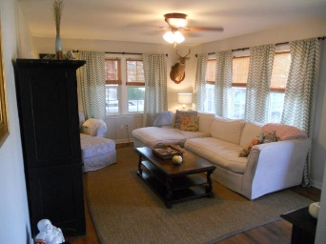
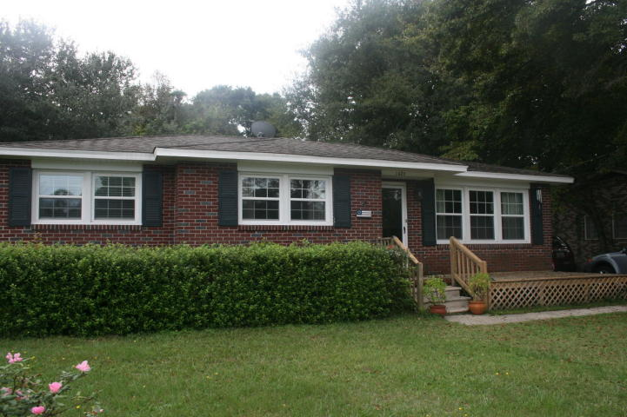
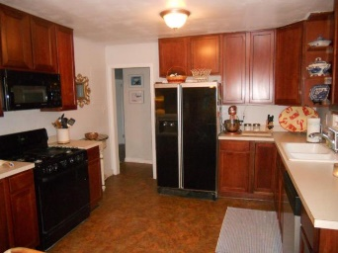
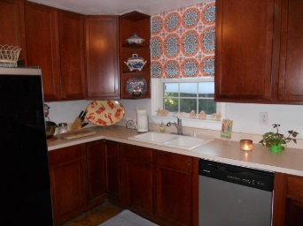
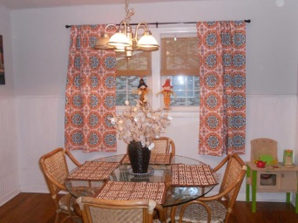
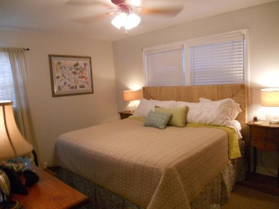
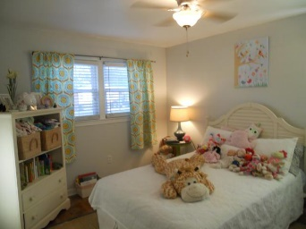
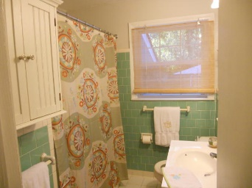
Great West Ashley Home With Loads of Upgrades
$225,000
3 Bedroom
1½ Bath
1,200 Sq Ft
1623 Woodcrest Avenue
Memminger Hall
Charleston, SC 29407
MLS# 15025663
Fantastic brick home in great West Ashley location.
This house has had many upgrades that include smooth ceilings, new windows in 2010, new roof in 2011 and HVAC in 2012.
Most recent the owner has spent over $30,000 encapsulating the crawl space, installing new duct work and brand new hardwood floors throughout the house.
The interior of the home features 3 bedrooms, 1 1/2 baths, large eat-in kitchen with replaced cabinetry and a spacious family room.
The exterior of the house boast a large fenced in yard, attached storage room and separate storage shed.
Melanie Thornhill, Realtor®
(843) 270-8997
melaniethornhill1@gmail.com
Melanie Thornhill Realtor®
843-270-8997
melaniethornhill1@gmail.com
Places LLC
400 Hibben St., Suite 200
Mt Pleasant, SC 29464
www.scplaces.com

