Slide 1
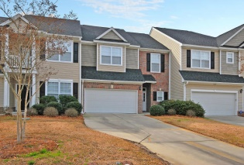
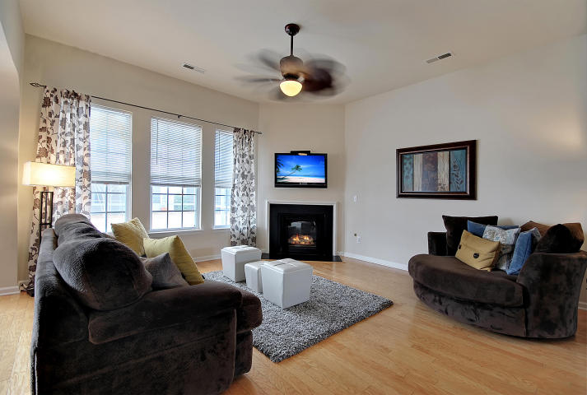
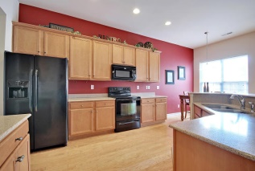
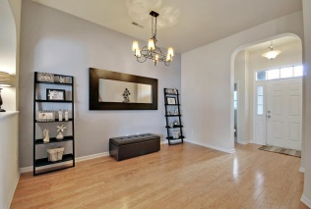
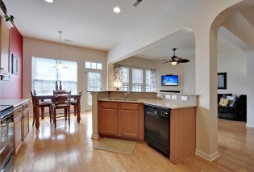
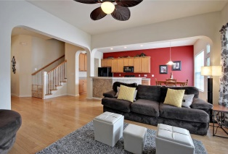
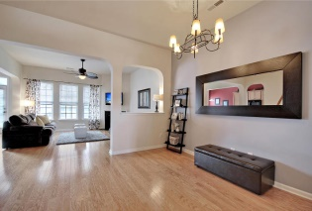
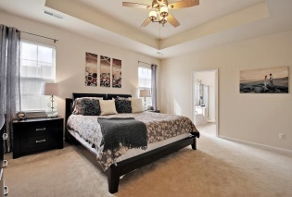
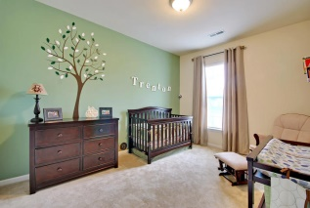
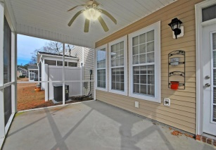
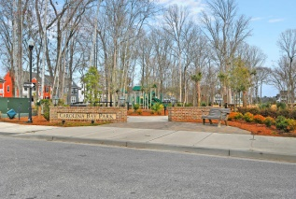
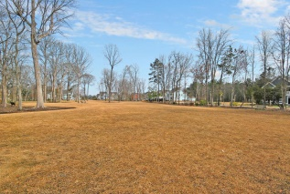
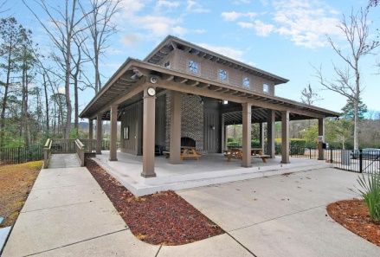
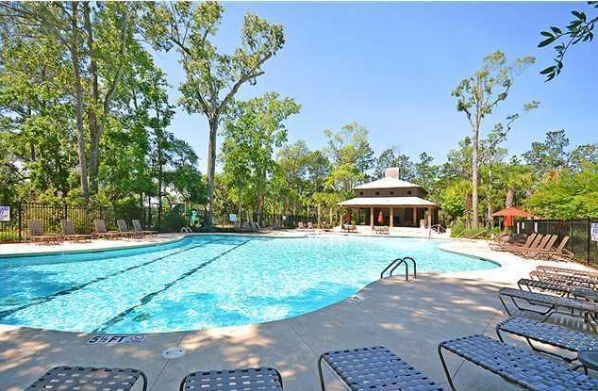
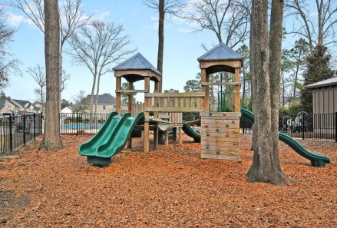
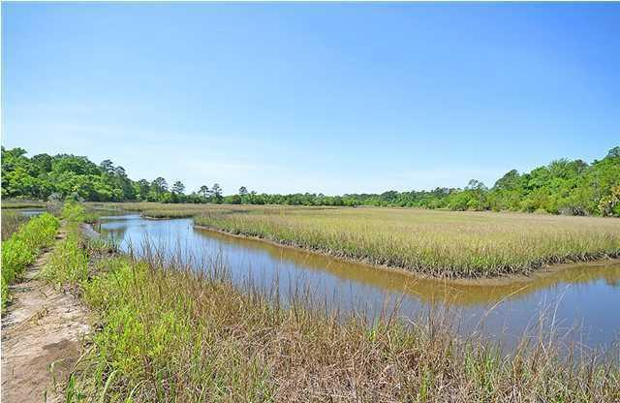

1624 Cristalino Circle
Carolina Bay | Charleston, SC 29414
MLS# 15008182 | $229,900
This is the home you have been waiting for!
Wow! Immaculate and spacious, this home is in highly coveted Carolina Bay, West Ashley’s premier neighborhood. Enjoy the beautiful Swimming Pool, 3 Tot Play-Parks, 3 acres of Lawn Park, Miles of Bike and Nature Trails that over look the Marsh, & a Fenced Dog Park. Over 2,000 sq. ft. of living space! The downstairs boasts an Open Concept living space with Gleaming hard wood floors, a Spacious Kitchen Island, Solid Surface Countertops, 42” Cabinets and Grand 10’ Ceilings. Use the flex space for a formal dining room, play area or office. Space for your dining table & chairs on your Screened-in porch, nice! The fabulous Master Suite has a tray ceiling, walk-in closet and Huge Master Bathroom with lots of Counter Space, extended Shower and Separate Soaking Tub. Just Just 3 Miles to I-526; 8 Miles to Downtown Charleston; 20 Minutes to the Charleston International Airport; and 17 Miles to the Beach! Low HOA Dues of $185 per month Includes: Pest Control, Termite Bond, Exterior Pressure Washing, Lawn Care, Irrigation, and ALL the amenities above!
Call or email for details: (843) 214-8451 or Robin@ThePhillipsRealtyGroup.com

