Slide 1

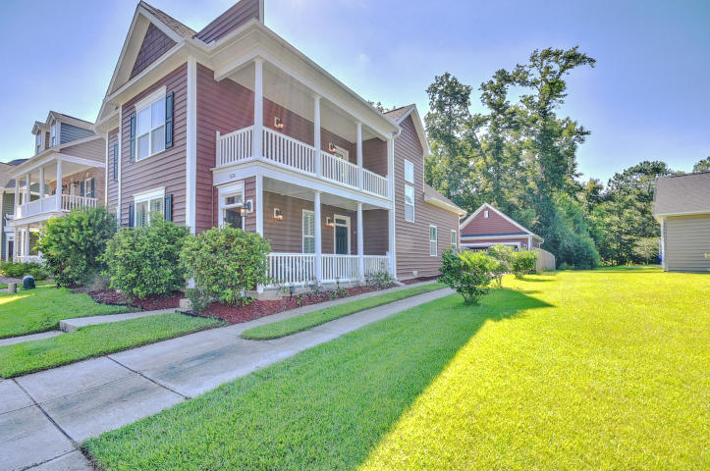
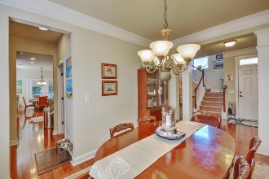
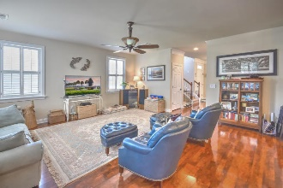
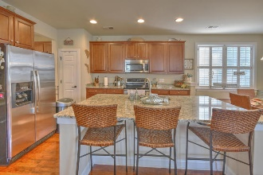
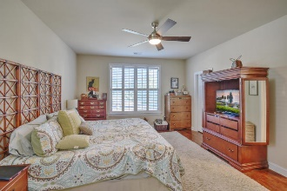
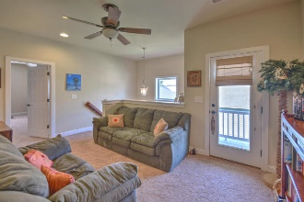
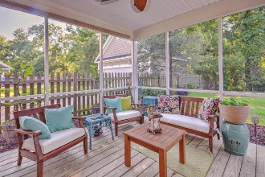
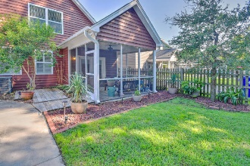

Great House
Motivated Seller!
Chad Woods
(843) 830-9760
cwoods@century21properties.com
www.century21properties.com
1624 Wrecklers Race Lane
Boltons Landing | Charleston, SC 29414 | MLS# 17020445 | $334,500
INCREDIBLE HOME! It will not last long!
This was an upgraded MODEL when built(GRANITE Counters, 42'' cabinets, fixtures, appliances, siding, flooring, BUTLER'S PANTRY, interior trim, shingles, etc) PRIVACY FENCE, PLANTATION SHUTTERS, screened-in-porch, fire-pit, etc. MASTER DOWN and GOURMET kitchen w/ large island. All bedrooms are oversized. ESTAR energy efficient = low electric bills. Great lot backs up to wetlands/wooded area. Bolton's Landing is Charleston's premier new home community that sets a new standard for design and lifestyle. Residents enjoy over 2.5 miles of walking trails, 38 acres of wetlands, neighborhood pool, and clubhouse. Restaurants, and shopping are all nearby. 12 minutes to downtown Charleston, 20 minutes to Kiawah. Come see this beautiful house for yourself!
Century 21 Properties Plus | 3301 Salterbeck Ct Suite 100 | Mt. Pleasant, SC 29466

