Slide 1
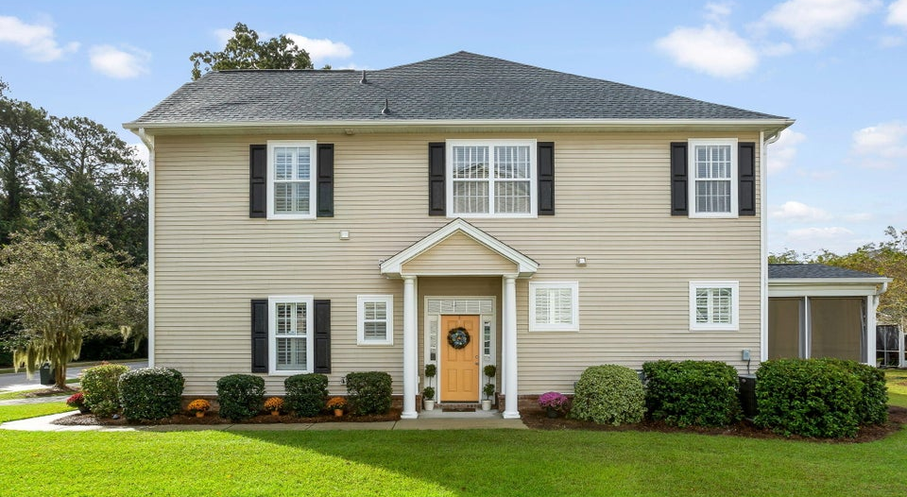
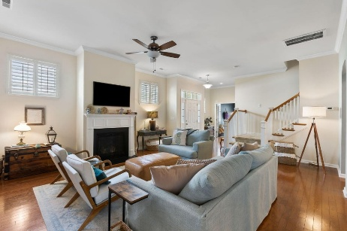
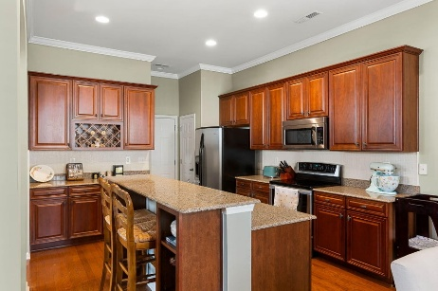
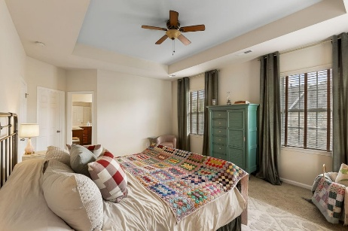
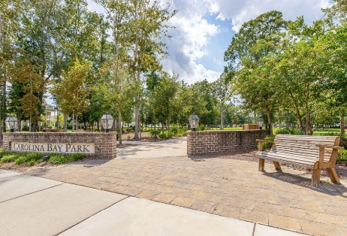

UNIQUE Jewel Box in the
OLD WALLED CITY
1626 Cristalino Circle
Carolina Bay | Charleston, SC 29414
MLS# 25027182 | $489,000
4 Bedrooms + Office for under $500K!
Buyer's Agent Compensation Included
Experience carefree living in this meticulously maintained, rare 4 bedrooms (plus office) END home located in highly coveted Carolina Bay. Elegance meets convenience with a 2400+ sq. ft open floorplan, great for entertaining and easy to maintain. Wood floors downstairs, gas fireplace, granite countertops, and plantation shutters are just a few upgrades about this light filled home with large yard and screened in porch. New architectural roof installed 2024, one less thing to worry about! Maintenance fees include landscaping, annual gutter cleaning/pressure washing, termite bond and quarterly pest control. Carolina Bay is a wonderful community with 3 pools, dog parks, playgrounds, walking trails and the lovely Carolina Bay Park that hosts many events such as Food Truck Fridays.
Great neighborhood location is walking distance to both the West Ashley Greenway and the swimming pool/pavilion. Washer/dryer can convey with acceptable offer. All information is believed to be correct, however, buyer and/or buyer agent to verify any information deemed important such as schools, measurements, taxes, etc. Agent/Owner
Branden Shirley
843-425-3230
bshirleyrealestate@outlook.com

