Slide 1
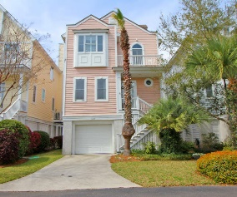
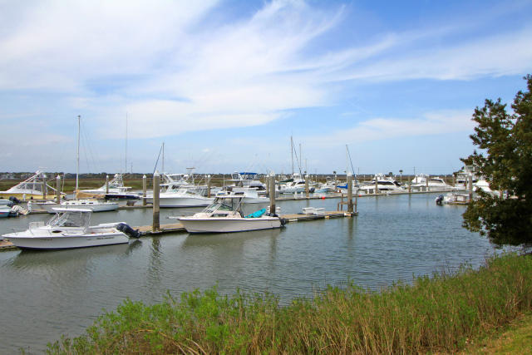
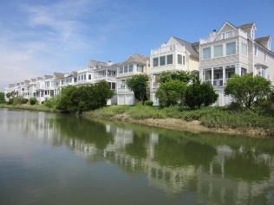
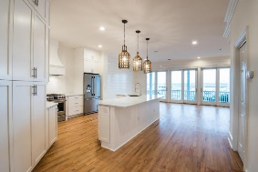
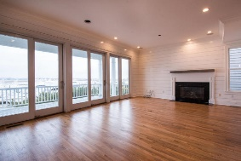
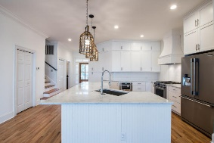
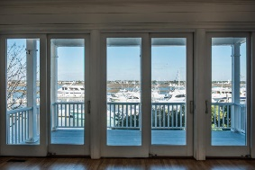
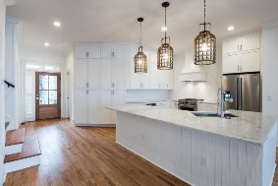
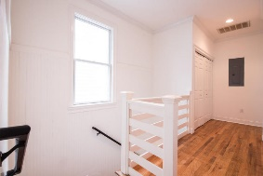
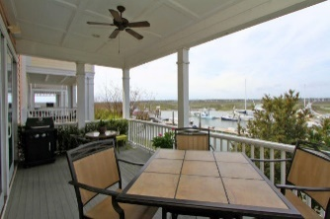
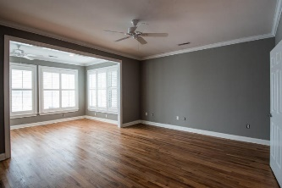
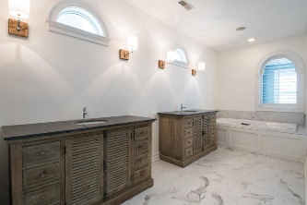
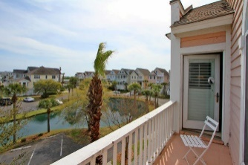
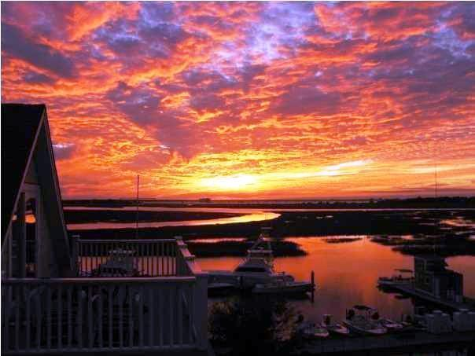

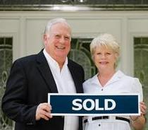
1627 Marsh Harbor Ln Marsh Harbor | Mount Pleasant, SC 29464 | MLS# 16004260 | $997,900
Best Of All Worlds!!!
WOW! A REAL SHOW PLACE!! RENOVATIONS FINALLY COMPLETED!!
This 3 BR, 3 BA, 2210 sq.ft. elevated Charleston single style home, within a gated community, has undergone a complete makeover. New and refinished flooring, modernized bathrooms and fabulous new kitchen w/custom cabinets, countertops, stainless appliances, gas top stove with custom hood are just a few of the features which make this residence move in ready. A showcase home perfect for entertaining or relaxation while enjoying views of the intracoastal waterway, marsh, marina and majestic sunsets. The marina, clubhouse w/ pool and exercise room, dock and tennis courts are steps away. DEEDED 35' BOAT SLIP (B-20)CAN BE PURCHASED FOR ADDITIONAL $100,000. BEST LOCATION AND VALUE FOR CHARLESTON AREA. TOTAL PACKAGE $1,097,900.
Tommy & Lynne Lovett Tommy - (843) 442-1276
Lynne - (843) 697-0491
tlovett@carolinaone.com lynne.lovett@carolinaone.com
www.tommylovettrealestate.com
Carolina One Real Estate
628 Long Point Rd.
Mt Pleasant, SC 29464-3032

