Slide 1
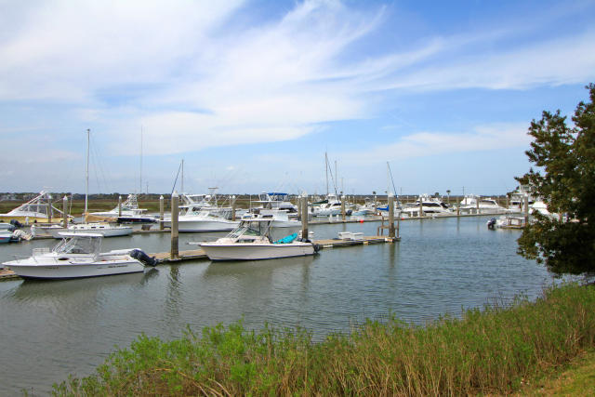
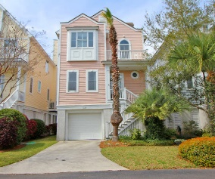
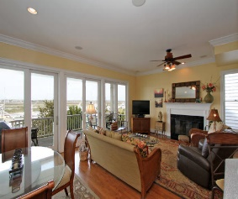
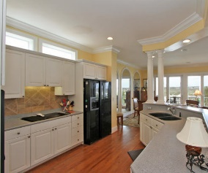
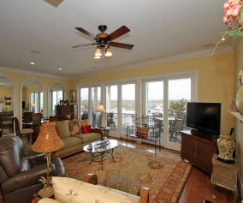
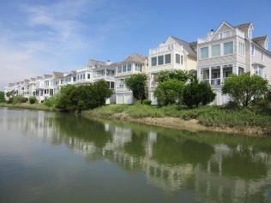
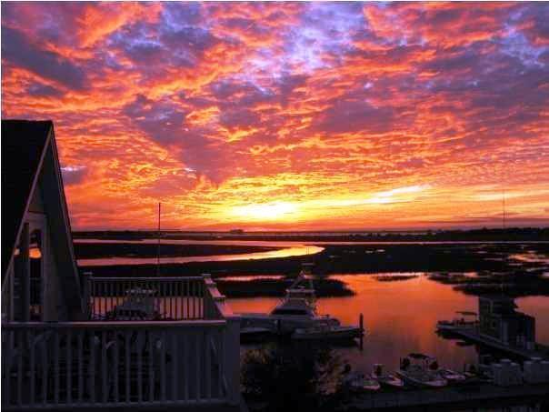
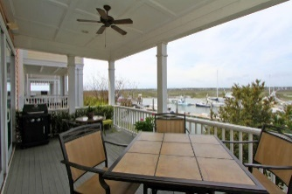
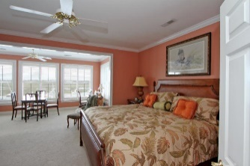
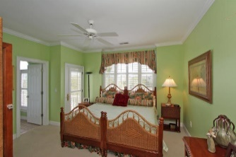
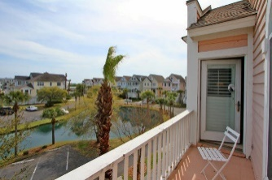
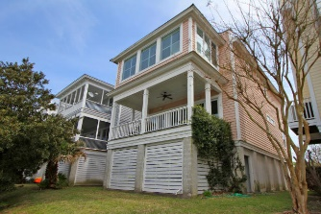

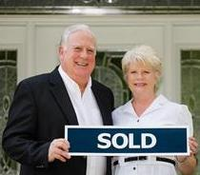
1627 Marsh Harbor Ln Marsh Harbor | Mount Pleasant, SC 29464 | MLS# 15008385 | $890,000
Best Of All Worlds!!!
Marsh Harbor is a gated island community with private Toler's Cove Marina providing incomparable boating and easy lifestyle. Located between Mt Pleasant and Sullivans Island. This 3br/3ba custom raised Charleston single home affords gracious living spaces with unparalleled marsh, marina, water and sunset views. Home features hardwood flooring, custom trims and cabinetry throughout first level, bright and open plan with spacious kitchen with breakfast bar and mirrored dining room, all opening to family room with fireplace. Full glass windows and door lead onto large covered deck overlooking Toler's Cove Marina. The second level master bedroom suite with sitting room also has incredible views. Club house, tennis and boat slip just steps away from home. Boat slip available for purchase.
Tommy & Lynne Lovett Tommy - (843) 442-1276
Lynne - (843) 697-0491
tlovett@carolinaone.com lynne.lovett@carolinaone.com
www.tommylovettrealestate.com
Carolina One Real Estate
628 Long Point Rd.
Mt Pleasant, SC 29464-3032

