Slide 1
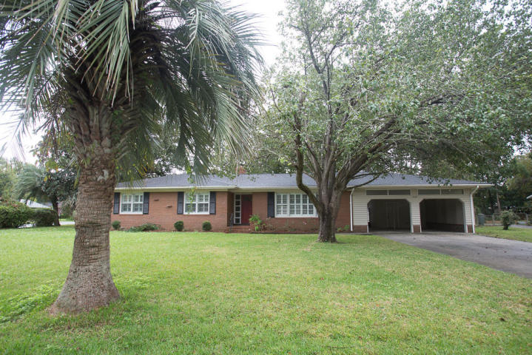
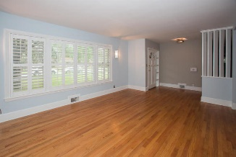
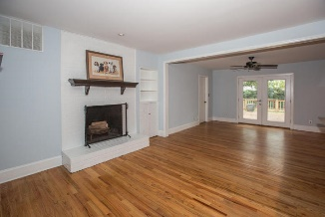
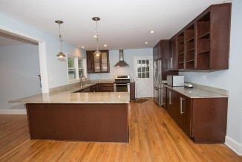

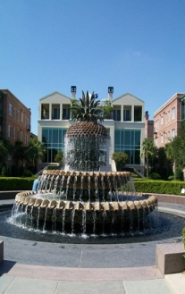
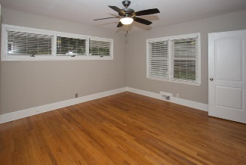
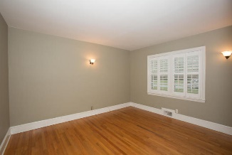
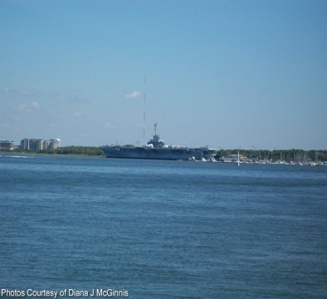
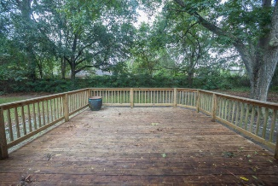


OPEN HOUSE
Sunday Oct 15th
1:00 - 4:00
$450,000
$450,000
1629 Timothy Street
Wappoo Shores · Charleston, SC 29407 · MLS# 17025886 · $379,900
Rodney Hancock
(843) 437-1347
rodneyhancock08@gmail.com mortgageprofessionalsonline.com
This beautifully remodeled brick ranch on nearly 1/2 acre corner lot is very close to downtown, MUSC, The Citadel, local area hospitals, beaches, and the Charleston International Airport! The kitchen has granite countertops and custom cherry cabinets with built-in wine storage. It also features new stainless steel appliances and a master hood. The open floor plan is perfect for entertaining family and guests. 1629 Timothy has no carpet - hardwood floors throughout the home and tile in the newly renovated master bathroom. The 2nd bathroom has been updated also. Throughout the home, there is custom lighting, recessed lighting and wood plantation shutters that add a nice touch. Interior has been newly painted. When you exit the living room onto the outside deck, you are welcomed into a dog friendly, fenced-in back yard perfect for grilling and entertaining. The 2 car carport offers plenty of storage with built-ins as well as a utility room and storage room. Easily bike or walk to Whole Foods, Avondale Restaurant district, the brand new elementary school and new county park on the banks of the Stono. The West Ashley Greenway is steps away from the house and is perfect for biking, walking or baby strolling.
AgentOwned Charleston Group
902 Savannah Hwy
Charleston, SC 29407
Real Estate ● Mortgage Insurance ● Business Brokerage

