Slide 1

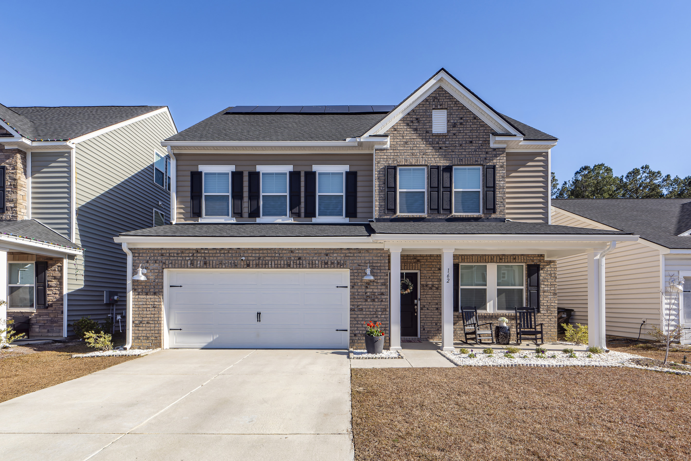
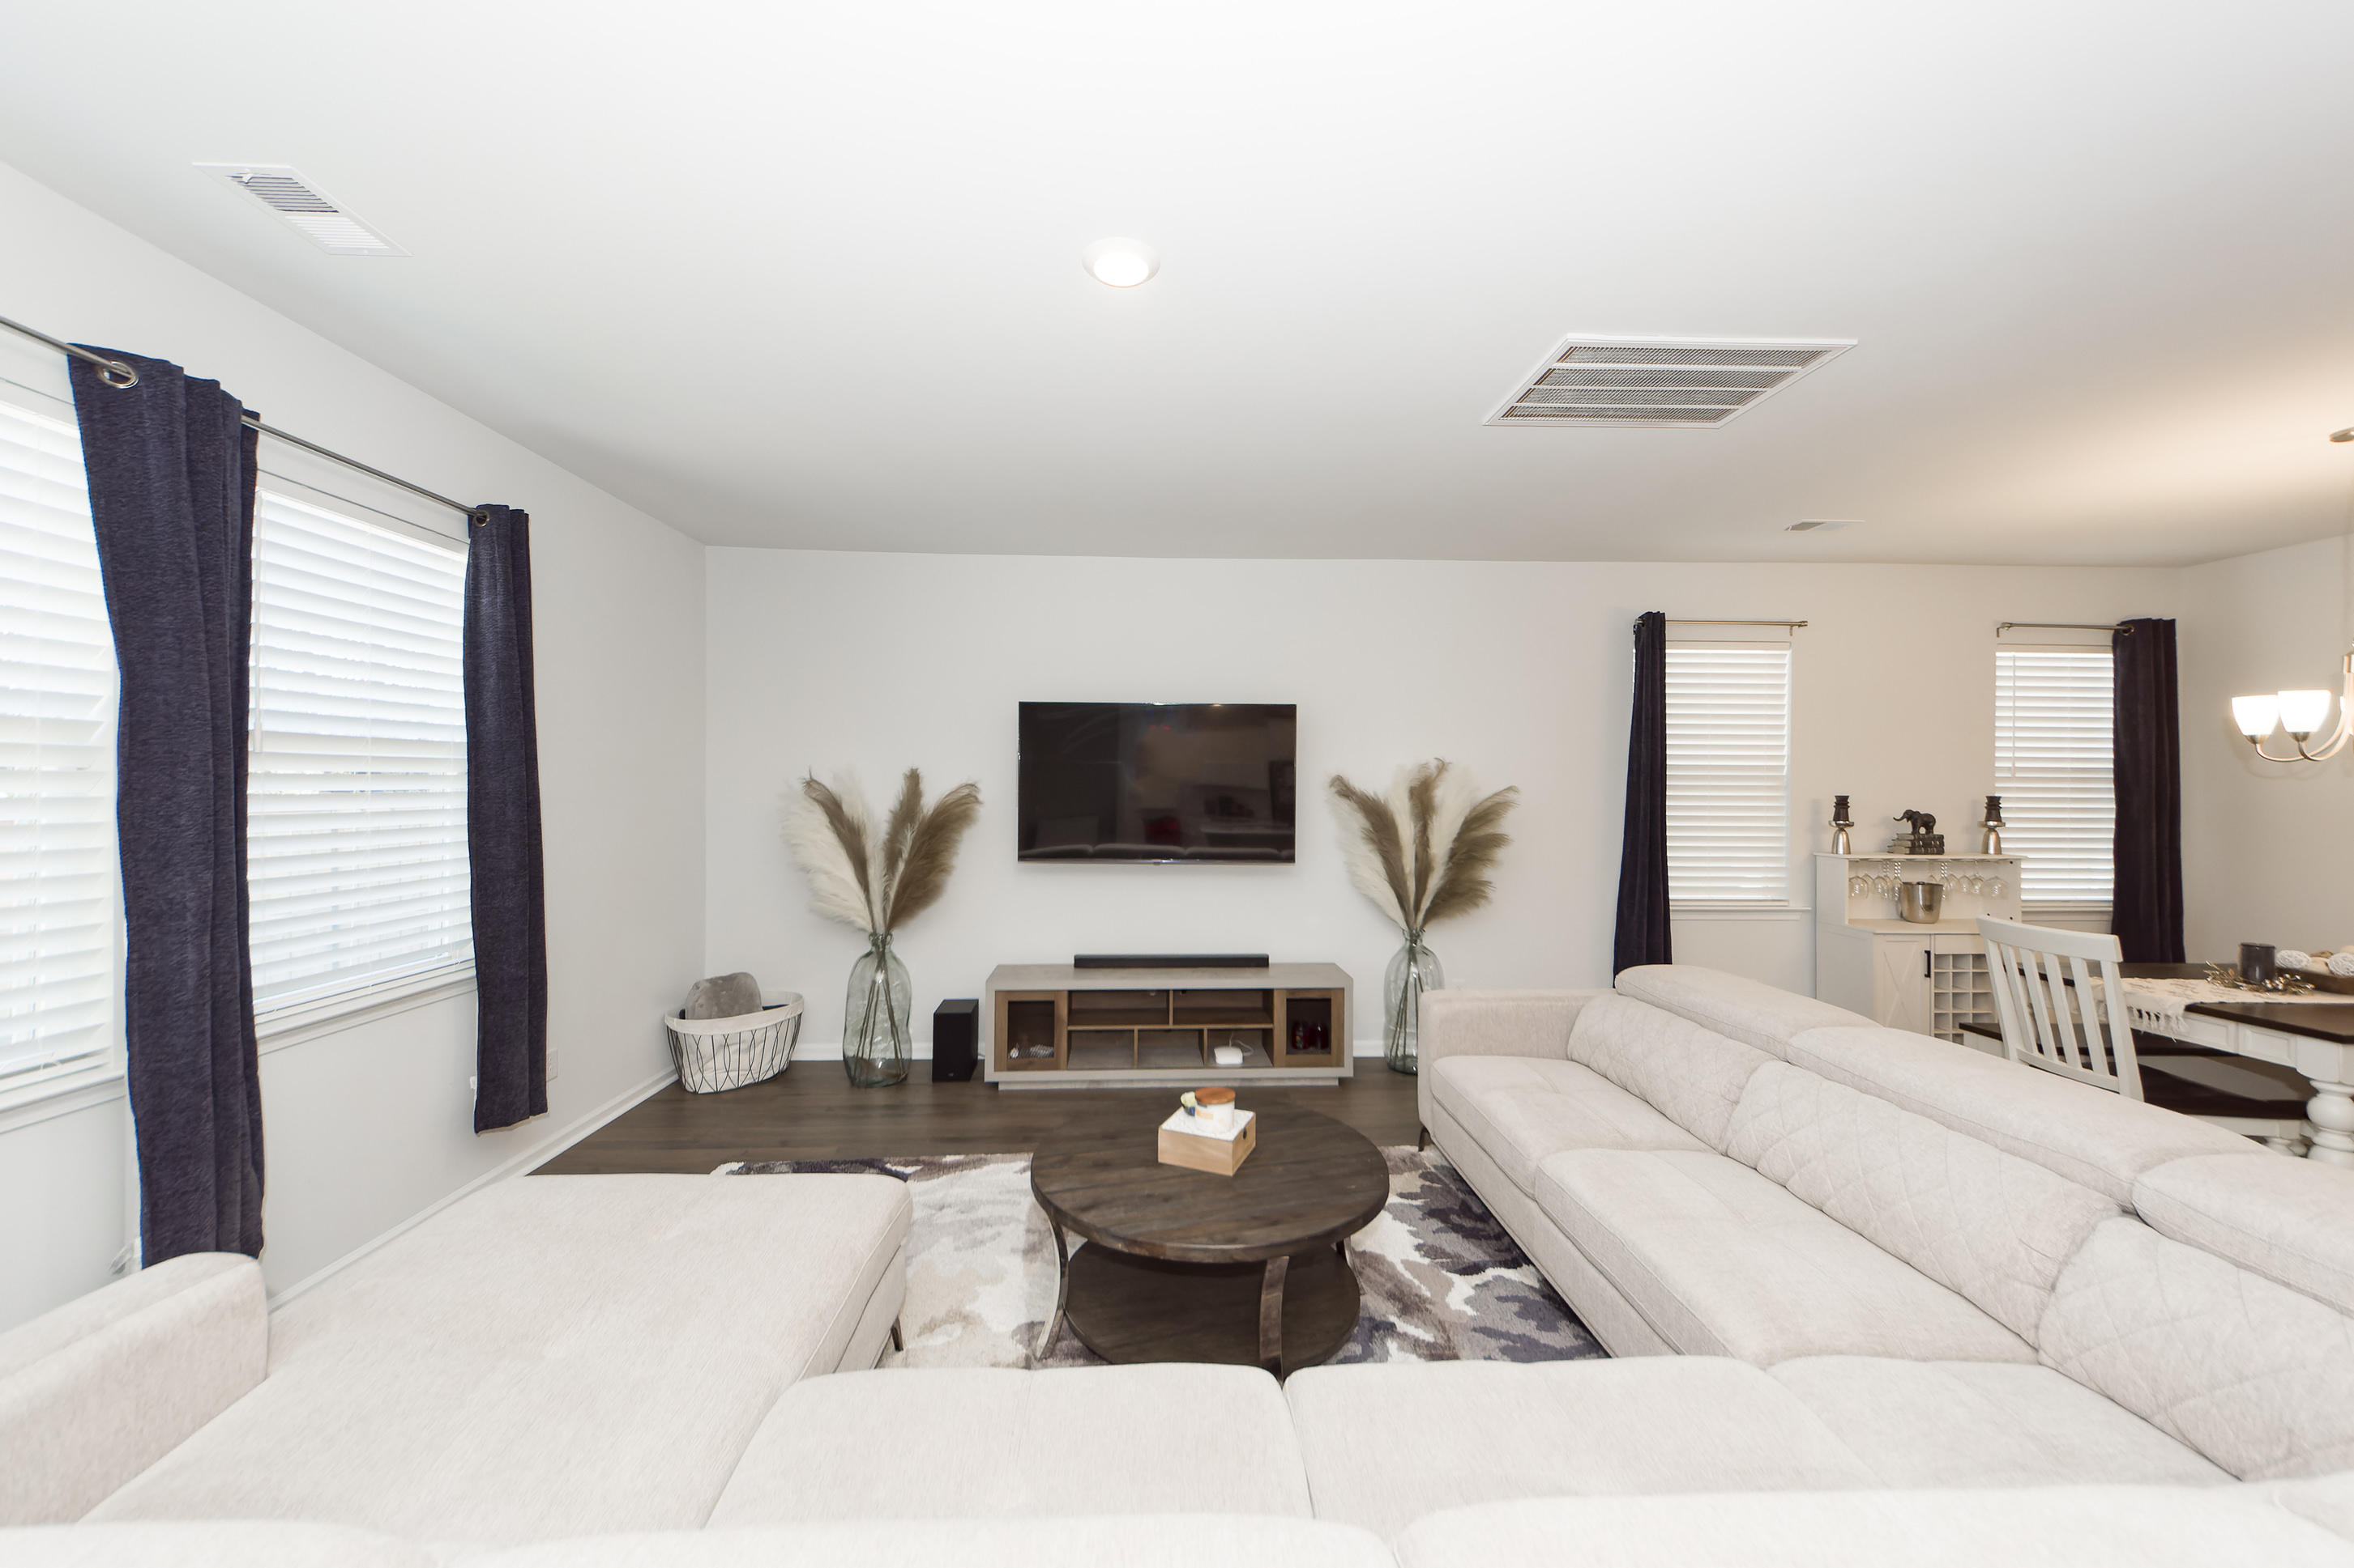
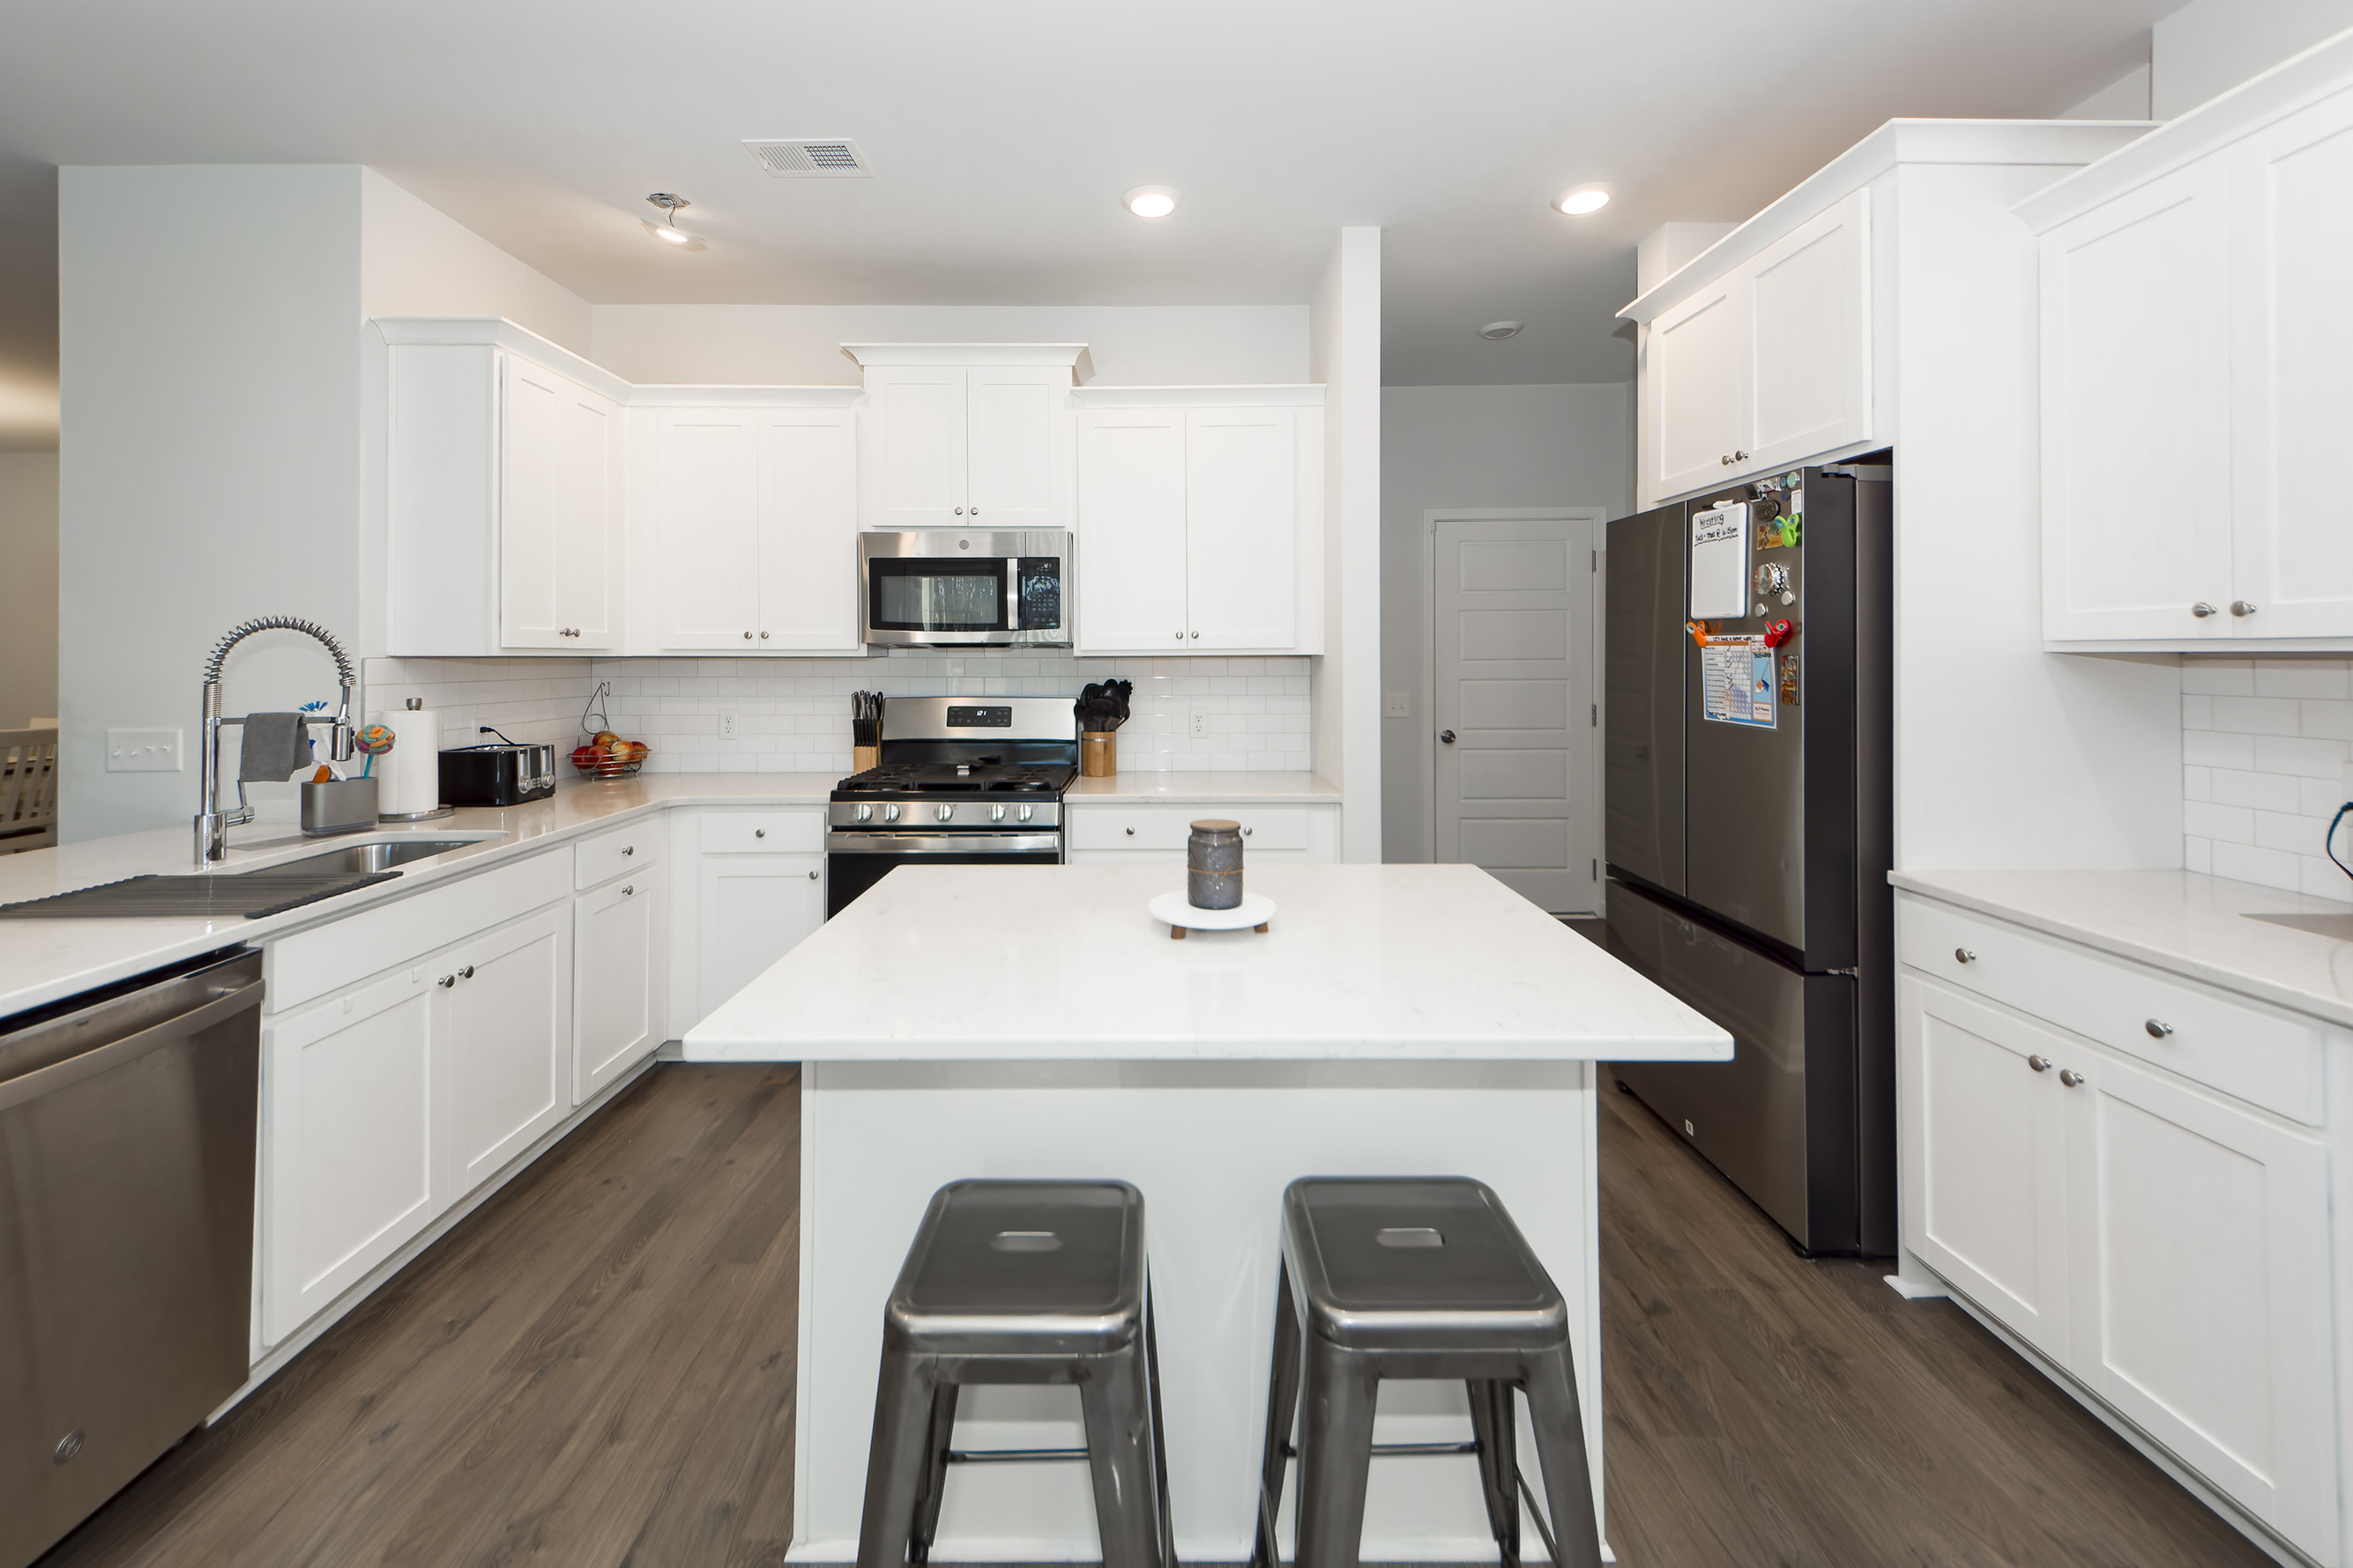


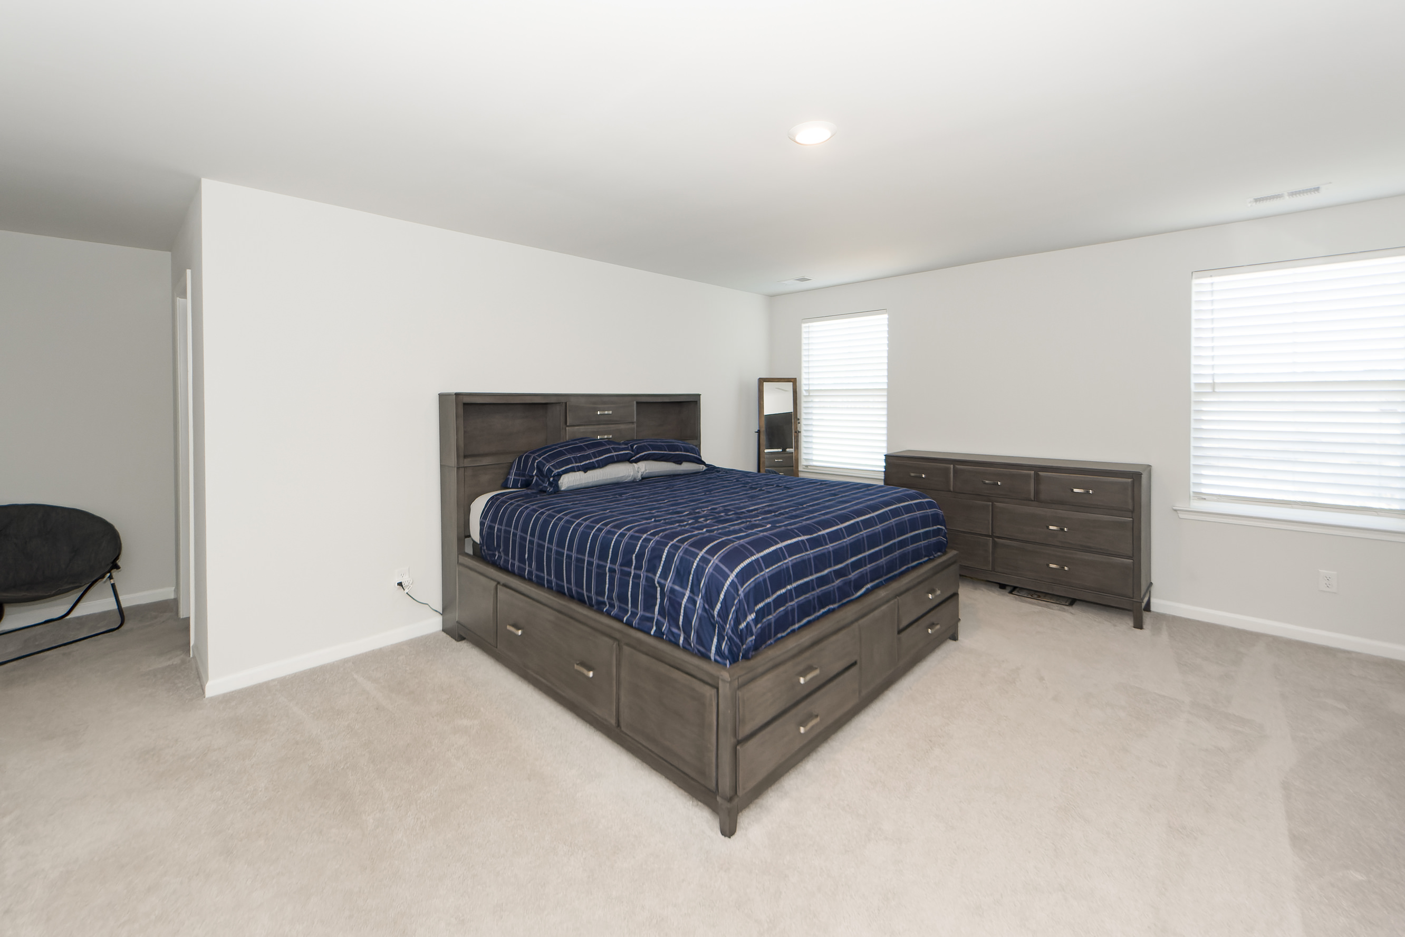
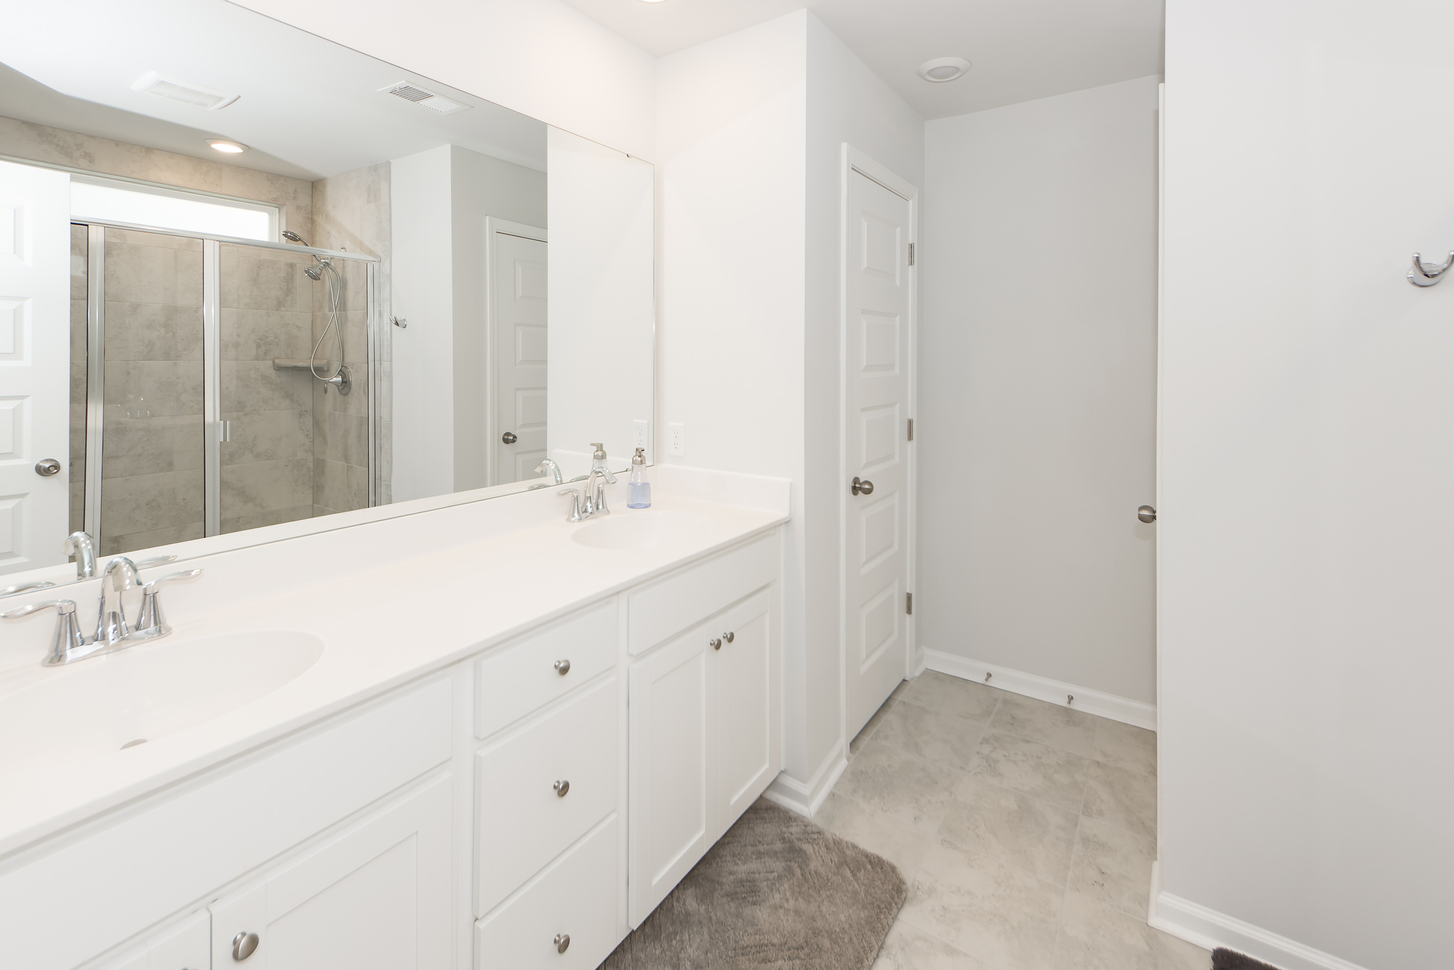



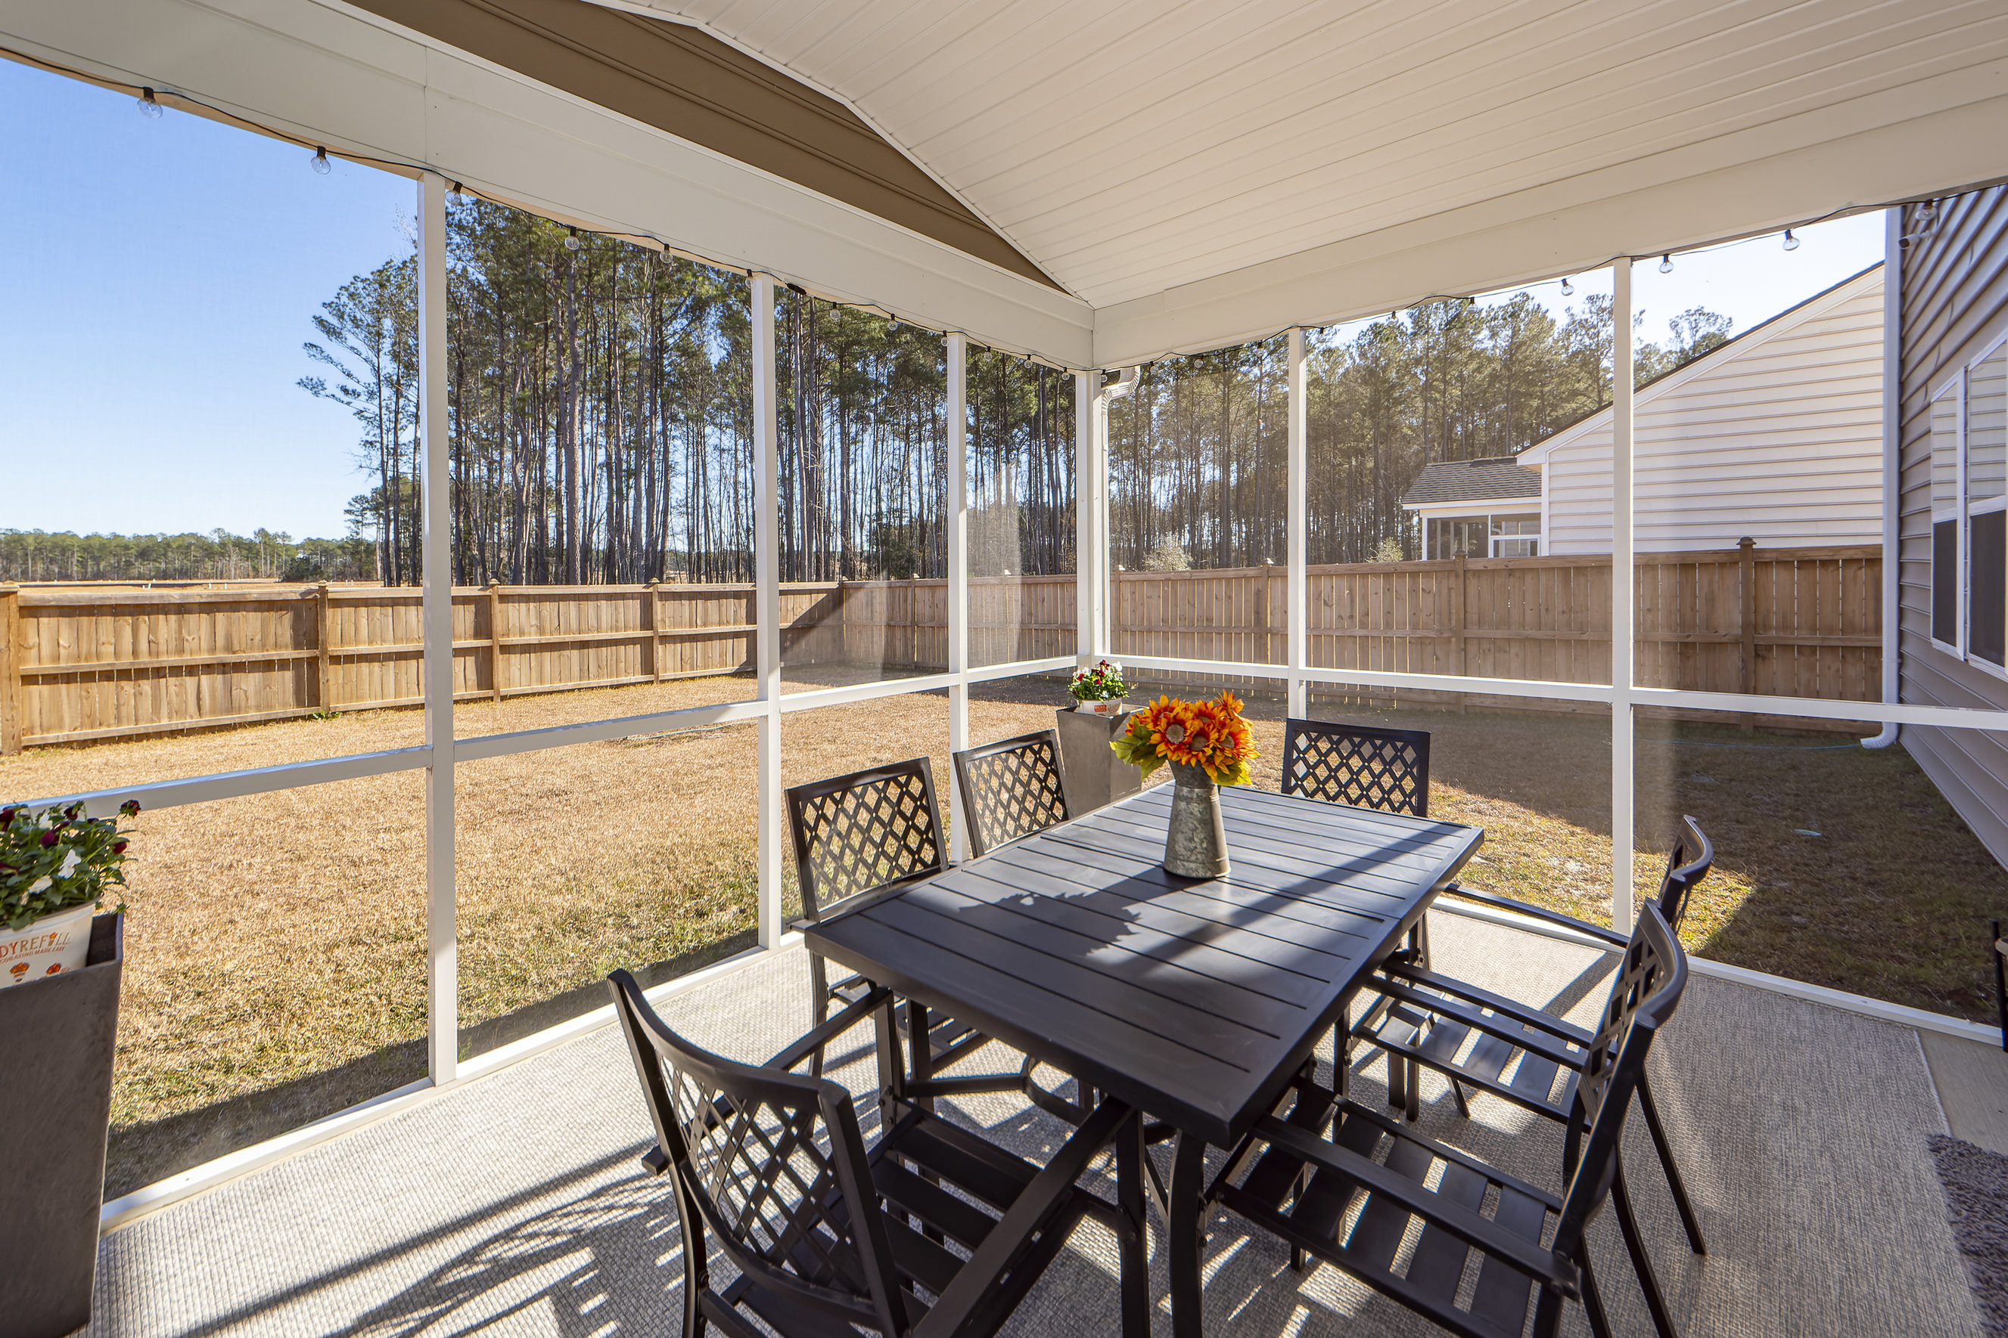
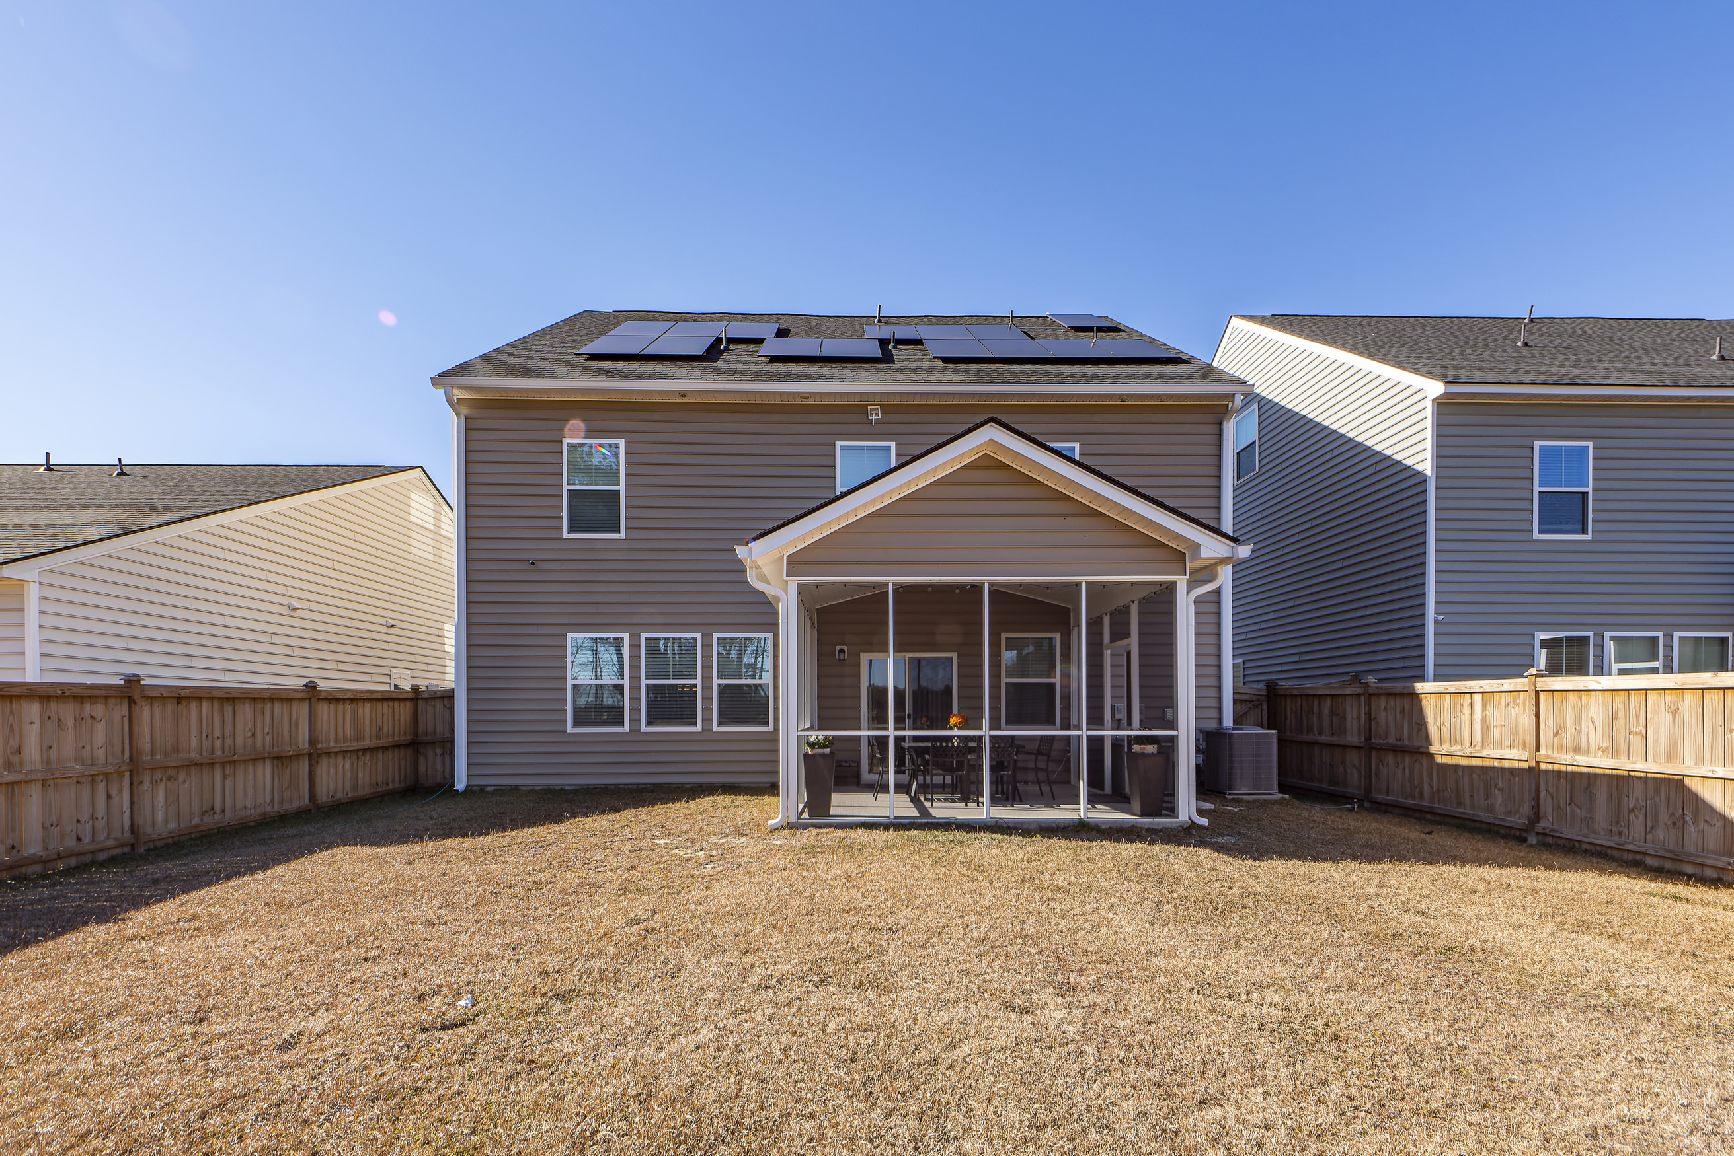

3 Story New Construction Home
162 Cypress Preserve Boulevard
Cypress Preserve | Moncks Corner, SC 29461 | MLS# 24000254 | $475,000
Welcome to the new community of Cypress Preserve and a 2022 New Construction Home. The Eastland model is a 3 Story home showcasing beauty and excellence in design and architecture. Front door entry reveals a grand foyer and laminate hardwood that travels through the first floor. A bonus room with French doors is currently used as a home gym and you have an instant visual of the open concept living/dining/kitchen. Quartz counter tops and huge island are showcased in the kitchen with tile backsplash and stainless appliances. Second floor has a loft, master bedroom with 5 ft walk in shower with tile surround and dual vanity. 3 additional bedrooms with separate bath with dual vanity. Go up to third floor and experience a living space, additional bedroom and bathroom! With acceptable offer, sellers will convey furniture the buyer may desire. Sectional in living room is oversized and was custom ordered for this space. Great opportunity to purchase a new home and new furniture!
5 Bedroom
3½ Bath
3,272 sf
Virtual Tour
Connie White, Broker
843-532-3356
connie@conniewhiteteam.com
conniewhiterealestate.com
Connie White Real Estate & Design, LLC
102 Six Point Court
Goose Creek, SC 29445

