Slide 1
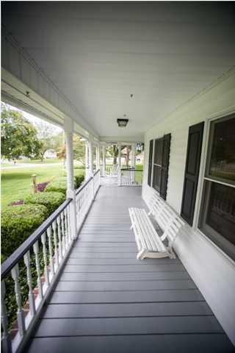
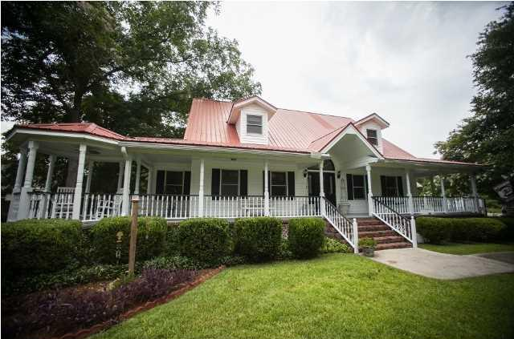
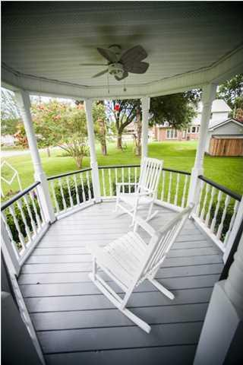
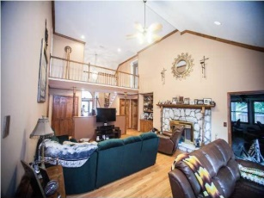
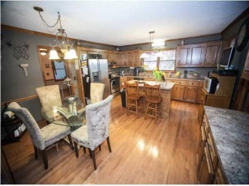
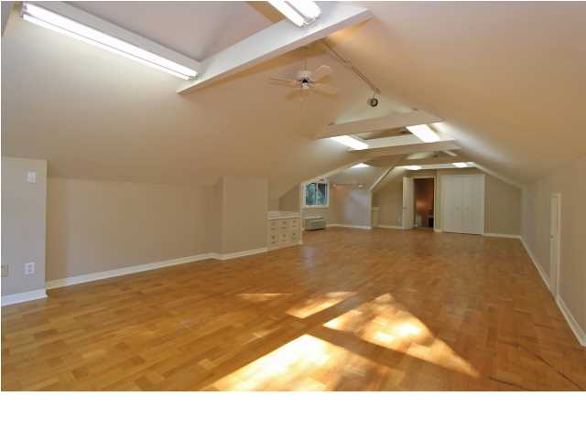
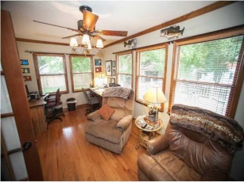
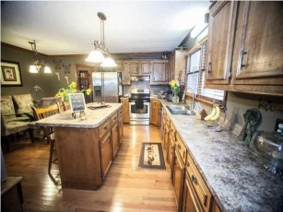
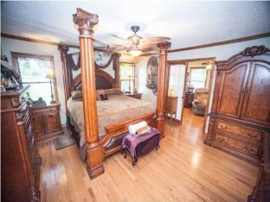
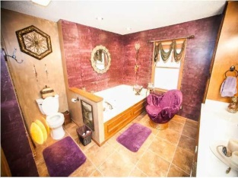
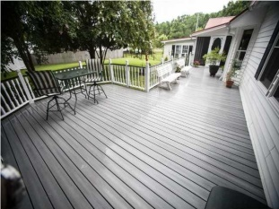
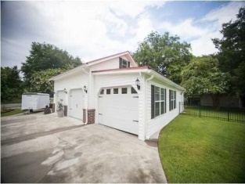


1630 Cedar Avenue
Moncks Corner, SC 29461
MLS# 1417375 ~ $400,000
Southern Plantation Home on Cedar Island
REDUCED FOR QUICK SALE!
As you come onto Cedar Island you will notice the caliber of fine homes! This breath taking Southern plantation home is nestled on a double lot, beautifully landscaped and mature trees! The full length wrap around shed roof porch is most inviting. You will immediately notice the massive, upper end metal roof. Hear the rain falling as it puts you to sleep! Entering this recently updated home and you will enjoy the beautiful wood floors, spacious family room with cavernous ceilings. Rock fireplace. A down stairs Master Suite that will leave you impressed. Huge master bath, walk in, sitting room over looking a beautiful back yard. This home just keeps spreading out as you go! Out back is a screened porch and custom, large, composite deck area. Upstairs is a 18X23 FROG currently used as a craft room. Up stairs there are 2 ample bedrooms, each with in suite bathrooms. The formal dining room can seat 20 plus family and friends! The large kitchen is made for hosting parties. Attached to the 2 car garage is a 13X40 enclosed room housing a custom bass boat or collectors car, workbench, flat screen, a/c unit! Out back is a 18X28 work shop with a 10X18 covered porch. There is a 24X30 storage shed also! The split A/C system, 2 brand new RUDD units. Small community boat ramp use also!
Christopher McCormick
Office - 843-974-6200
Cell - 843-224-3204
cjmccormick@carolinaone.com
Carolina One Real Estate
900 N Main St
Summerville, SC 29483

