Slide 1
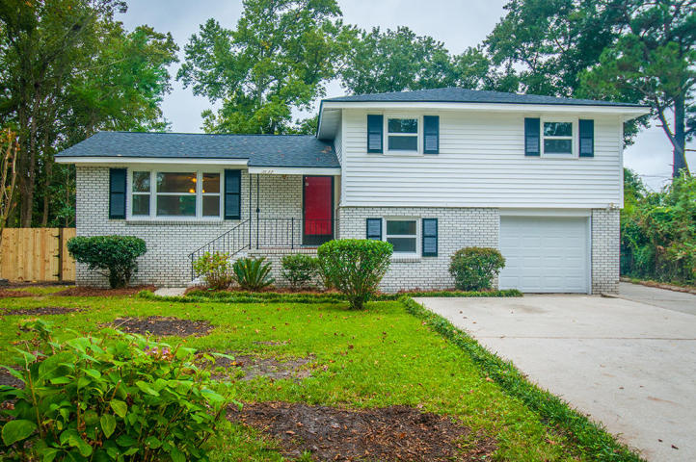
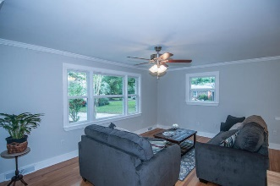
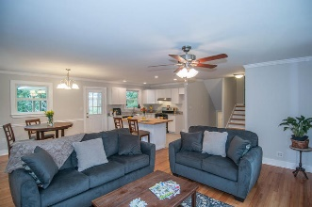
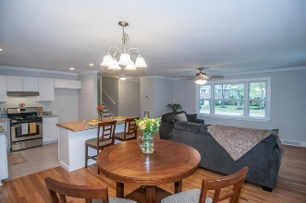
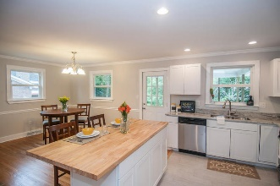
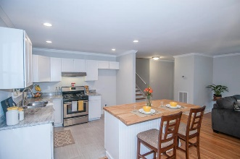
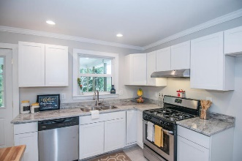
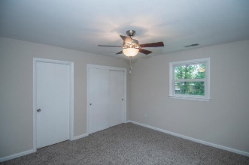
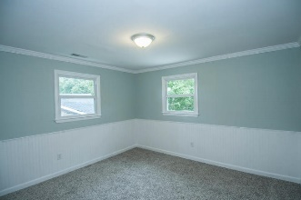
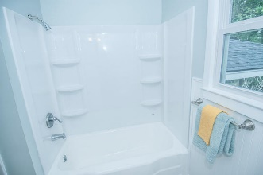
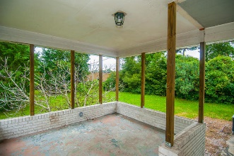
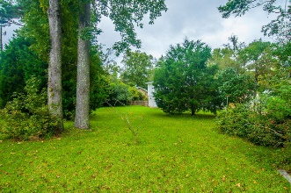
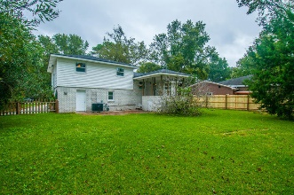

Updated & Upgraded
Open House Saturday 12-3 Refreshments Provided
1633 Falmouth Street
Ashley Hall Manor :: Charleston, SC 29407 :: MLS# 15025296 :: $274,900
Check out this RENOVATED, beautiful 4 bedroom house in the 29407 zip code, UPDATED and NEW from Top to Bottom, for UNDER $275K! Brand NEW architectural ROOF, NEW WINDOWS, two brand NEW HEIL HVAC systems (one gas and one electric-upstairs/downstairs zoned) including ductwork, new electrical panel, REFINISHED WOOD FLOORS, ceramic tile in the kitchen and baths, NEW KITCHEN CABINETRY, GRANITE COUNTERS, undermount sink, BUTCHER BLOCK ISLAND, BRAND NEW GE STAINLESS APPLIANCES including gas range, new carpet in bedrooms, fresh paint throughout. Lots of natural light, huge fenced in yard with mature landscaping, extra wide driveway perfect for parking the boat. It has one bedroom and full bathroom on the ground level, perfect for teenager or mother-in-law suite. Open kitchen/dining/family area great for entertaining. Back covered porch and patio as well. Located on a quiet street in beautiful Ashley Hall Manor, central and close to I-26, 526, downtown Charleston, James Island, Mt Pleasant, the beaches, grocery stores, 10 mins to Avondale, and close to Orange Grove Charter School. NO FLOOD INSURANCE REQUIRED! Come see it today, won't last long!
Scott Baskin
843-324-4139 M | 843-972-2400 O scott.r.baskin@gmail.com | www.scottbaskin.com
RE/MAX Advanced Realty
311 Johnnie Dodds Blvd
Mt Pleasant, SC 29464

