Slide 1
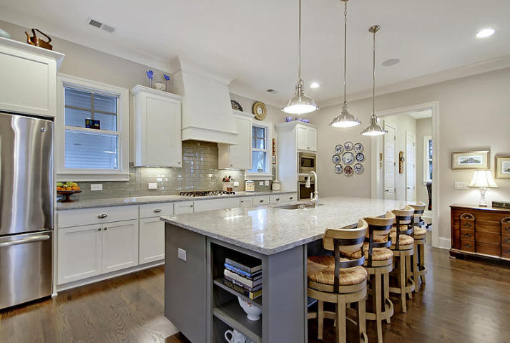
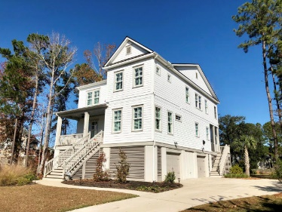
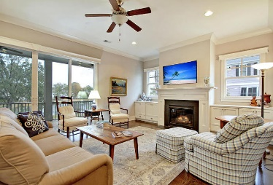
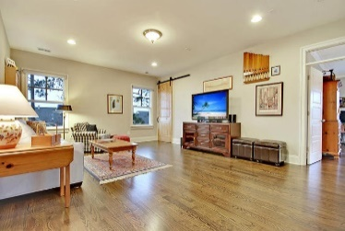
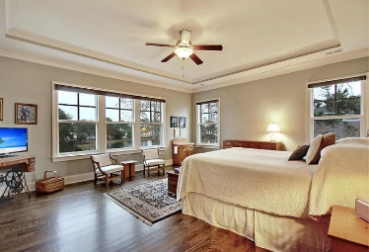
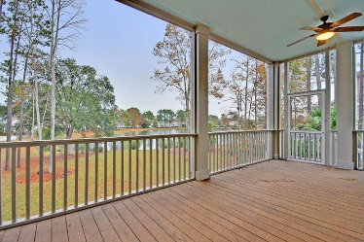
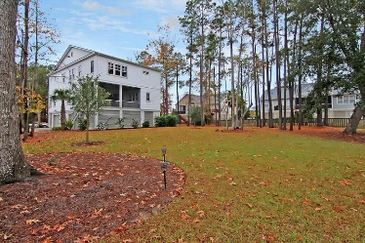
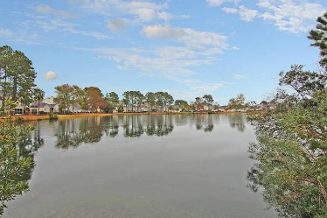

1633 Rivertowne Country Club Drive
Rivertowne Country Club · Mt Pleasant
MLS# 17032487 · $735,000
Gorgeous Listing
Rivertowne Country Club
New Low Price
Stunning 4-5 bedroom, 4 bath home in Rivertowne Country Club has spectacular views of the pond from the living room, kitchen and master bedroom that are relaxing and ever changing, no matter the season. An abundance of water fowl grace the shores year round. This beautiful home shows like a model and is better than new with plantation shutters, handsome hardwood floors, heavy molding, natural light and a gourmet kitchen that has an ENORMOUS granite island, glass subway tile backsplash, custom white cabinets, gas stove, walk-in pantry, and stainless steel appliances! Additional features include barn door into laundry room, screened porch, fireplace in family room, huge expansive loft for second living area, office/flex area that could be 5th bedroom on main level with full bath, parking for three cars plus a golf cart, tons of storage, and an elevator shaft. The large master suite retreat has a wall of windows, and spa-like bath with separate vanities, large tiled shower, and pocket door to the over-sized master closet. This home really has it all and is PERFECT for entertaining or relaxing on the screen porch with a beverage or a good book watching the birds by the pond. Rivertowne Country Club in Mount Pleasant is a wonderfully landscaped community with a play park, tennis courts, community pool, club house and golf course memberships available! The neighborhood is close to local shopping and grocery stores and is a short drive to downtown Charleston with 5-star restaurants, world class shopping and iconic history as well as a short drive to the beaches, the airport, Boeing and Daniel Island. Come take a look because you will not find another home that offers as much as this one: a chef's delight and entertainer's dream!
Stan Huff
843-670-2835
stan.huff@agentowned.com
Jill Marcacci
843-297-5590
jill@agentowned.com
www.agentownedrealty.com
AgentOwned Realty Co. Preferred Group, Inc. | 824 Johnnie Dodds Blvd | Mt Pleasant, SC 29464

