Slide 1
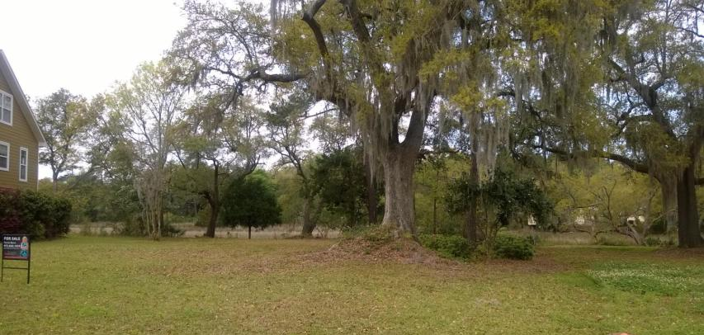
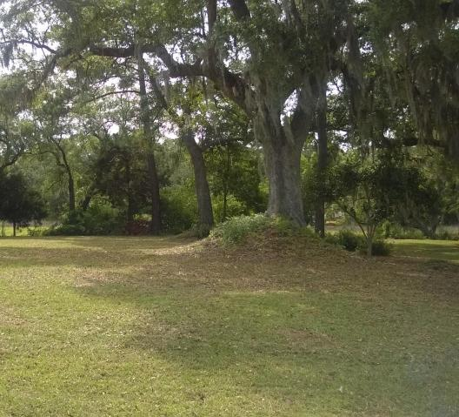
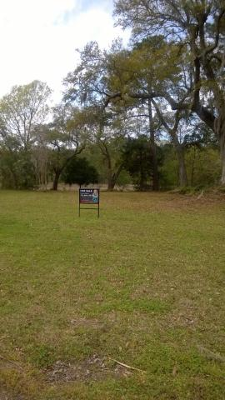
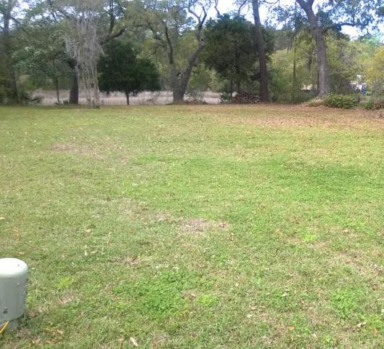


Marsh front! Very private! Cul-de-sac!
1634 Bull Creek
Bull Creek Peninsula | Charleston, SC 29414 | MLS# 15006736 | $119,000
A beautiful marsh front lot in a small well established professional neighborhood in West Ashley!
Close to town and all amenities in this fast growing community!
Patricia Lehman Byrne
Mobile - (973) 868-1039 Patricia@kwluxuryhomes.com
luxurypropertiesincharleston.com
Keller Williams Realty Charleston West Ashley
1180 Sam Rittenberg Ste 105
Charleston, SC 29407

