Slide 1
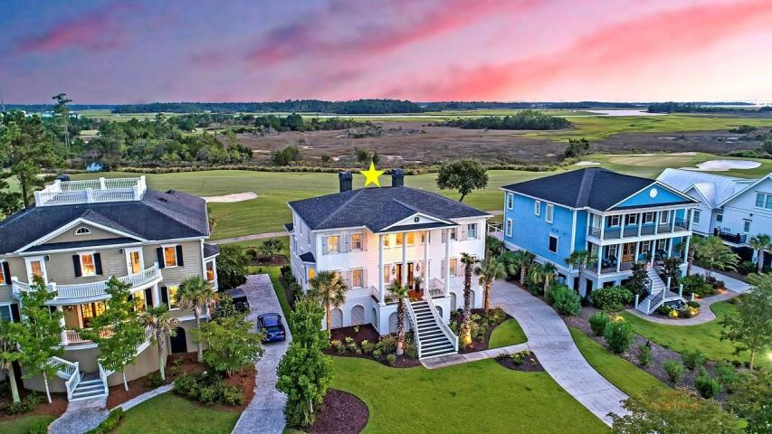
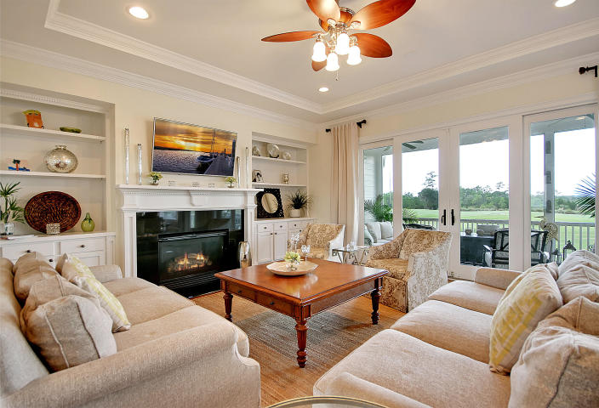
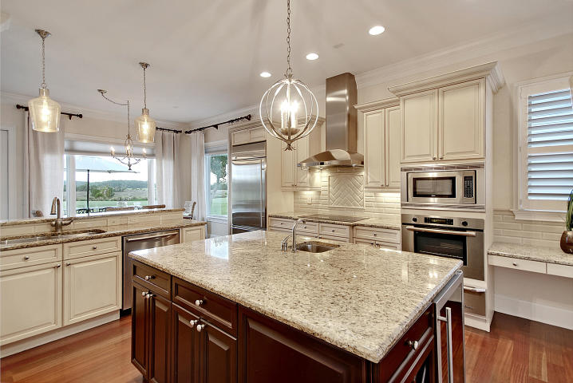
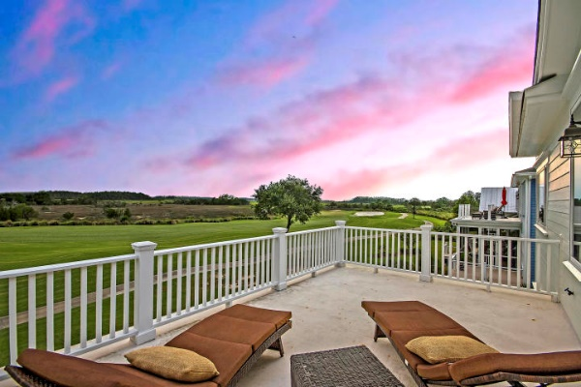
Price Reduced in Dunes West! New A/C Units With Nest Controllers PLUS a 10 Year Warranty
This Home Is Not To Be Missed!
1636 Rivertowne Country Club Drive Rivertowne Country Club ~ Mount Pleasant, SC 29466 ~ MLS# 18023226 ~ $949,000
Golf course, marsh and even Ravenel Bridge views can be taken in from this stunning custom home in Mount Pleasant's Rivertowne community. Located just steps from the country club, you're love being so close to the pool, playground, tennis courts, basketball courts and restaurant.
Nate Gainey nate@mattoneillteam.com 843-513-2038

