Slide 1
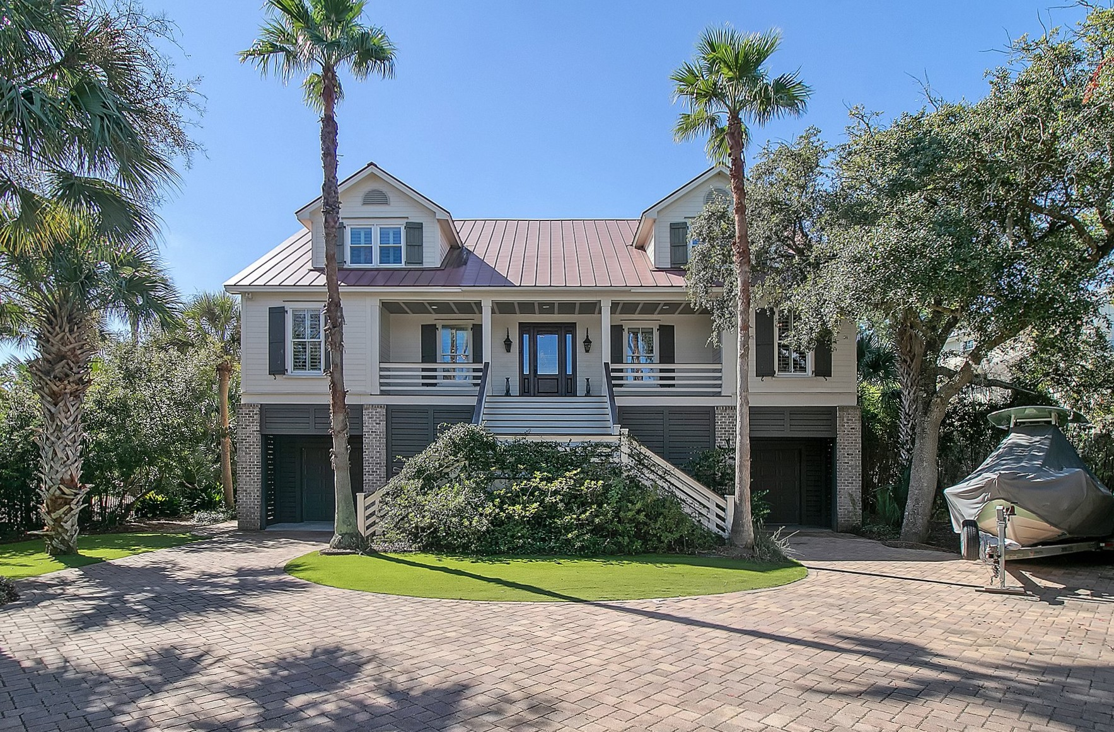
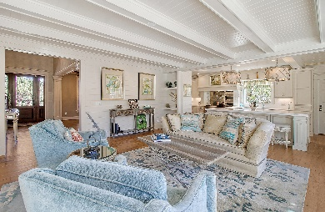
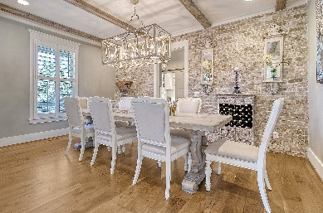
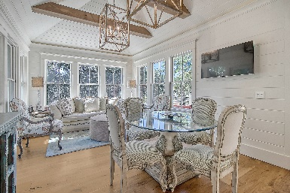
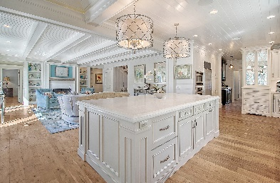
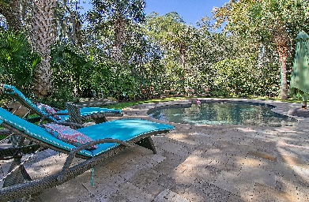


1636 Home Farm Road
Home Farm | Mount Pleasant, SC 29464 | $2,700,000
HOME FARM - BROKER EVENT
Thursday, November 2, 11am-1pm | A light lunch will be served
4 Bedroom | 4 Bath | 4,300sf | Pool | Views
Steve Kaul
843-817-5547
skaul@carolinaone.com
http://www.charlestonhousehunt.com/
Carolina One Real Estate
195 W Coleman Blvd
Mt Pleasant, SC 29464-3495

