Slide 1
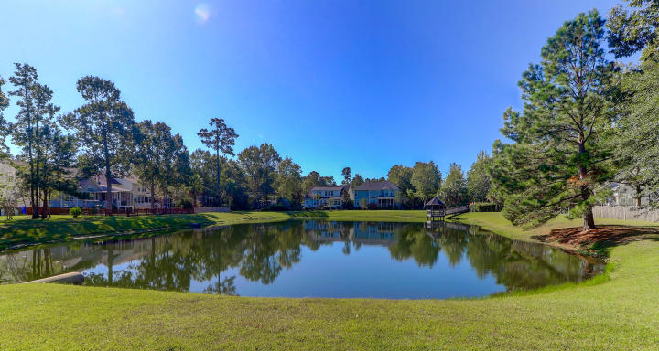
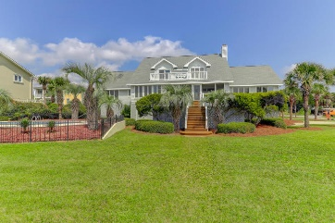
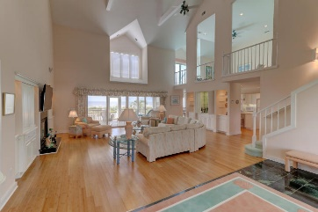
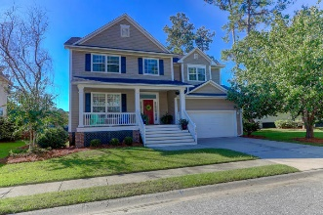
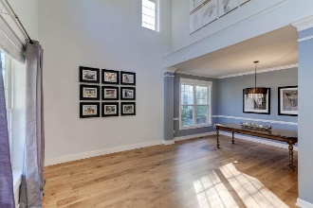
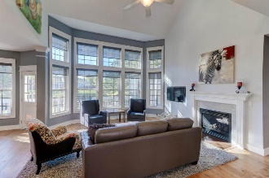
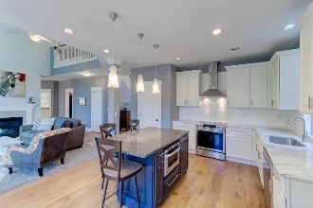
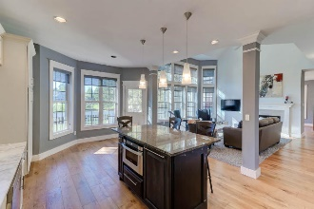
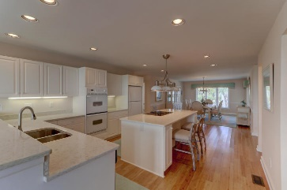
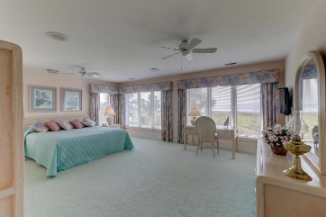
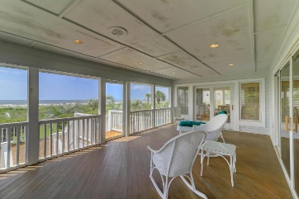
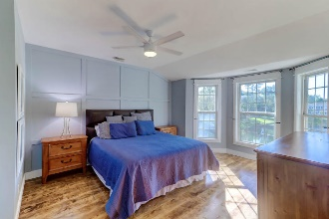
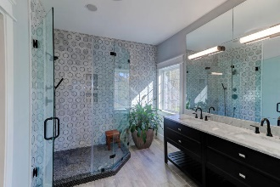
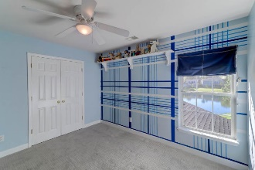
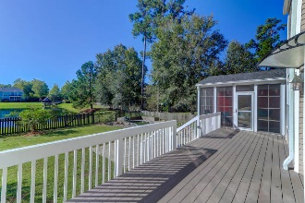
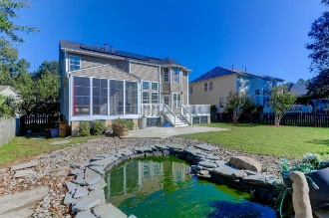


1637 William Hapton Way
Park West | Mount Pleasant, SC 29466 | MLS# 19029319 | $479,000
Lovely Move-In Ready Park West Home on Pond
New Price
Enjoy living in this spacious, lovely home in Park West!!
This home features a formal living and dining room and an exceptional kitchen that is open to the Family Room. The Family room has lots of space, floor to ceiling windows and a gas fireplace. There is an additional room downstairs that could be an office or work out area. All bedrooms are upstairs with an additional Loft area. Screened porch with ''All Season panels and deck with expansive views of the pond! This is an extraordinary home, on the pond, with a 2 car garage and beautiful updates. 17 Solar Panels have been added to this home. This is a home you need to see and move in ready! A 1 year American Home Shield warranty will be provided to the buyer at closing.
Darlene Smith
Office - (843) 886-8110
Mobile - (843) 696-7824
darlenesmith@carolinaone.com
DarleneSmithTeam.com
Carolina One Real Estate
1503 Palm Blvd Ste
Isle of Palms, SC 29451

