Slide 1
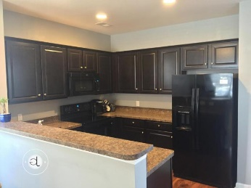
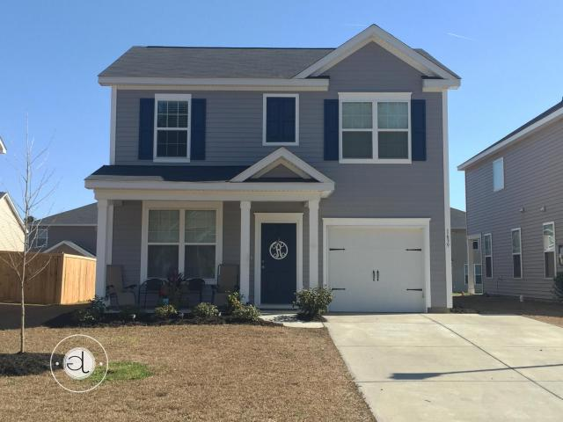
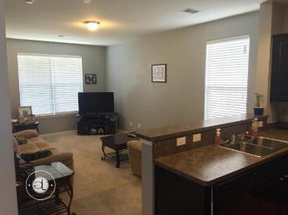
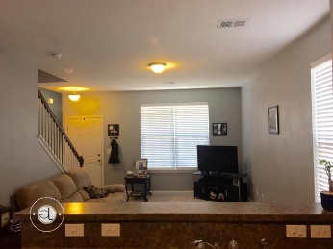
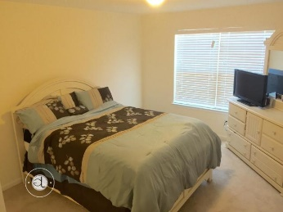
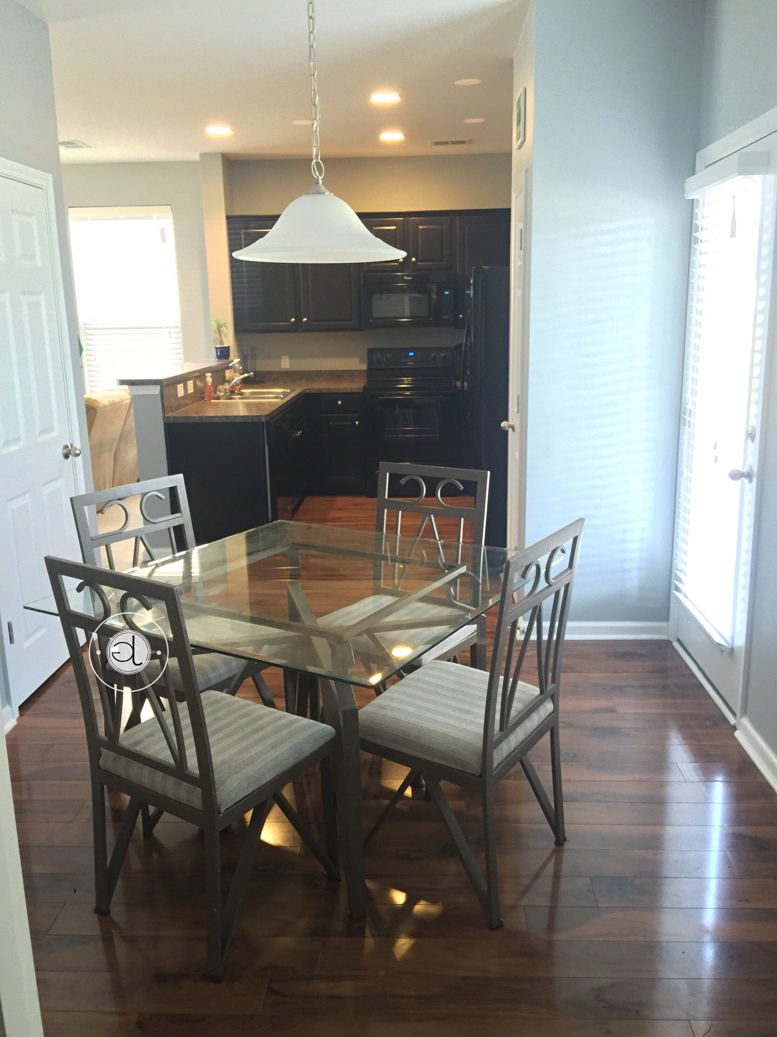
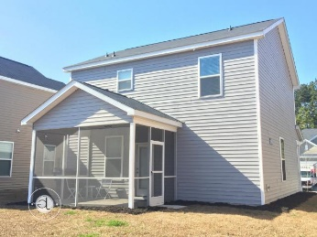

USDA 100% Financing (Direct or Guaranteed) ~ Absolute Steal!!!
1639 Eider Down Dr
Drakesborough · Summerville · MLS# 16004194 · $167,000
The highly sought after Calhoun Floor plan in a barely lived in home that has an abundance of upgrades! This highly loved home has an entertaining and open floor plan with gorgeous laminate flooring throughout most of the 1st floor. Upstairs leads to the Master Bedroom with a wonderful spacious walk-in closet, and 2 additional bedrooms along with another full bath. Further upgrades included are: Beautiful Dark Cabinetry with coordinating Black Whirlpool appliances, as well as, the Washer and Dryer conveying! After a long day of work-sit on the Screened Porch with a spacious backyard to watch the kids play! To top it off-this home is extremely Energy Efficient being awarded a 100% Energy Star Certification & HERS Rated for low utilities and more.
Mattie Nesmith, ABR
Broker-in-Charge
Mobile - (843) 452-3779 | mattie@ergroupofsc.com
The Elite Realty Group of SC, LLC · 8310-A Rivers Ave · North Charleston, SC 29406

