Slide 1
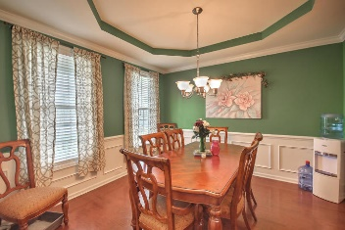
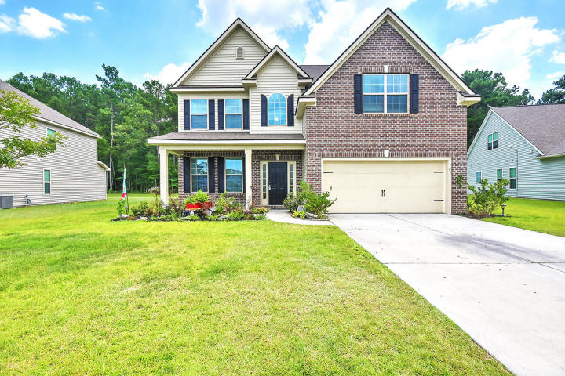
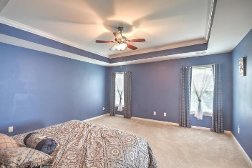
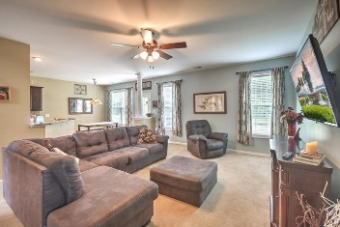
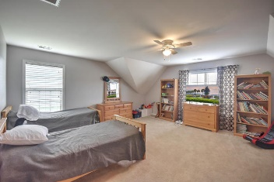
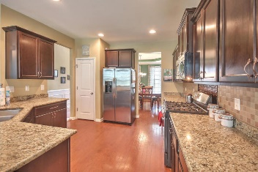
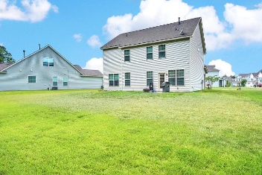


$1,000 Agent Bonus If Ratified Before 7/31/2018
163 Carolina Wren Avenue
Cypress Ridge · Moncks Corner · MLS# 18019479 · $255,000
MOTIVATED SELLER! Beautiful home in Cypress Ridge features a 2-story foyer, formal dining room and open kitchen with Stainless Steel Appliances, upgraded cabinets and granite counter tops with hardwood floors throughout. There is a very spacious family room with a 4th bedroom downstairs as well as a full bath! Upstairs you will find the Master Bedroom with a tray ceiling that leads you into the deluxe master bath with separate shower, tub and a walk in closet. Also located upstairs is a huge bonus room or 5th bedroom. The upstairs also features and addition 2 bedrooms and a true laundry room. The backyard is truly amazing to see and is built for entertaining. All Kitchen Appliances will convey with the home!
Michael Waites
Mobile - (843) 637-1464 | michael@originrealty.org
Origin Realty Inc | 4925 Lacross Rd. #215 | North Charleston, SC 29406

