Slide 1
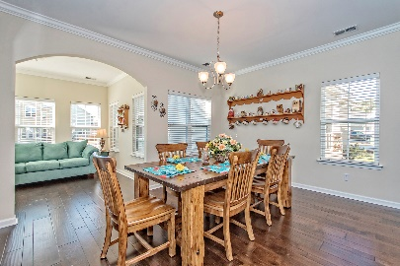
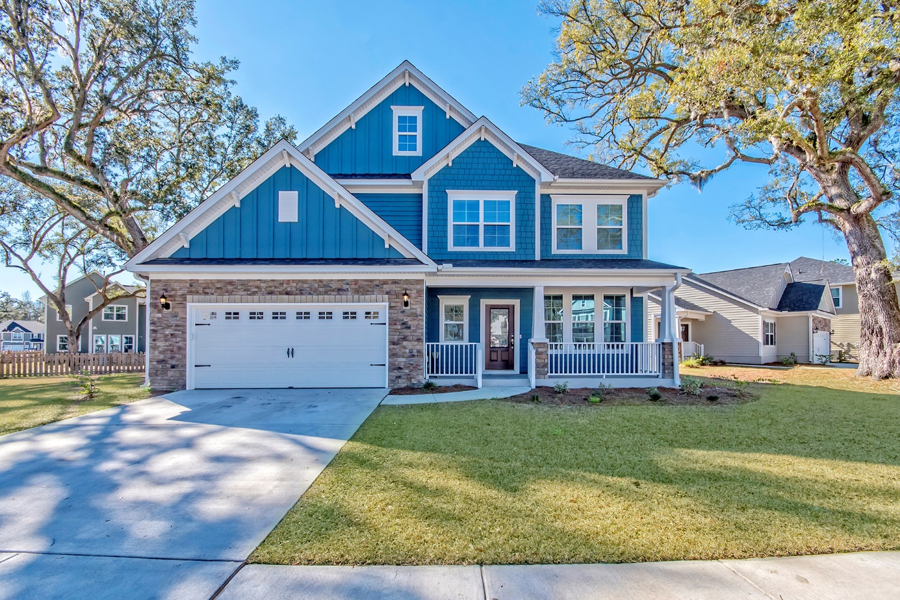
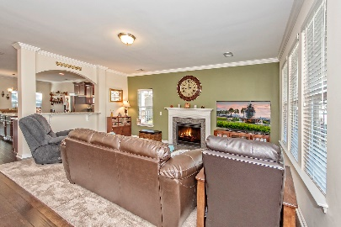
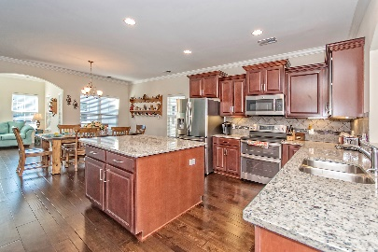
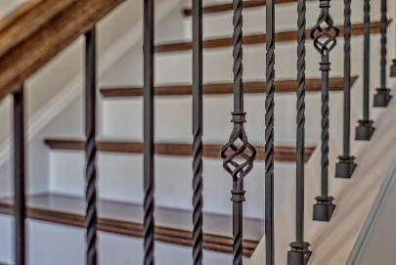
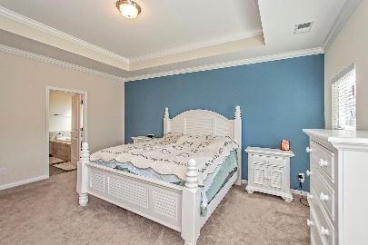
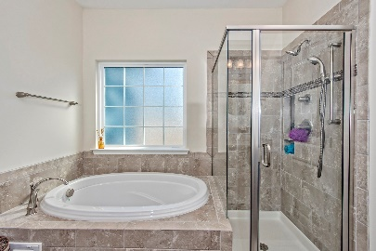
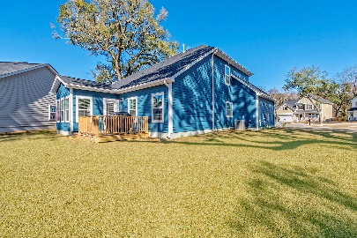



163 Daniels Ridge Drive
The Bluffs at Ashley River | Summerville | MLS# 17000758 | $349,500
$1,500 Agent Bonus With Ratified Contract Before The End Of March
Welcome to the quaint upscale community of The Bluffs at Ashley River. Why wait for a new home when this virtually new home is ready now!!
Loads of upgrades throughout this beautiful home, no expense was spared in this Wonderfully constructed Mungo Home Jamison "C" model. As you enter the home you will immediately notice the upgraded wood floors throughout the downstairs. The kitchen has numerous enhancements from the expansive island, well appointed tile backsplash, upgraded stove with double oven, and dream door in door refrigerator. Relax with a good book in the Sunroom, or out on the back wooden deck. All of the bathroom cabinets are raised to a "comfort height" and the Master Bath has a custom tiled bath and shower. There are far too many upgrades to list.
Come and see this home!
Amy Andraszek
(843) 695-7038
arealestatecouple@gmail.com
www.arealestatecouple.com
Robert Andraszek
(843) 695-7050
randraszek@century21properties.com
www.rahomesales.com
Century 21 Properties Plus of Summerville | 118 W Richardson Ave | Summerville, SC 29483

